Slide 1
CHAPTER 12
THERMODYNAMIC PROPERTY RELATIONS
Thermodynamics: An Engineering Approach
8th Edition
Yunus A. Çengel, Michael A. Boles
McGraw-Hill, 2015
Lecture slides by
Mehmet Kanoglu
Copyright © The McGraw-Hill Education. Permission required for reproduction or display.

Slide 2
Objectives
Develop fundamental relations between commonly encountered thermodynamic properties and express the properties that cannot be measured directly in terms of easily measurable properties.
Develop the Maxwell relations, which form the basis for many thermodynamic relations.
Develop the Clapeyron equation and determine the enthalpy of vaporization from P, v, and T measurements alone.
Develop general relations for c_{v}, c_{p}, du, dh, and ds that are valid for all pure substances.
Discuss the Joule-Thomson coefficient.
Develop a method of evaluating the ∆h, ∆u, and ∆s of real gases through the use of generalized enthalpy and entropy departure charts.

Slide 3
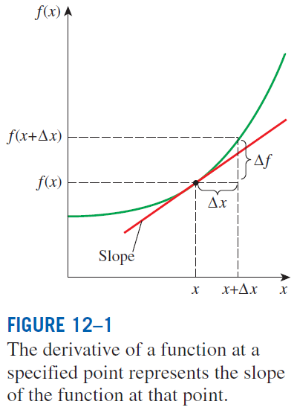

A LITTLE MATH—PARTIAL DERIVATIVES AND ASSOCIATED RELATIONS
The state postulate: The state of a simple, compressible substance is completely specified by any two independent, intensive properties. All other properties at that state can be expressed in terms of those two properties.
The derivative of a function f(x) with respect to x represents the
rate of change of f with x.

Slide 4
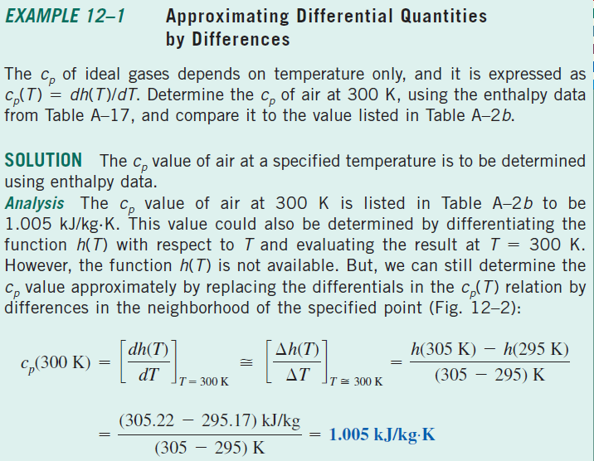
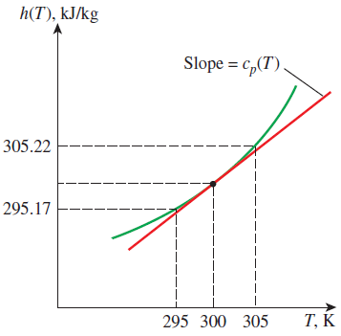

Slide 5
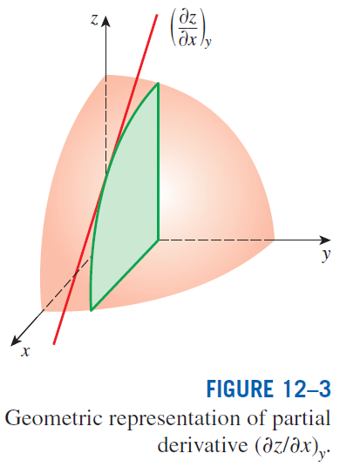
Partial Differentials
The variation of z(x, y) with x when y is held constant is called the partial derivative of z with respect to x, and it is expressed as
The symbol ∂ represents differential changes, just like the symbol d. They differ in that the symbol d represents the total differential change of a function and reflects the influence of all variables, whereas ∂ represents the partial differential change due to the variation of a single variable.
The changes indicated by d and ∂ are identical for independent variables, but not for dependent variables.

Slide 6
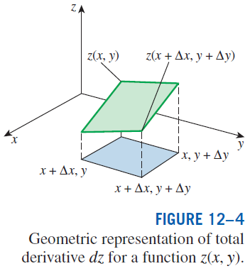
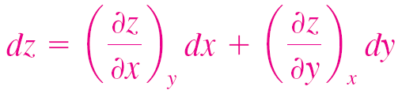
This is the fundamental relation for the total differential of a dependent variable in terms of its partial derivatives with respect to the independent variables.

Slide 7
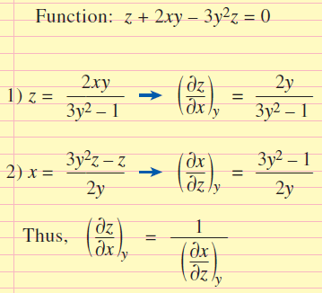
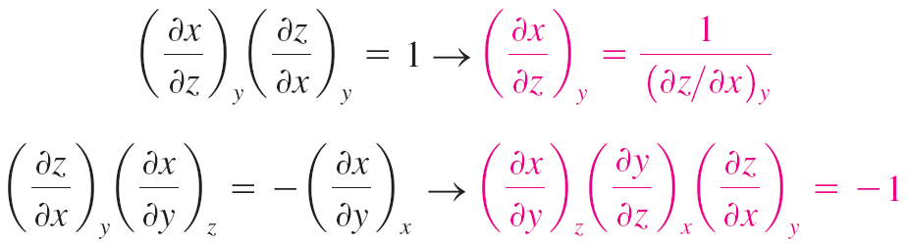
Partial Differential Relations
The order of differentiation is immaterial for properties since they are continuous point functions and have exact differentials. Thus,
Demonstration of the reciprocity relation for the function z + 2xy − 3y²z = 0.
Reciprocity relation
Cyclic relation

Slide 8
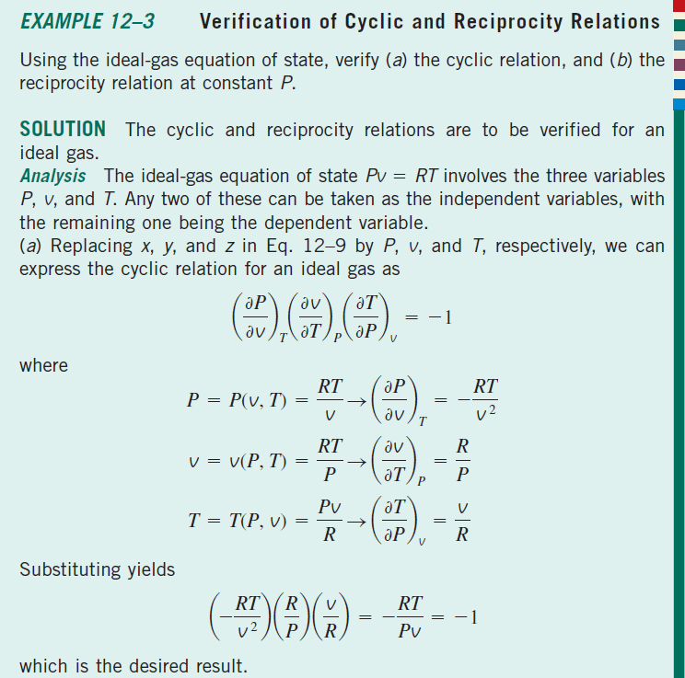

Slide 9

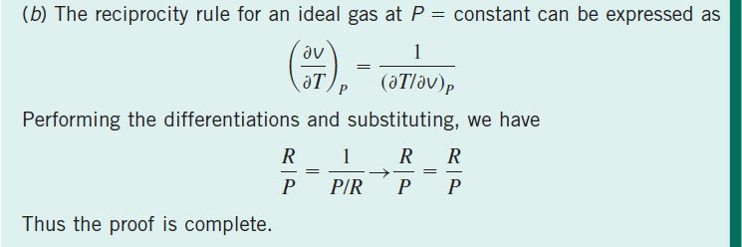

Slide 10
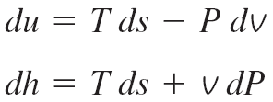
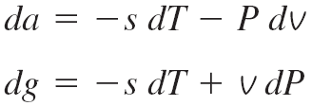

THE MAXWELL RELATIONS
The equations that relate the partial derivatives of properties P, v, T, and s
of a simple compressible system to each other are called the Maxwell relations. They are obtained from the four Gibbs equations by exploiting the
exactness of the differentials of thermodynamic properties.
Helmholtz function
Gibbs function
Maxwell relations are extremely valuable in thermodynamics because they provide a means of determining the change in entropy, which cannot be measured directly, by simply measuring the changes in properties P, v, and T.
These Maxwell relations are limited to simple compressible systems.
Maxwell relations

Slide 11
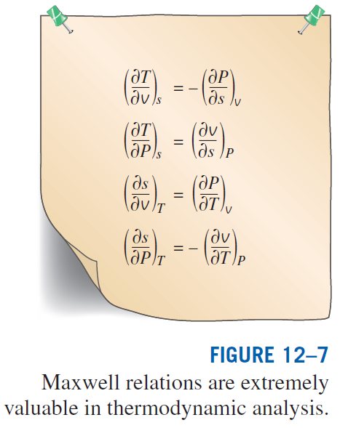

Slide 12

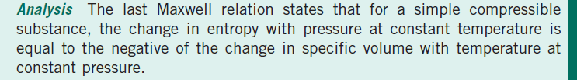
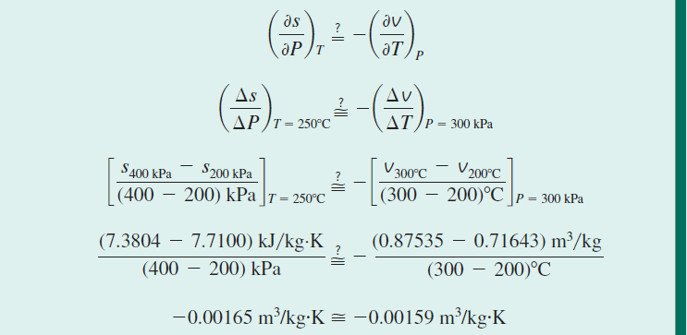

Slide 13
THE CLAPEYRON EQUATION

Slide 14
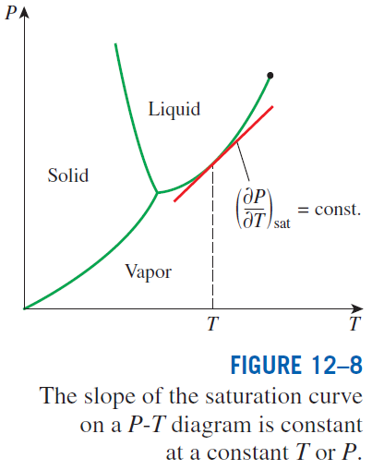
Clapeyron equation
The Clapeyron equation enables us to determine the enthalpy of vaporization h_{fg} at a given temperature by simply measuring the slope of the saturation curve on a P-T diagram and the specific volume of saturated liquid and saturated vapor at the given temperature.
General form of the Clapeyron equation when the subscripts 1 and 2 indicate the two phases.

Slide 15
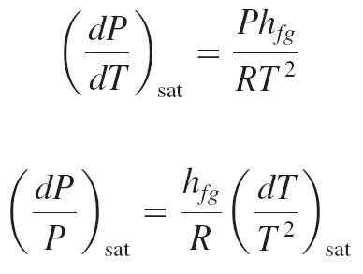
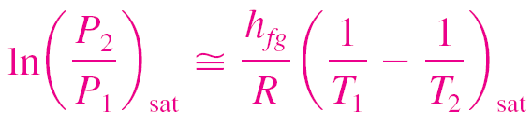
The Clapeyron equation can be simplified for liquid–vapor and solid–vapor phase changes by utilizing some approximations.
At low pressures
Treating vapor as an ideal gas
The Clapeyron–Clausius equation can be used to determine the variation of saturation pressure with temperature.
It can also be used in the solid–vapor region by replacing h_{fg} by h_{ig} (the enthalpy of sublimation) of the substance.
Substituting these equations into the Clapeyron equation
Integrating between two saturation states
Clapeyron–Clausius equation

Slide 16
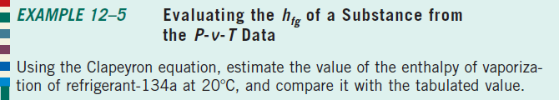
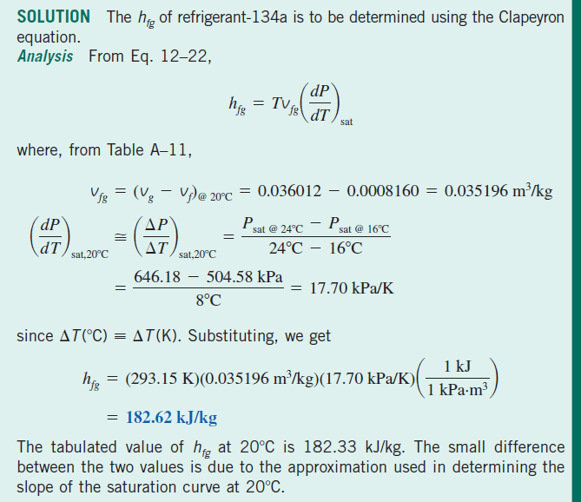

Slide 17
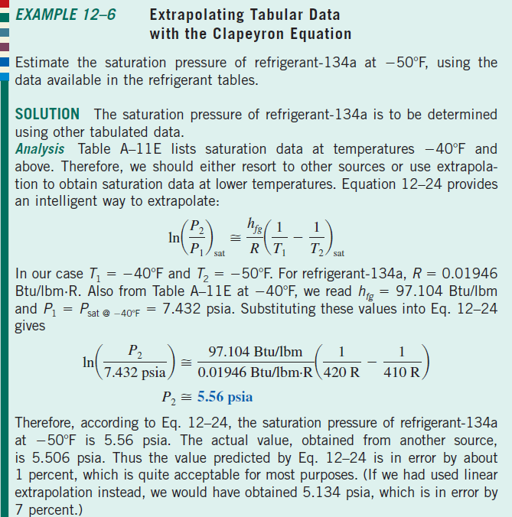

Slide 18
GENERAL RELATIONS FOR du, dh, ds, c_{v}, AND c_{p}
The state postulate established that the state of a simple compressible system is completely specified by two independent, intensive properties.
Therefore, we should be able to calculate all the properties of a system such as internal energy, enthalpy, and entropy at any state once two independent, intensive properties are available.
The calculation of these properties from measurable ones depends on the availability of simple and accurate relations between the two groups.
In this section we develop general relations for changes in internal energy, enthalpy, and entropy in terms of pressure, specific volume, temperature, and specific heats alone.
We also develop some general relations involving specific heats.
The relations developed will enable us to determine the changes in these properties.
The property values at specified states can be determined only after the selection of a reference state, the choice of which is quite arbitrary.

Slide 19
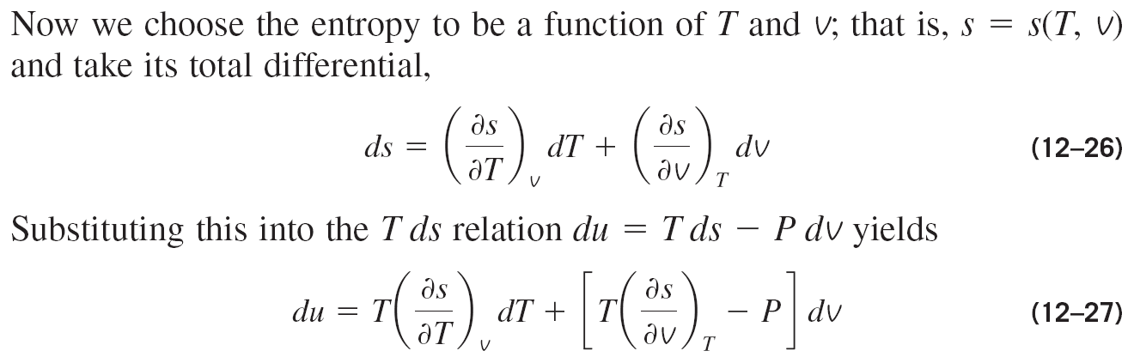
Internal Energy Changes

Slide 20
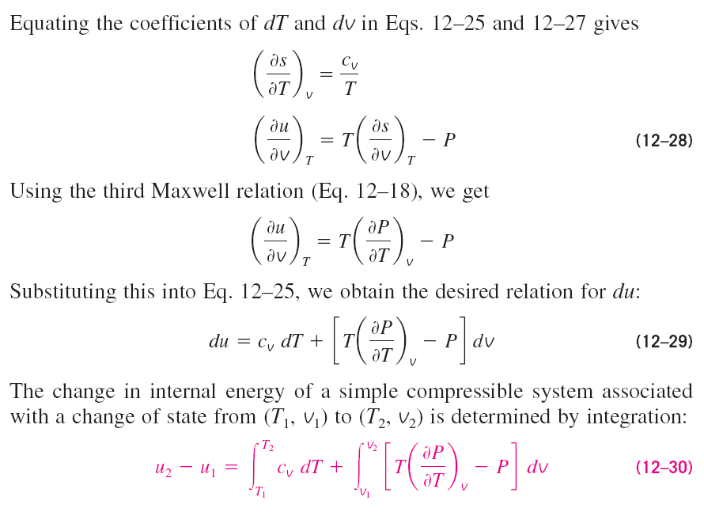

Slide 21
Enthalpy Changes

Slide 23
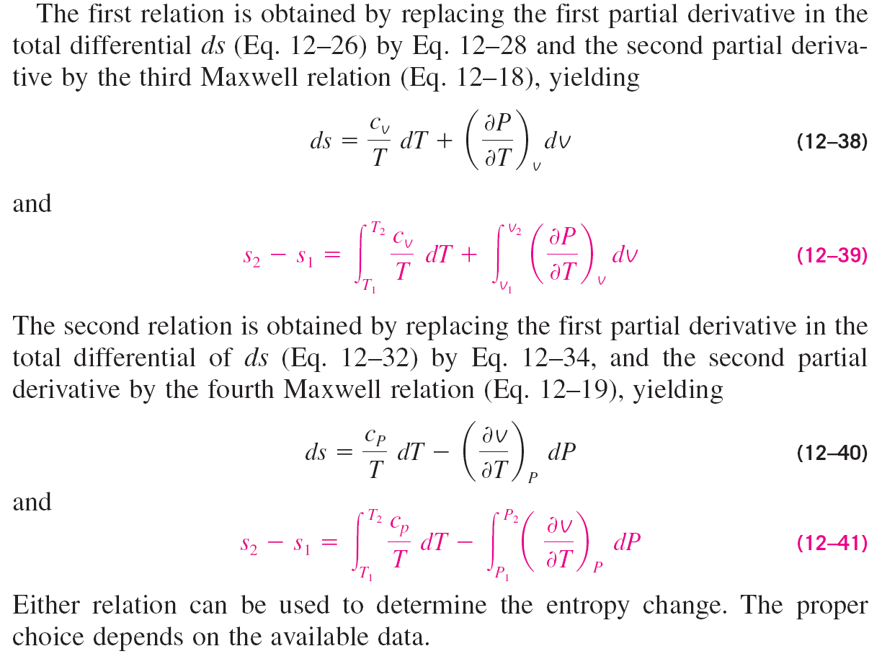
Entropy Changes

Slide 24
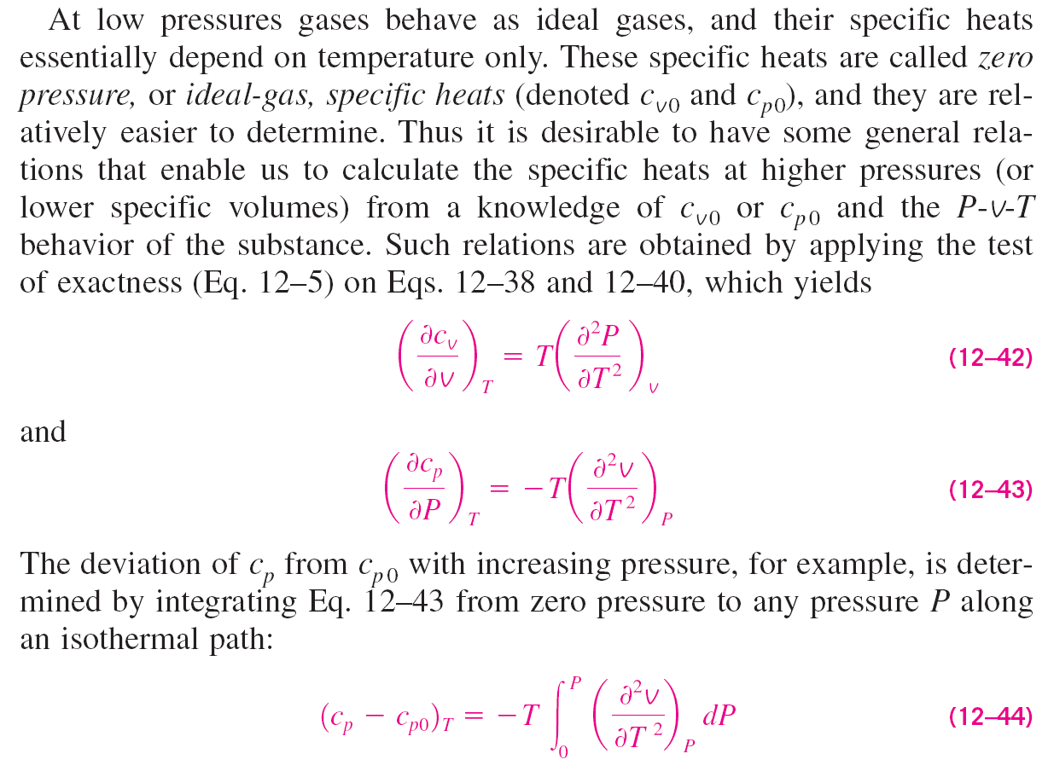
Specific Heats c_{v} and c_{p}

Slide 26
Mayer relation

Slide 27
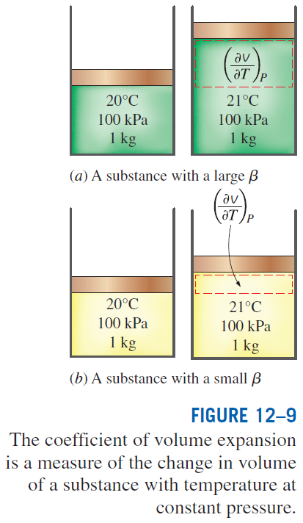
Mayer relation
Conclusions from Mayer relation:
1. The right hand side of the equation is always greater than or equal to zero. Therefore, we conclude that
2. The difference between c_{p} and c_{v} approaches zero as the absolute temperature approaches zero.
3. The two specific heats are identical for truly incompressible substances since v constant. The difference between the two specific heats is very small and is usually disregarded for substances that are nearly incompressible, such as liquids and solids.

Slide 28
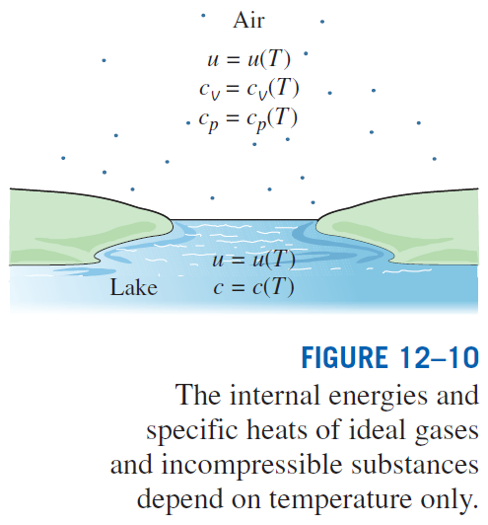

Slide 29
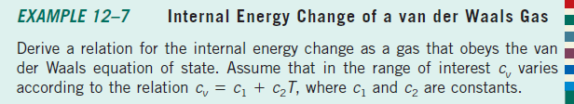
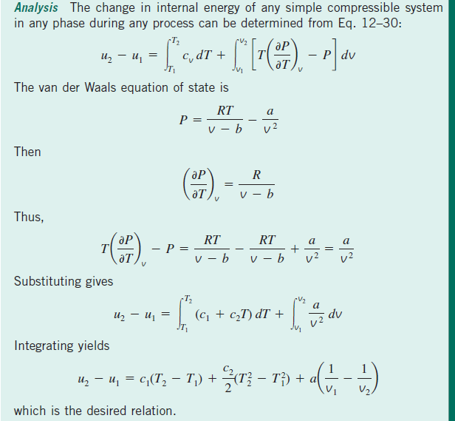

Slide 30
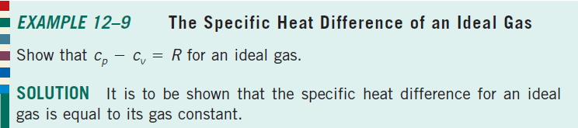
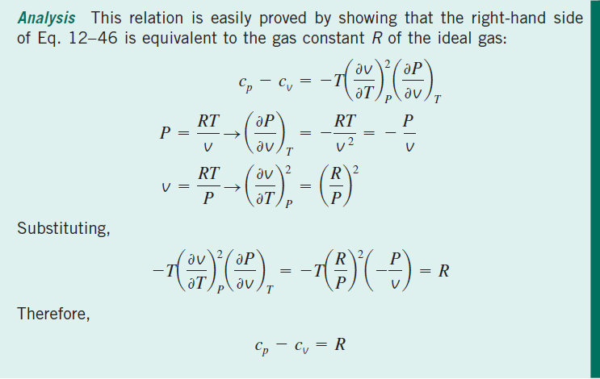

Slide 31
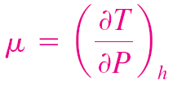
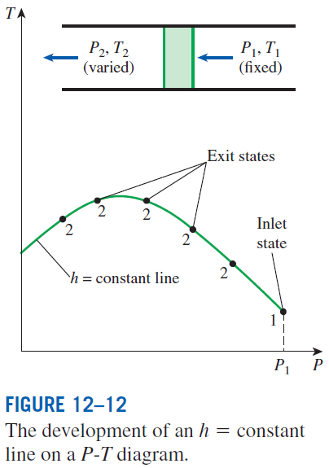
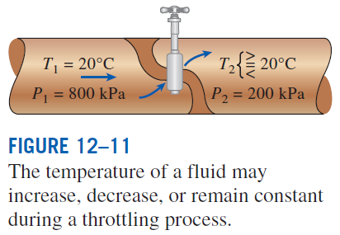
THE JOULE-THOMSON COEFFICIENT
The temperature behavior of a fluid during a throttling (h = constant) process is described by the Joule-Thomson coefficient
The Joule-Thomson coefficient represents the slope of h = constant lines on a T-P diagram.

Slide 32
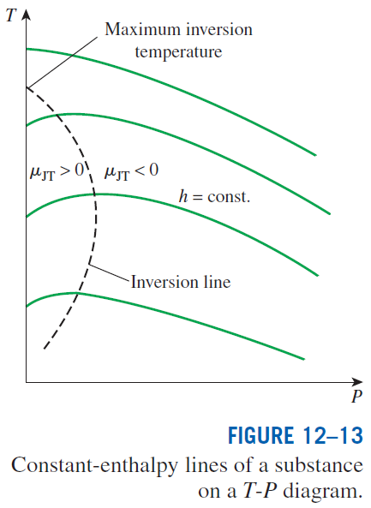
A throttling process proceeds along a constant-enthalpy line in the direction of decreasing pressure, that is, from right to left.
Therefore, the temperature of a fluid increases during a throttling process that takes place on the right-hand side of the inversion line.
However, the fluid temperature decreases during a throttling process that takes place on the left-hand side of the inversion line.
It is clear from this diagram that a cooling effect cannot be achieved by throttling unless the fluid is below its maximum inversion temperature.
This presents a problem for substances whose maximum inversion temperature is well below room temperature.

Slide 33
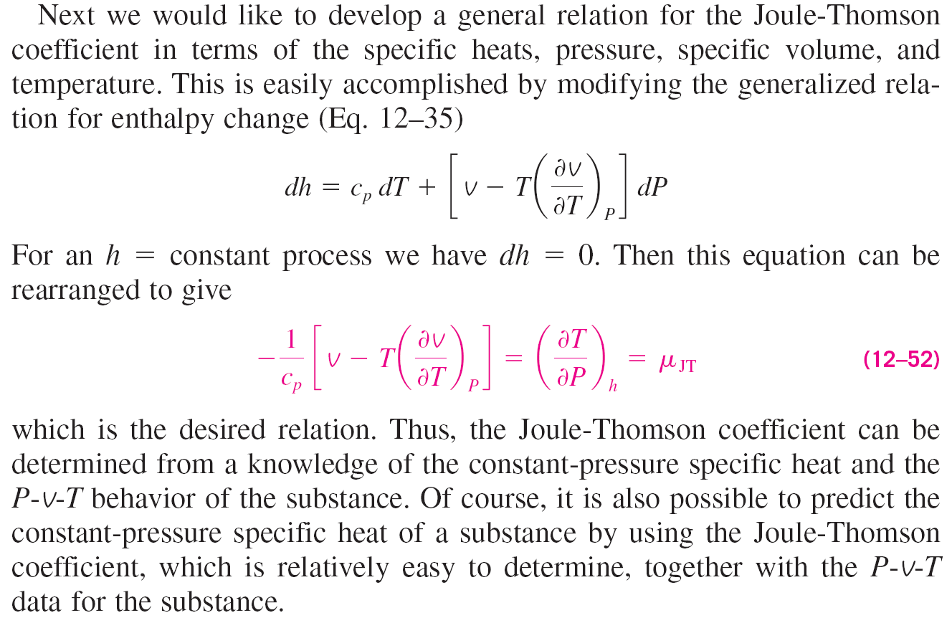

Slide 34
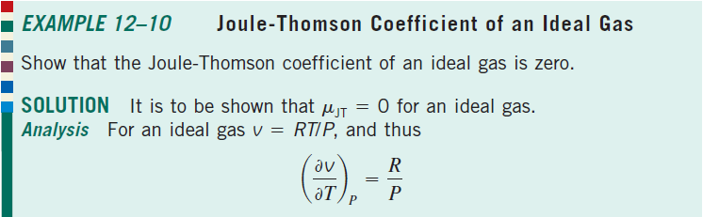
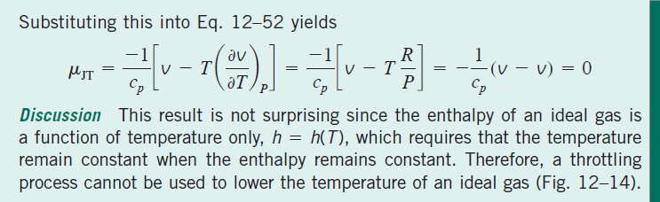
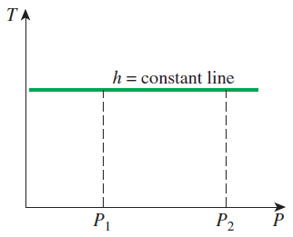
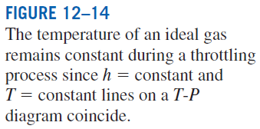

Slide 35
THE ∆h, ∆u, AND ∆s OF REAL GASES
Gases at low pressures behave as ideal gases and obey the relation Pv = RT. The properties of ideal gases are relatively easy to evaluate since the properties u, h, c_{v}, and c_{p} depend on temperature only.
At high pressures, however, gases deviate considerably from ideal-gas behavior, and it becomes necessary to account for this deviation.
In Chap. 3 we accounted for the deviation in properties P, v, and T by either using more complex equations of state or evaluating the compressibility factor Z from the compressibility charts.
Now we extend the analysis to evaluate the changes in the enthalpy, internal energy, and entropy of nonideal (real) gases, using the general relations for du, dh, and ds developed earlier.

Slide 36
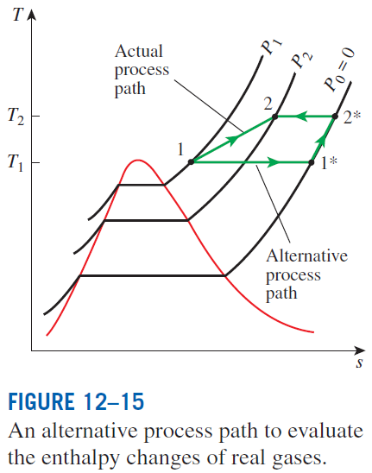
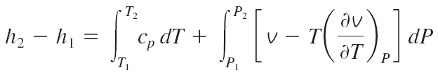
Enthalpy Changes of Real Gases
The enthalpy of a real gas, in general, depends on the pressure as well as on the temperature. Thus the enthalpy change of a real gas during a process can be evaluated from the general relation for dh
For an isothermal process dT = 0, and the first term vanishes. For a constant-pressure process, dP = 0, and the second term vanishes.

Slide 37
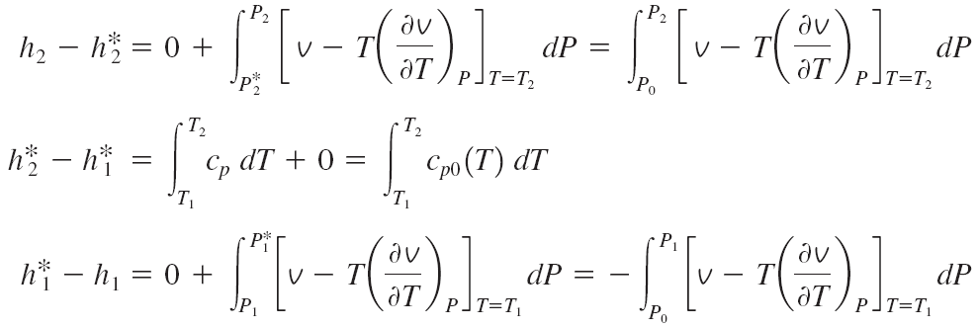
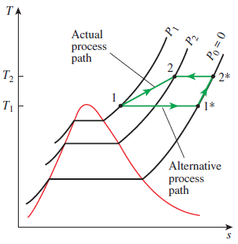
Using a superscript asterisk (*) to denote an ideal-gas state, we can express
the enthalpy change of a real gas during process 1-2 as
The difference between h and h* is called the enthalpy departure, and it represents the variation of the enthalpy of a gas with pressure at a fixed temperature. The calculation of enthalpy departure requires a knowledge of the P-v-T behavior of the gas. In the absence of such data, we can use the relation Pv = ZRT, where Z is the compressibility factor. Substituting,

Slide 38

Enthalpy departure factor
The values of Z_{h} are presented in graphical form as a function of P_{R} (reduced pressure) and T_{R} (reduced temperature) in the generalized enthalpy departure chart.
Z_{h} is used to determine the deviation of the enthalpy of a gas at a given P and T from the enthalpy of an ideal gas at the same T.
For a real gas during a process 1-2
from ideal gas tables
Internal Energy Changes of Real Gases
Using the definition

Slide 39
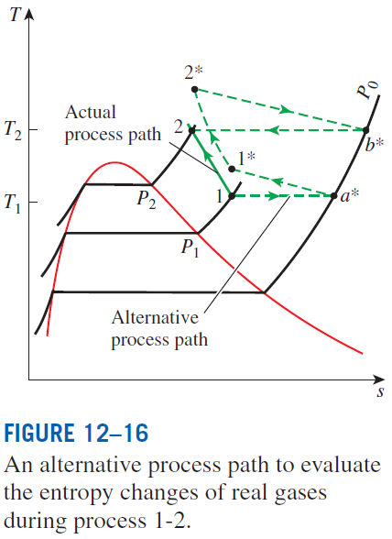
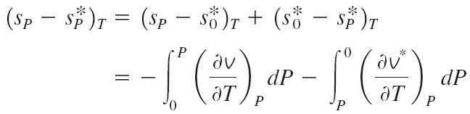

Entropy Changes of Real Gases
General relation for ds
Using the approach in the figure
During isothermal process

Slide 40


Entropy departure factor
Entropy departure
The values of Z_{s} are presented in graphical form as a function of P_{R} (reduced pressure) and T_{R} (reduced temperature) in the generalized entropy departure chart.
Z_{s} is used to determine the deviation of the entropy of a gas at a given P and T from the entropy of an ideal gas at the same P and T.
For a real gas during a process 1-2
from the ideal gas relations

Slide 41
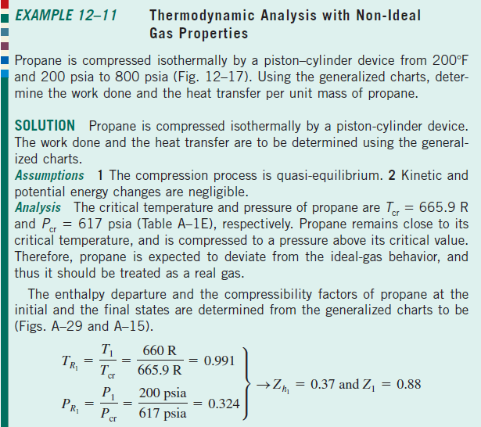
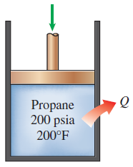
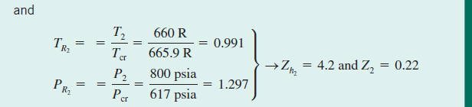

Slide 42
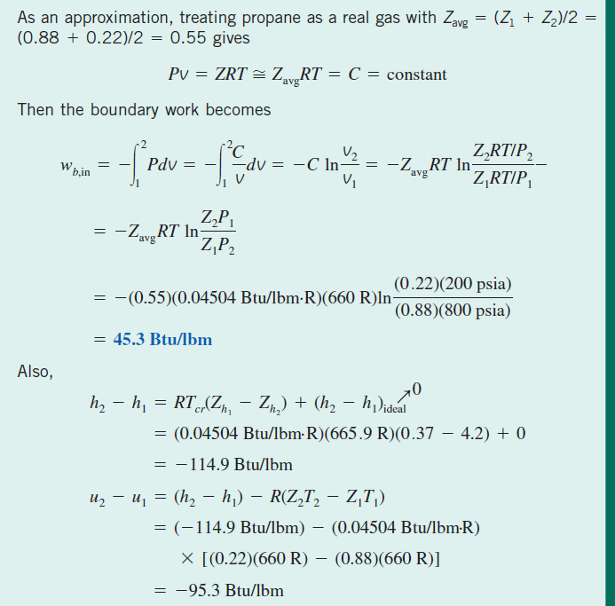

Slide 43


Slide 44
Summary
A little math—Partial derivatives and associated relations
  Partial differentials
  Partial differential relations
The Maxwell relations
The Clapeyron equation
General relations for du, dh, ds, c_{v},and c_{p}
  Internal energy changes
  Enthalpy changes
  Entropy changes
  Specific heats c_{v} and c_{p}
The Joule-Thomson coefficient
The ∆h, ∆ u, and ∆ s of real gases
  Enthalpy changes of real gases
  Internal energy changes of real gases
  Entropy changes of real gases

