Slide 1
CHAPTER 14
GAS–VAPOR MIXTURES AND AIR-CONDITIONING
Thermodynamics: An Engineering Approach
8th Edition
Yunus A. Çengel, Michael A. Boles
McGraw-Hill, 2015
Lecture slides by
Mehmet Kanoglu
Copyright © The McGraw-Hill Education. Permission required for reproduction or display.

Slide 2
Objectives
Differentiate between dry air and atmospheric air.
Define and calculate the specific and relative humidity of atmospheric air.
Calculate the dew-point temperature of atmospheric air.
Relate the adiabatic saturation temperature and wet-bulb temperatures of atmospheric air.
Use the psychrometric chart as a tool to determine the properties of atmospheric air.
Apply the principles of the conservation of mass and energy to various air-conditioning processes.

Slide 3
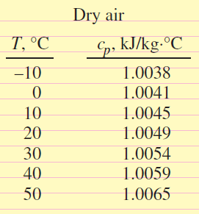
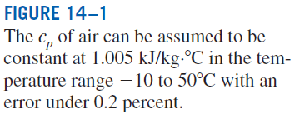
DRY AND ATMOSPHERIC AIR
Atmospheric air: Air in the atmosphere containing some water vapor (or moisture).
Dry air: Air that contains no water vapor.
Water vapor in the air plays a major role in human comfort. Therefore, it is an important consideration in air-conditioning applications.
Water vapor in air behaves as if it existed alone and obeys the ideal-gas relation Pv = RT. Then the atmospheric air can be treated as an ideal-gas mixture:
P_{a} Partial pressure of dry air
P_{v} Partial pressure of vapor (vapor pressure)

Slide 4
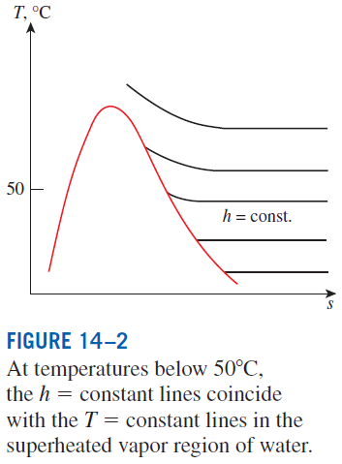
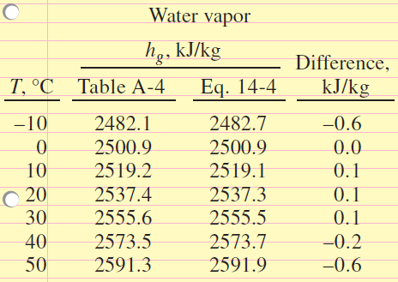
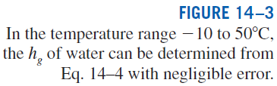
For water
h_{g} = 2500.9 kJ/kg at 0°C
c_{p,avg} = 1.82 kJ/kg · °C at −10 to 50°C range
h = h(T ) since water vapor is an ideal gas

Slide 5
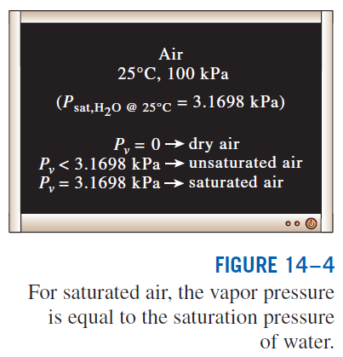
SPECIFIC AND RELATIVE HUMIDITY OF AIR
Absolute or specific humidity (humidity ratio): The mass of water vapor present in a unit mass of dry air.
Saturated air: The air saturated with moisture.
Relative humidity: The ratio of the amount of moisture the air holds (m_{v}) to the maximum amount of moisture the air can hold at the same temperature (m_{g}).

Slide 6
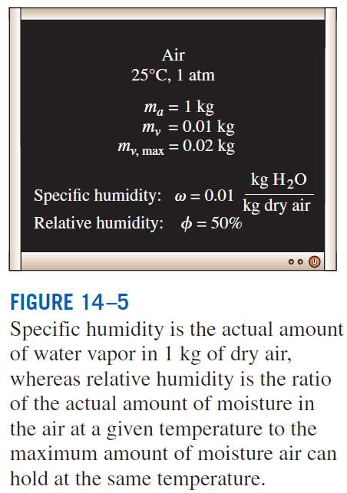

Slide 7
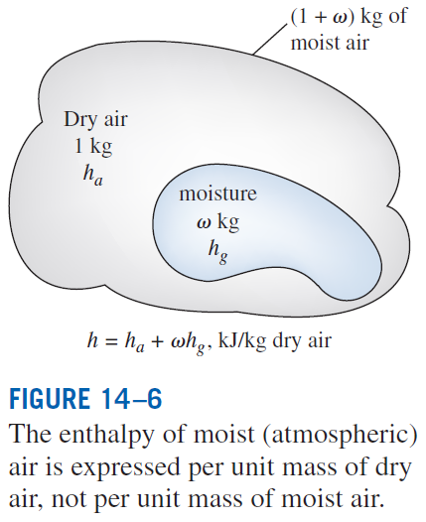
What is the relative humidity of dry air and saturated air?
In most practical applications, the amount of dry air in the air–water-vapor mixture remains constant, but the amount of water vapor changes.
Therefore, the enthalpy of atmospheric air is expressed per unit mass of dry air.
Dry-bulb temperature: The ordinary temperature of atmospheric air.

Slide 8
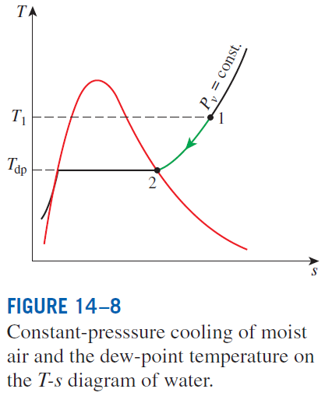

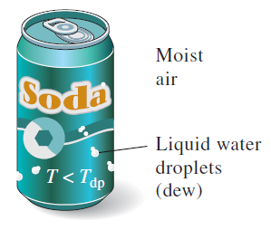
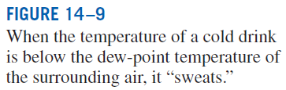
DEW-POINT TEMPERATURE
Dew-point temperature T_{dp}: The temperature at which condensation begins when the air is cooled at constant pressure (i.e., the saturation temperature of water corresponding to the vapor pressure.)

Slide 9
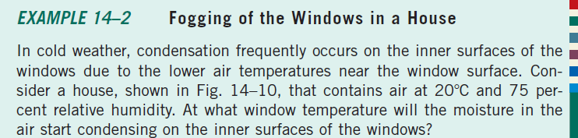
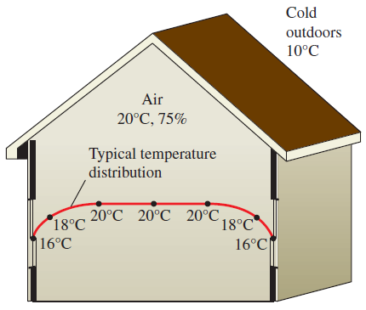



Slide 10
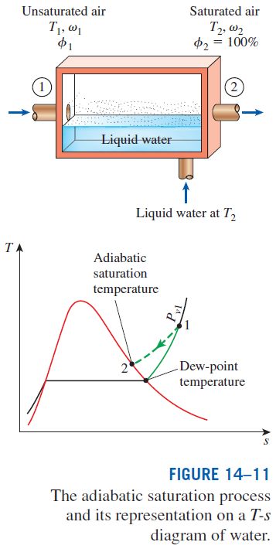
ADIABATIC SATURATION AND WET-BULB TEMPERATURES
The specific humidity (and relative humidity) of air can be determined from these equations by measuring the pressure and temperature of air at the inlet and the exit of an adiabatic saturator.

Slide 11
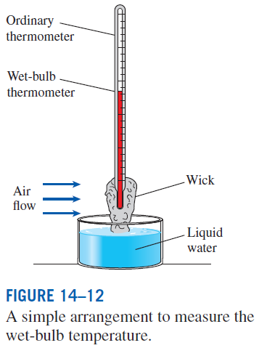
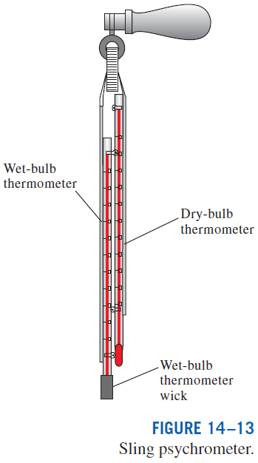
The adiabatic saturation process is not practical. To determine the absolute and relative humidity of air, a more practical approach is to use a thermometer whose bulb is covered with a cotton wick saturated with water and to blow air over the wick.
The temperature measured is the wet-bulb temperature T_{wb} and it is commonly used in A-C applications.
Sling psychrometer
For air–water vapor mixtures at atmospheric pressure, T_{wb} is approximately equal to the adiabatic saturation temperature.

Slide 12
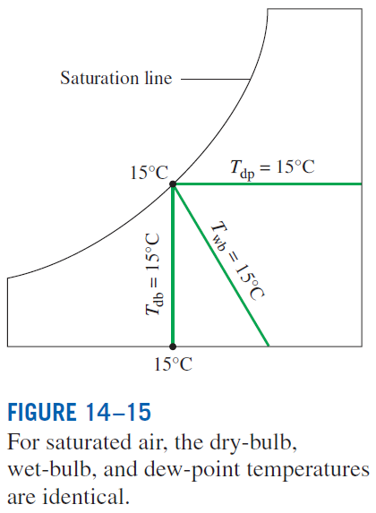
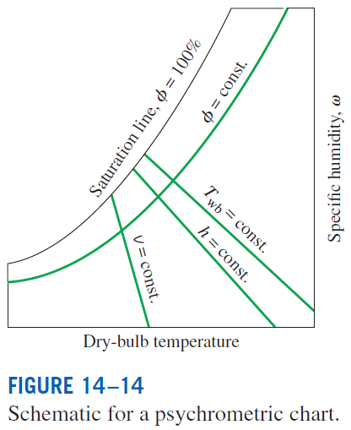
THE PSYCHROMETRIC CHART
Psychrometric charts: Present moist air properties in a convenient form. They are used extensively in A-C applications. The psychrometric chart serves as a valuable aid in visualizing the A-C processes such as heating, cooling, and humidification.

Slide 13
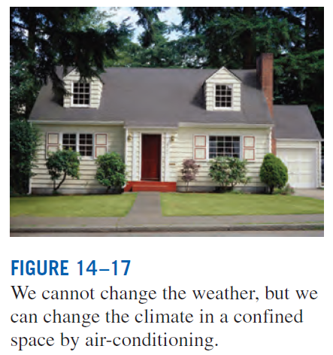
Today, modern air-conditioning systems can heat, cool, humidify, dehumidify, clean, and even deodorize the air–in other words, condition the air to peoples’ desires.
The rate of heat generation by human body depends on the level of the activity. For an average adult male, it is about 87 W when sleeping, 115 W when resting or doing office work, and 440 W when doing heavy physical work.
When doing light work or walking slowly, about half of the rejected body heat is dissipated through perspiration as latent heat while the other half is dissipated through convection and radiation as sensible heat.
In an environment at 10°C with 48 km/h winds feels as cold as an environment at -7°C with 3 km/h winds as a result of the body-chilling effect of the air motion (the wind-chill factor).
HUMAN COMFORT AND AIR-CONDITIONING

Slide 14
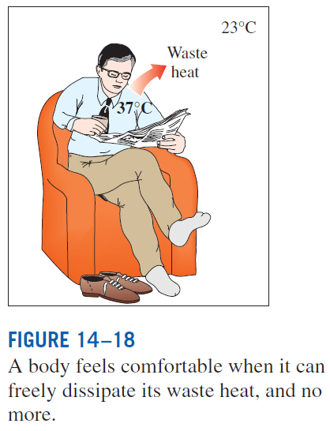
The comfort of the human body depends primarily on three factors: the (dry-bulb) temperature, relative humidity, and air motion.
The relative humidity affects the amount of heat a body can dissipate through evaporation. Most people prefer a relative humidity of 40 to 60%.
Air motion removes the warm, moist air that builds up around the body and replaces it with fresh air. Air motion should be strong enough to remove heat and moisture from the vicinity of the body, but gentle enough to be unnoticed.
An important factor that affects human comfort is heat transfer by radiation between the body and the surrounding surfaces such as walls and windows.
Other factors that affect comfort are air cleanliness, odor, and noise.

Slide 15
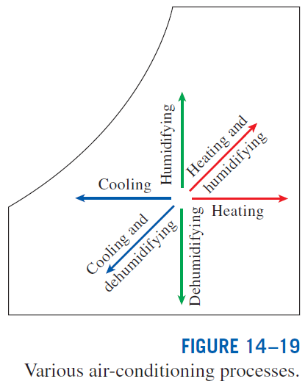
AIR-CONDITIONING PROCESSES
Maintaining a living space or an industrial facility at the desired temperature and humidity requires some processes called air-conditioning processes.
These processes include simple heating (raising the temperature), simple cooling (lowering the temperature), humidifying (adding moisture), and dehumidifying (removing moisture).
Sometimes two or more of these processes are needed to bring the air to a desired temperature and humidity level.
Air is commonly heated and humidified in winter and cooled and dehumidified in summer.

Slide 16


Most air-conditioning processes can be modeled as steady-flow processes with the following general mass and energy balances:
Mass balance
Energy balance
The work term usually consists of the fan work input, which is small relative to the other terms in the energy balance relation.

Slide 17
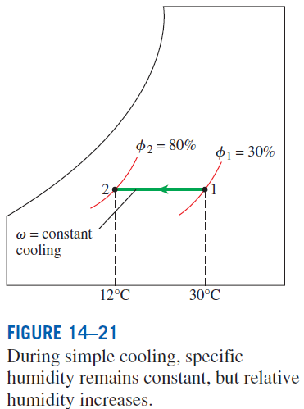
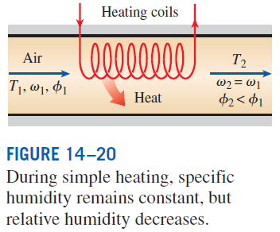
Simple Heating and Cooling (ω = constant)
Many residential heating systems consist of a stove, a heat pump, or an electric
resistance heater. The air in these systems is heated by circulating it through a duct that contains the tubing for the hot gases or the electric resistance wires.
Cooling can be accomplished by passing the air over some coils through which a refrigerant or chilled water flows.
Heating and cooling appear as a horizontal line since no moisture is added to or removed from the air.
Dry air mass balance
Water mass balance
Energy balance

Slide 18
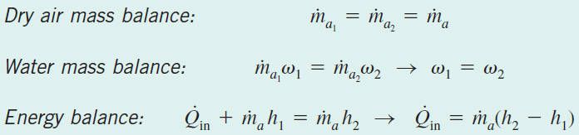
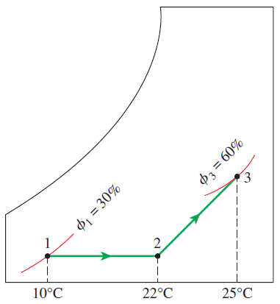


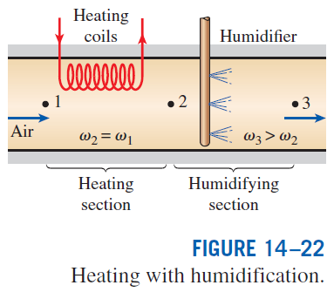
Heating with Humidification
Problems with the low relative humidity resulting from simple heating can be eliminated by humidifying the heated air. This is accomplished by passing the air first through a heating section and then through a humidifying section.

Slide 19
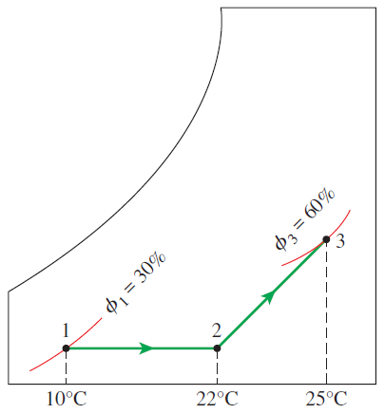
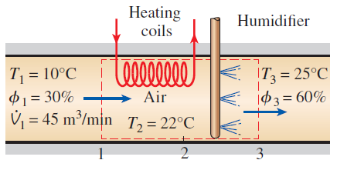
Heating and Humidification of Air

Slide 20
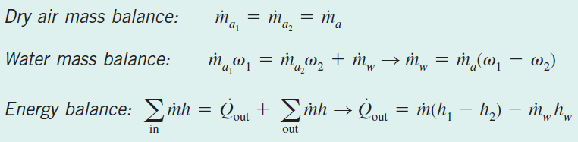
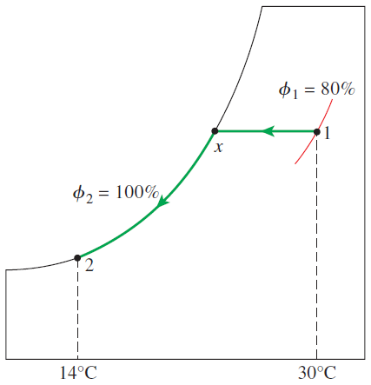
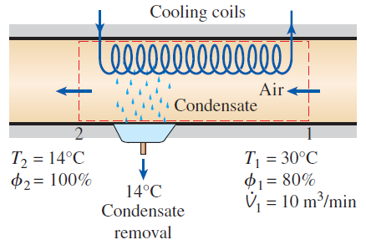
Cooling with Dehumidification
The specific humidity of air remains constant during a simple cooling process, but its relative humidity increases. If the relative humidity reaches undesirably high levels, it may be necessary to remove some moisture from the air, that is, to dehumidify it. This requires cooling the air below its dew-point temperature.

Slide 21
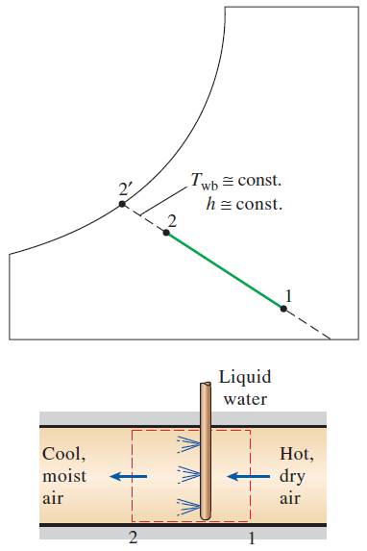
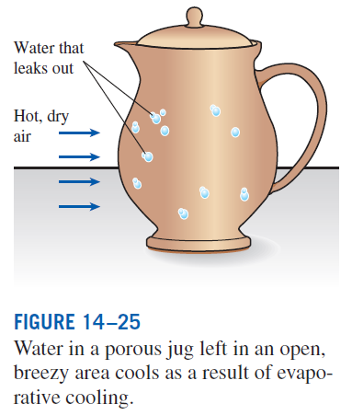
In desert (hot and dry) climates, we can avoid the high cost of conventional cooling by using evaporative coolers, also known as swamp coolers.
As water evaporates, the latent heat of vaporization is absorbed from the water body and the surrounding air. As a result, both the water and the air are cooled during the process.
Evaporative Cooling
This process is essentially identical to adiabatic saturation process.

Slide 22
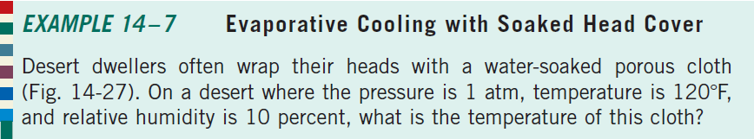




Slide 23
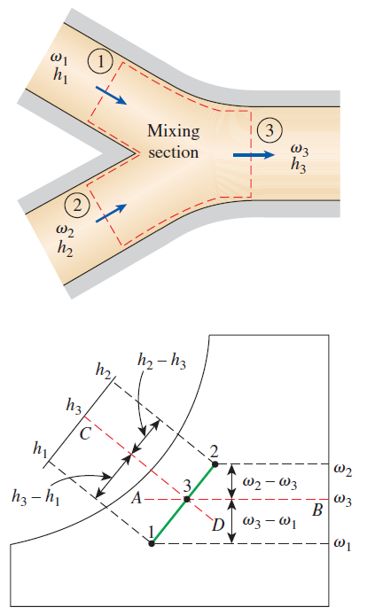
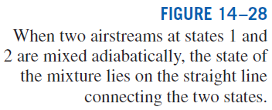
Adiabatic Mixing of Airstreams
Many A-C applications require the mixing of two airstreams. This is particularly true for large buildings, most production and process plants, and hospitals, which require that the conditioned air be mixed with a certain fraction of fresh outside air before it is routed into the living space.

Slide 24
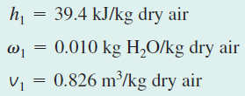
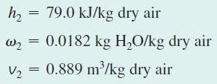
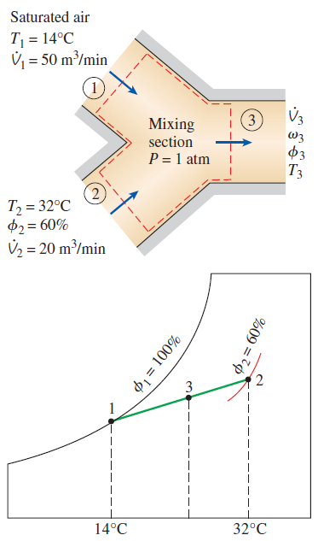


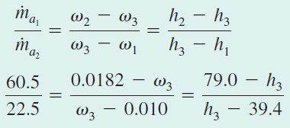

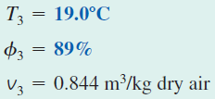
Mixing of Conditioned Air with Outdoor Air

Slide 25
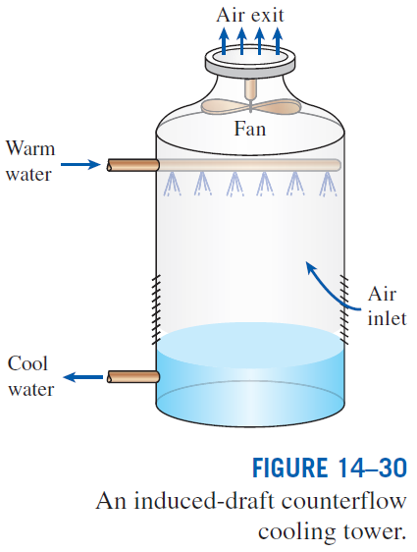
Wet Cooling Towers
Power plants, large air-conditioning systems, and some industries generate large quantities of waste heat that is often rejected to cooling water from nearby lakes or rivers.
In some cases, however, the cooling water supply is limited or thermal pollution is a serious concern.
In such cases, the waste heat must be rejected to the atmosphere, with cooling water recirculating and serving as a transport medium for heat transfer between the source and the sink (the atmosphere).
One way of achieving this is through the use of wet cooling towers.
A wet cooling tower is essentially a semi-enclosed evaporative cooler.

Slide 26
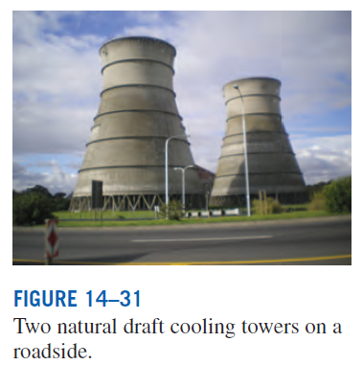
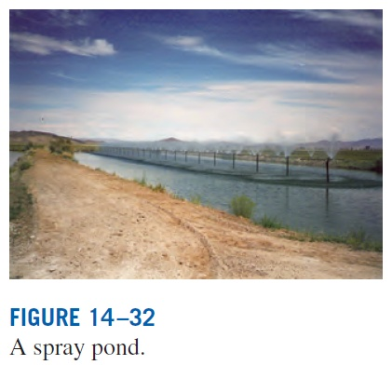
Natural-draft cooling tower: It looks like a large chimney and works like an ordinary chimney. The air in the tower has a high water-vapor content, and thus it is lighter than the outside air. Consequently, the light air in the tower rises, and the heavier outside air fills the vacant space, creating an airflow from the bottom of the tower to the top.
Spray pond: The warm water is sprayed into the air and is cooled by the air as it falls into the pond,
Cooling pond: Dumping the waste heat into a still pond, which is basically a large artificial lake open to the atmosphere.

Slide 27

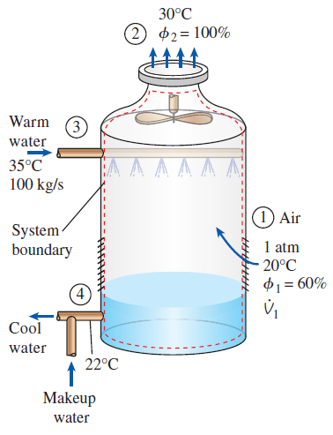





Cooling of a Power Plant by a Cooling Tower

Slide 28
Summary
Dry and atmospheric air
Specific and relative humidity of air
Dew-point temperature
Adiabatic saturation and wet-bulb temperatures
The psychrometric chart
Human comfort and air-conditioning
Air-conditioning processes
  Simple heating and cooling
  Heating with humidification
  Cooling with dehumidification
  Evaporative cooling
  Adiabatic mixing of airstreams
  Wet cooling towers

