Slide 1
CHAPTER 15
CHEMICAL REACTIONS
Thermodynamics: An Engineering Approach
8th Edition
Yunus A. Çengel, Michael A. Boles
McGraw-Hill, 2015
Lecture slides by
Mehmet Kanoglu
Copyright © The McGraw-Hill Education. Permission required for reproduction or display.

Slide 2
Objectives
Give an overview of fuels and combustion.
Apply the conservation of mass to reacting systems to determine balanced reaction equations.
Define the parameters used in combustion analysis, such as air–fuel ratio, percent theoretical air, and dew-point temperature.
Apply energy balances to reacting systems for both steady-flow control volumes and fixed mass systems.
Calculate the enthalpy of reaction, enthalpy of combustion, and the heating values of fuels.
Determine the adiabatic flame temperature for reacting mixtures.
Evaluate the entropy change of reacting systems.
Analyze reacting systems from the second-law perspective.

Slide 3
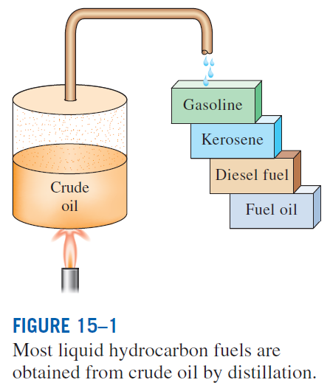
FUELS AND COMBUSTION
Fuel: Any material that can be burned to release thermal energy.
Most familiar fuels consist primarily of hydrogen and carbon.
They are called hydrocarbon fuels and are denoted by the general formula C_{n}H_{m}.
Hydrocarbon fuels exist in all phases, some examples being coal, gasoline (usually treated as octane C₈H₁₈), and natural gas.

Slide 4
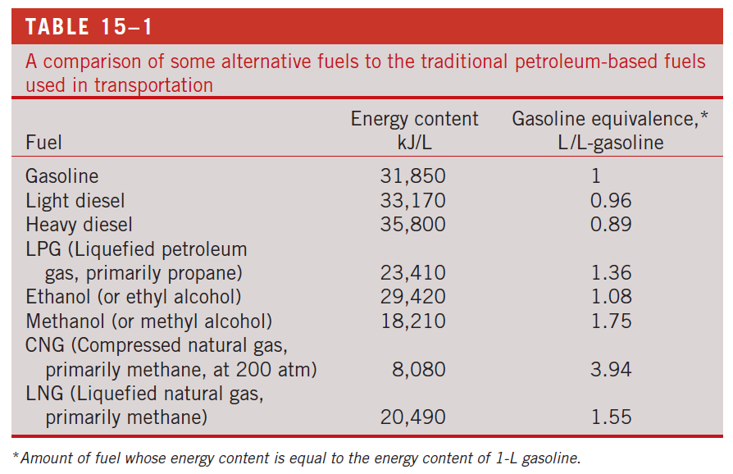

Slide 5
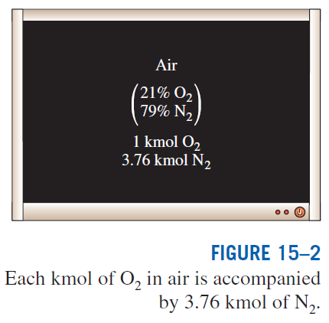
The oxidizer most often used in combustion processes is air. Why?
On a mole or a volume basis, dry air is composed of 20.9% O₂, 78.1% N₂, 0.9% Ar, and small amounts of CO₂, He, Ne, H₂.
In the analysis of combustion processes, dry air is approximated as 21% O₂ and 79% N₂ by mole numbers.
Combustion: A chemical reaction during which a fuel is oxidized and a large quantity of energy is released.

Slide 6
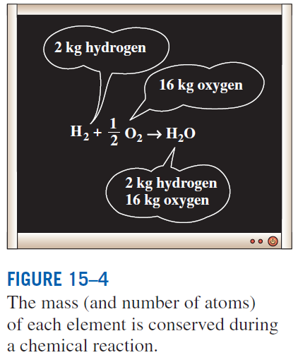
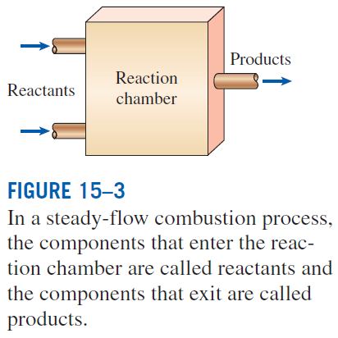
The fuel must be brought above its ignition temperature to start the combustion. The minimum ignition temperatures in atmospheric air are approximately 260°C for gasoline, 400°C for carbon, 580°C for hydrogen, 610°C for carbon monoxide, and 630°C for methane.
Proportions of the fuel and air must be in the proper range for combustion to begin. For example, natural gas does not burn in air in concentrations less than 5% or greater than about 15%.
The total number of moles is not conserved during a chemical reaction.

Slide 7

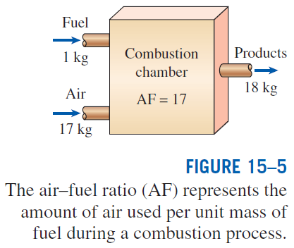
Air-fuel ratio (AF) is usually expressed on a mass basis and is defined as the ratio of the mass of air to the mass of fuel for a combustion process
m mass
N number of moles
M molar mass
Fuel–air ratio (FA): The reciprocal of air–fuel ratio.

Slide 8
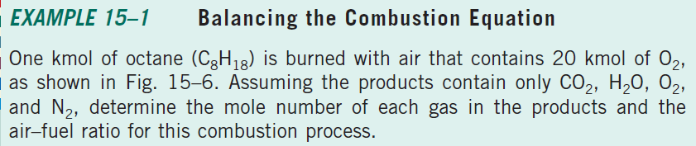
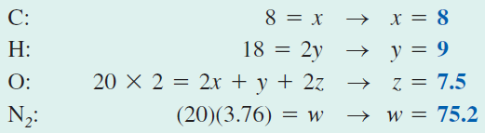
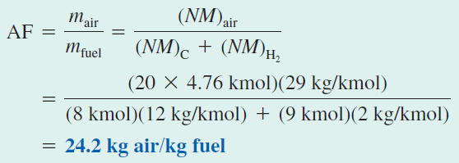

Slide 9
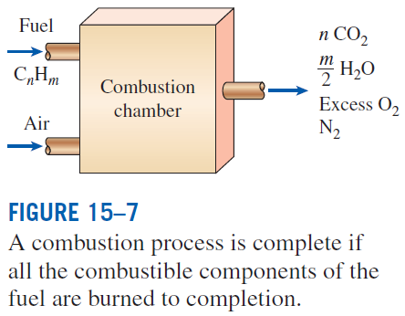
THEORETICAL AND ACTUAL COMBUSTION PROCESSES
Complete combustion: If all the carbon in the fuel burns to CO₂, all the hydrogen burns to H₂O, and all the sulfur (if any) burns to SO₂.
Incomplete combustion: If the combustion products contain any unburned fuel or components such as C, H₂, CO, or OH.
Reasons for incomplete combustion: 1 Insufficient oxygen, 2 insufficient mixing in the combustion chamber during the limited time that the fuel and the oxygen are in contact, and 3 dissociation (at high temperatures).
Oxygen has a much greater tendency to combine with hydrogen than it does with carbon. Therefore, the hydrogen in the fuel normally burns to completion, forming H₂O.

Slide 10
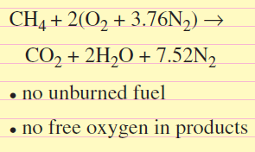
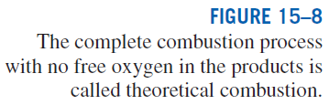
Stoichiometric or theoretical air: The minimum amount of air needed for the complete combustion of a fuel. Also referred to as the chemically correct amount of air, or 100% theoretical air.
Stoichiometric or theoretical combustion: The ideal combustion process during which a fuel is burned completely with theoretical air.
Excess air: The amount of air in excess of the stoichiometric amount. Usually expressed in terms of the stoichiometric air as percent excess air or percent theoretical air.
Deficiency of air: Amounts of air less than the stoichiometric amount. Often expressed as percent deficiency of air.
Equivalence ratio: The ratio of the actual fuel–air ratio to the stoichiometric fuel–air ratio.
50% excess air = 150% theoretical air
200% excess air = 300% theoretical air.
90% theoretical air = 10% deficiency of air
Theoretical combustion of methane

Slide 11
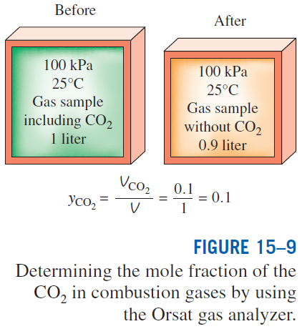
Predicting the composition of the products is relatively easy when the combustion process is assumed to be complete.
With actual combustion processes, it is impossible to predict the composition of the products on the basis of the mass balance alone.
Then the only alternative we have is to measure the amount of each component in the products directly.
A commonly used device to analyze the composition of combustion gases is the Orsat gas analyzer.
The results are reported on a dry basis.

Slide 12
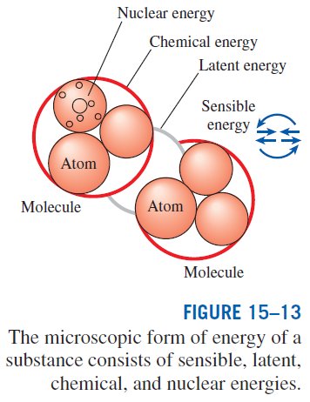
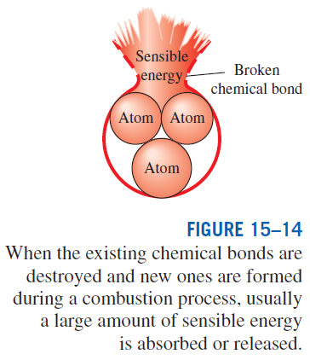
ENTHALPY OF FORMATION AND ENTHALPY OF COMBUSTION
Disregarding any changes in kinetic and potential energies, the energy change of a system during a chemical reaction is due to a change in state and a change in chemical composition:

Slide 13

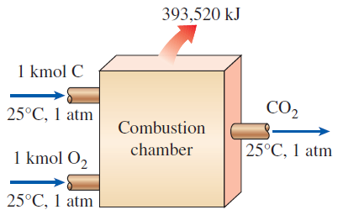

Enthalpy of reaction h_{R} : The difference between the enthalpy of the products at a specified state and the enthalpy of the reactants at the same state for a complete reaction.
Enthalpy of combustion h_{C} : It is the enthalpy of reaction for combustion processes. It represents the amount of heat released during a steady-flow combustion process when 1 kmol (or 1 kg) of fuel is burned completely at a specified temperature and pressure.
Enthalpy of formation h_{f} : The amount of energy absorbed or released as the component is formed from its stable elements during a steady-flow process at a specified state.
To establish a starting point, we assign the enthalpy of formation of all stable elements (such as O₂, N₂, H₂, and C) a value of zero at the standard reference state of 25°C and 1 atm.

Slide 14

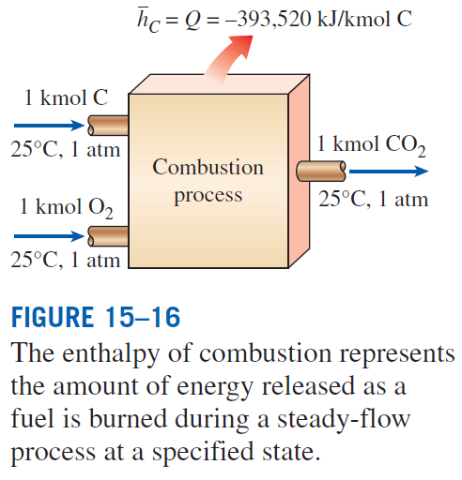

Slide 15
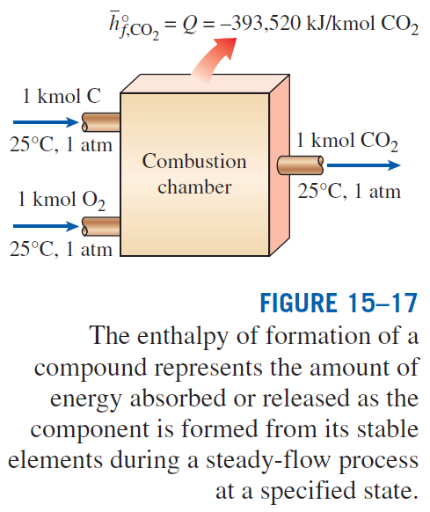
Enthalpy of formation: The enthalpy of a
substance at a specified state due to its chemical composition.

Slide 16
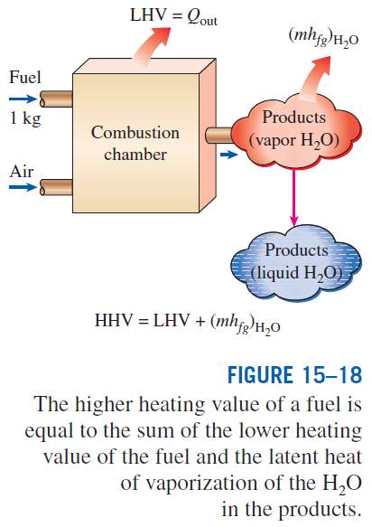
Heating value: The amount of heat released when a fuel is burned completely in a steady-flow process and the products are returned to the state of the reactants. The heating value of a fuel is equal to the absolute value of the enthalpy of combustion of the fuel.
Higher heating value (HHV): When the H₂O in the products is in the liquid form.
Lower heating value (LHV): When the H₂O in the products is in the vapor form.
For the fuels with variable composition (i.e., coal, natural gas, fuel oil), the heating value may be determined by burning them directly in a bomb calorimeter.

Slide 17
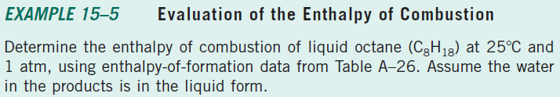
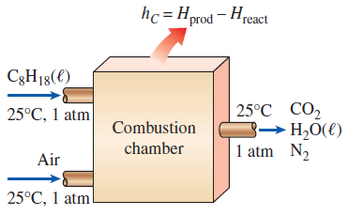

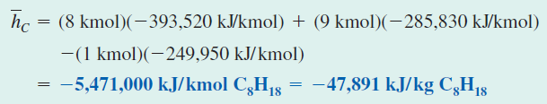

Slide 18

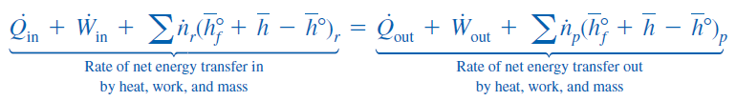
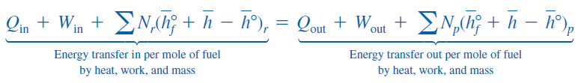
FIRST-LAW ANALYSIS OF REACTING SYSTEMS
The energy balance (the first-law) relations developed in Chaps. 4 and 5 are applicable to both reacting and nonreacting systems. We rewrite the energy balance relations including the changes in chemical energies.
Steady-Flow Systems
When the changes in kinetic and potential energies are negligible, the steady-flow energy balance for a chemically reacting steady-flow system:

Slide 19
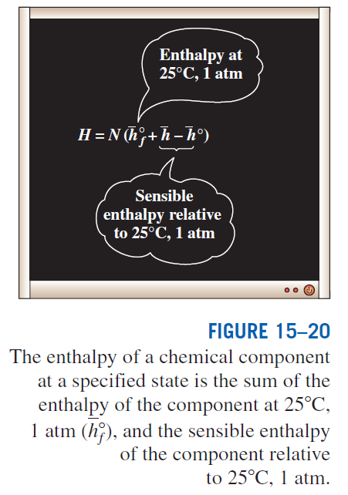

Slide 20
Taking heat transfer to the system and work done by the system to be positive quantities, the energy balance relation is
If the enthalpy of combustion for a particular reaction is available:
Most steady-flow combustion processes do not involve any work interactions. Also, combustion chamber normally involves heat output but no heat input:

Slide 21
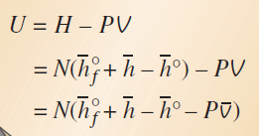
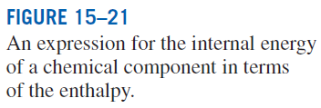


Closed Systems
Taking heat transfer to the system and work done by the system to be positive quantities, the general closed-system energy balance relation can be expressed for a stationary chemically reacting closed system as
Utilizing the definition of enthalpy:
The Pv terms are negligible for solids and liquids, and can be replaced by R_{u}T for gases that behave as an ideal gas.

Slide 22
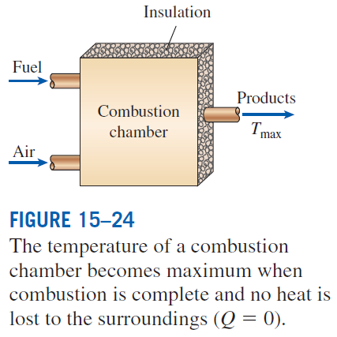
ADIABATIC FLAME TEMPERATURE
In the limiting case of no heat loss to the surroundings (Q = 0), the temperature of the products reaches a maximum, which is called the adiabatic flame or adiabatic combustion temperature.
since
The determination of the adiabatic flame temperature by hand requires the use of an iterative technique.

Slide 23
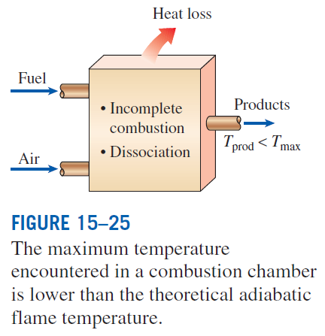
The adiabatic flame temperature of a fuel depends on
  the state of the reactants
  the degree of completion of the reaction
  the amount of air used
For a specified fuel at a specified state burned with air at a specified state,
the adiabatic flame temperature attains its maximum value when complete combustion occurs with the theoretical amount of air.

Slide 24

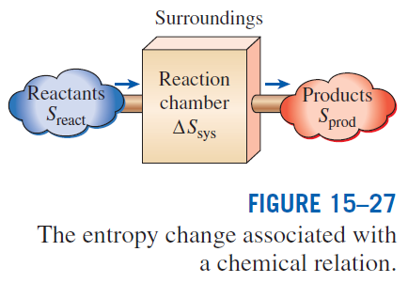
ENTROPY CHANGE OF REACTING SYSTEMS
entropy balance for any system (including reacting systems) undergoing any process
for a closed or steady-flow reacting system
for an adiabatic process (Q = 0)

Slide 25
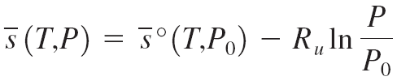
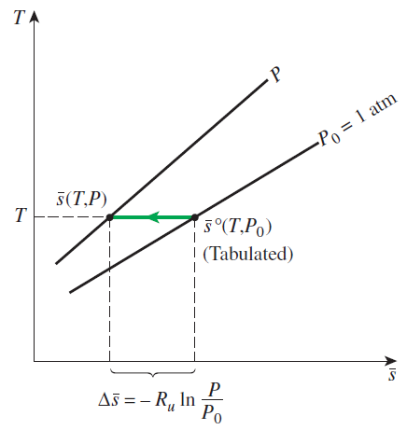
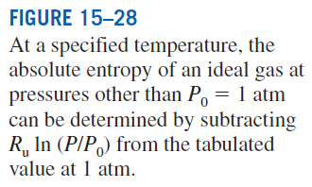
Entropy of a component
P₀ = 1 atm
P_{i} partial pressure
y_{i} mole fraction
P_{m} total pressure of mixture.
When evaluating the entropy of a component of an ideal-gas mixture, we should use the temperature and the partial pressure of the component.
The absolute entropy values are listed in Tables A–18 through A–25 for various ideal gases at the specified temperature and at a pressure of 1 atm. The absolute entropy values for various fuels are listed in Table A–26 at the standard reference state of 25°C and 1 atm.

Slide 26

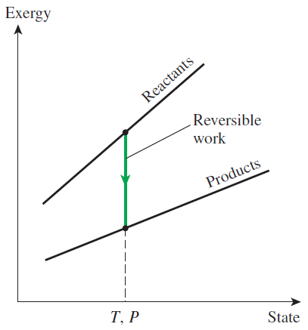


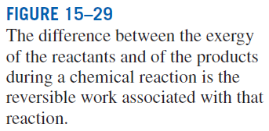
SECOND-LAW ANALYSIS OF REACTING SYSTEMS
Exergy destruction
The reversible work for a steady-flow combustion process that involves heat transfer with only the surroundings at T₀
When both the reactants and the products are at T₀
Gibbs function

Slide 27
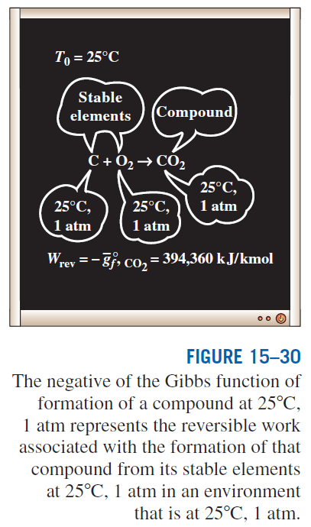

For the very special case of
T_{react} = T_{prod} = T₀ = 25°C
We can conclude from the above equation that the value (the negative of the Gibbs function of formation at 25°C and 1 atm) of a compound represents the reversible work associated with the formation of that compound from its stable elements at 25°C and 1 atm in an environment at 25°C and 1 atm.

Slide 28
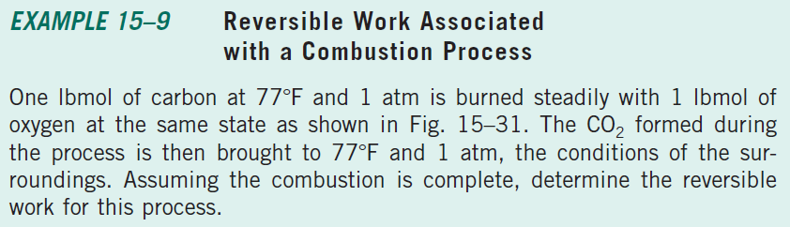
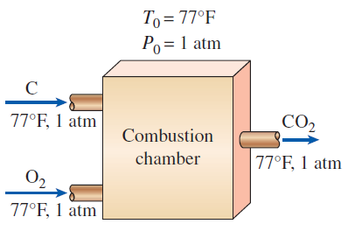

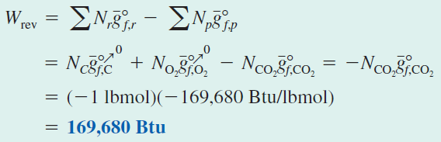

Slide 29
Summary
Fuels and combustion
Theoretical and actual combustion processes
Enthalpy of formation and enthalpy of combustion
First-law analysis of reacting systems
  Steady-flow systems
  Closed systems
Adiabatic flame temperature
Entropy change of reacting systems
Second-law analysis of reacting systems

