Slide 1
CHAPTER 16
CHEMICAL AND PHASE EQUILIBRIUM
Thermodynamics: An Engineering Approach
8th Edition
Yunus A. Çengel, Michael A. Boles
McGraw-Hill, 2015
Lecture slides by
Mehmet Kanoglu
Copyright © The McGraw-Hill Education. Permission required for reproduction or display.

Slide 2
Objectives
Develop the equilibrium criterion for reacting systems based on the second law of thermodynamics.
Develop a general criterion for chemical equilibrium applicable to any reacting system based on minimizing the Gibbs function for the system.
Define and evaluate the chemical equilibrium constant.
Apply the general criterion for chemical equilibrium analysis to reacting ideal-gas mixtures.
Apply the general criterion for chemical equilibrium analysis to simultaneous reactions.
Relate the chemical equilibrium constant to the enthalpy of reaction.
Establish the phase equilibrium for nonreacting systems in terms of the specific Gibbs function of the phases of a pure substance.
Apply the Gibbs phase rule to determine the number of independent variables associated with a multicomponent, multiphase system.
Apply Henry’s law and Raoult’s law for gases dissolved in liquids.

Slide 3
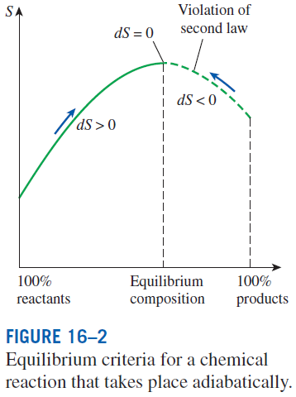
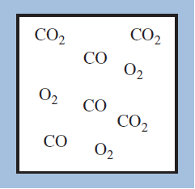
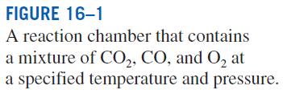
CRITERION FOR CHEMICAL EQUILIBRIUM
We may know the temperature, pressure, and composition (thus the state) of a system but we are unable to predict whether the system is in chemical equilibrium.
The increase of entropy principle
A chemical reaction in an adiabatic chamber proceeds in the direction of increasing entropy. When the entropy reaches a maximum, the reaction stops.

Slide 4
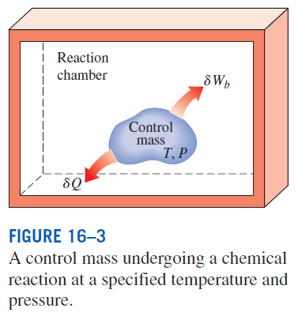
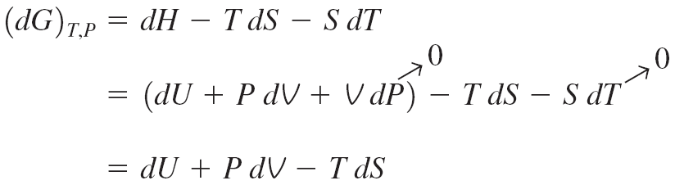

Combining the first- and the second-law
relations for the control mass in the figure
The differential of the Gibbs function (G=H−TS) at constant temperature and pressure
from the two equations
A chemical reaction at a specified T and P proceeds in the direction of a decreasing Gibbs function. The reaction stops and chemical equilibrium is established when the Gibbs function attains a minimum value. Therefore, the criterion for chemical equilibrium is

Slide 5
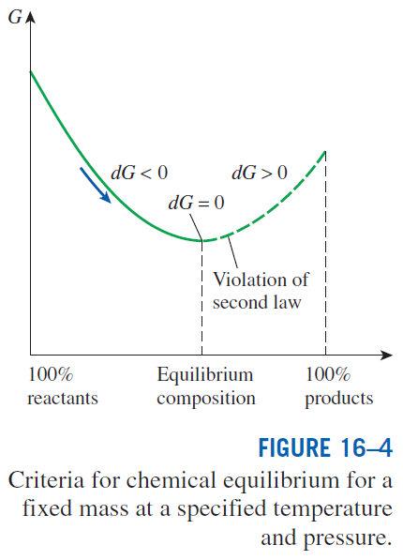

Slide 6
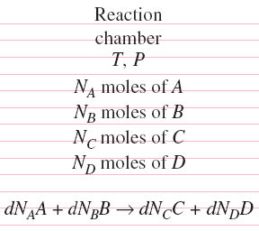
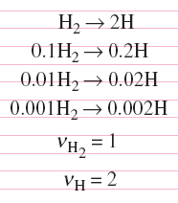
To obtain a relation for chemical equilibrium in terms of the properties of the individual components, we consider a mixture of four chemical components A, B, C, and D that exist in equilibrium at a specified T and P.
From the equilibrium criterion
An infinitesimal reaction in a chamber at constant temperature and pressure.
To find a relation between the dN’s, we write the corresponding stoichiometric (theoretical) reaction
the ν ’s are the stoichiometric coefficients
The changes in the number of moles of the components during a chemical reaction are proportional to the stoichiometric coefficients regardless of the extent of the reaction.
ε is the proportionality constant. Substituting,
Criterion for chemical equilibrium

Slide 7

THE EQUILIBRIUM CONSTANT
FOR IDEAL-GAS MIXTURES
(16-9)

Slide 8
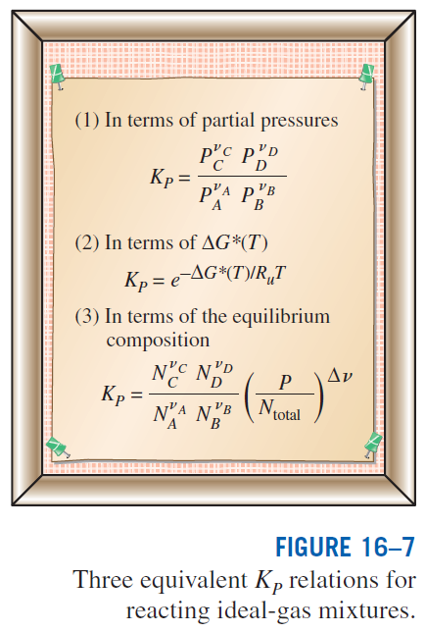
Now we define the equilibrium constant K_{P} for the chemical equilibrium of ideal-gas mixtures as
Substituting into Eq. 16–12 and rearranging, we obtain
Therefore, the equilibrium constant K_{P} of an ideal-gas mixture at a specified temperature can be determined from a knowledge of the standard-state Gibbs function change at the same temperature. The K_{P} values for several reactions are given in Table A–28.
Partial pressure in terms of mole numbers

Slide 9
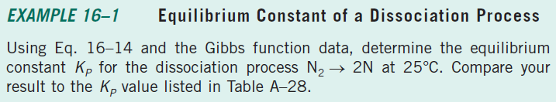

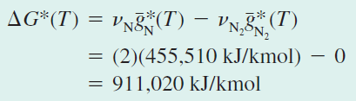
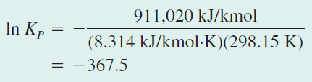



Slide 10
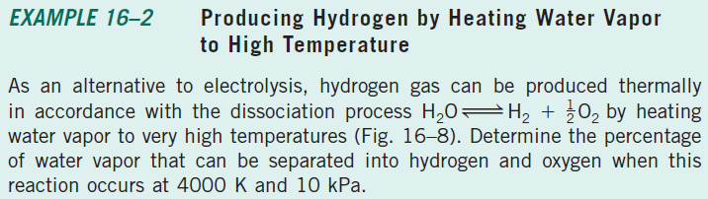
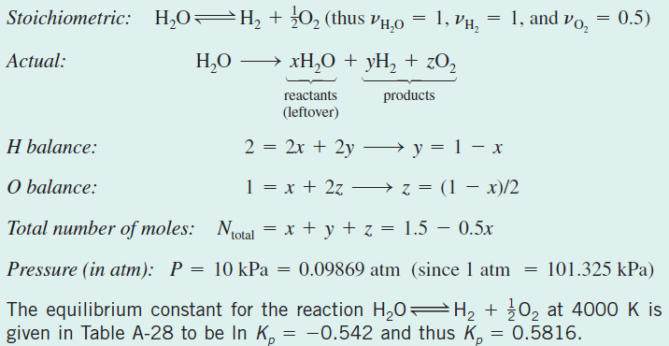
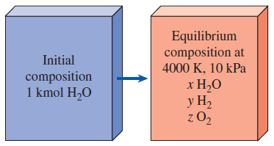



Slide 11
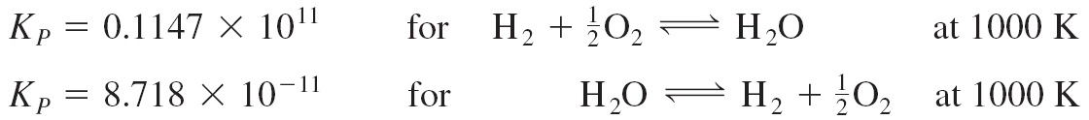
SOME REMARKS ABOUT THE K_{P} OF IDEAL-GAS MIXTURES
1. The K_{P} of a reaction depends on temperature only. It is independent of
the pressure of the equilibrium mixture and is not affected by the presence
of inert gases. This is because K_{P} depends on ΔG*(T), which depends on temperature only, and the ΔG*(T) of inert gases is zero. Thus, at a specified temperature the following four reactions have the same K_{P} value:
2. The K_{P} of the reverse reaction is 1/K_{P}.
This is easily seen from Eq. 16–13. For example, from Table A–28,

Slide 12
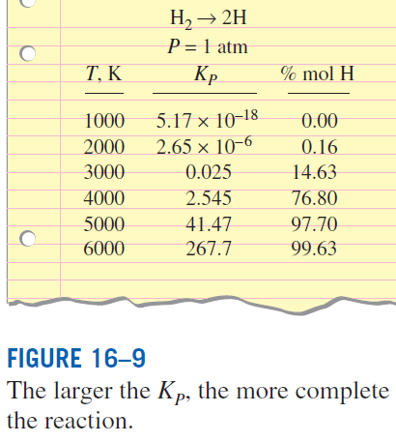
3. The larger the K_{P}, the more complete the reaction. If the equilibrium composition consists largely of product gases, the partial pressures of the products are considerably larger than the partial pressures of the reactants, which results in a large value of K_{P}. In the limiting case of a complete reaction (no leftover reactants in the equilibrium mixture), K_{P} approaches infinity. Reactions with very small K_{P} values at a specified temperature can be neglected.
4. The mixture pressure affects the equilibrium composition (although it does not affect the equilibrium constant K_{P}). At a specified temperature, the K_{P} value of the reaction, and thus the right-hand side of Eq. 16–15, remains constant. Therefore, the mole numbers of the reactants and the products must change to counteract any changes in the pressure term.

Slide 13
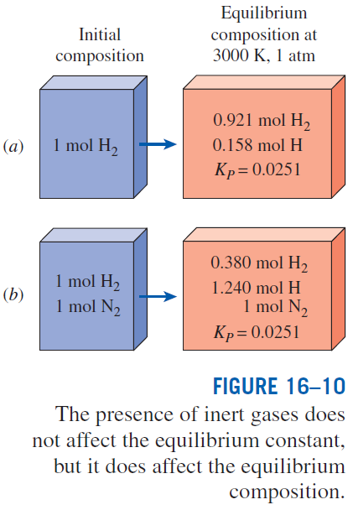
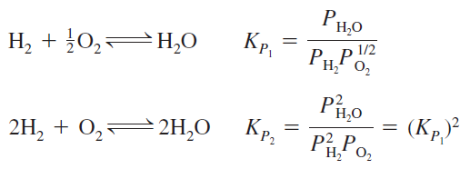
5. The presence of inert gases affects the equilibrium composition (although it does not affect the equilibrium constant K_{P}). This can be seen from Eq. 16–15, which involves the term (1/N_{total})^{Δν}, where N_{total} includes inert gases.
6. When the stoichiometric coefficients are doubled, the value of K_{P} is squared. For example,

Slide 14
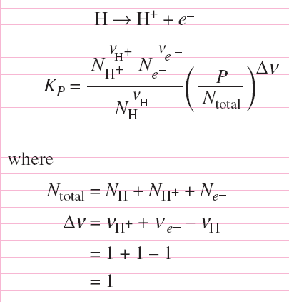
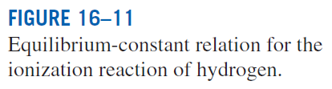
7. Free electrons in the equilibrium composition can be treated as an ideal gas. At high temperatures (usually above 2500 K), gas molecules start to dissociate into unattached atoms, and at even higher temperatures atoms start to lose electrons and ionize.
8. Equilibrium calculations provide information on the equilibrium composition of a reaction, not on the reaction rate. Sometimes it may even take years to achieve the indicated equilibrium composition. When the right catalyst is used, the reaction goes to completion rather quickly to the predicted value.

Slide 15
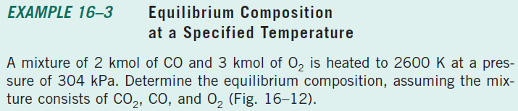
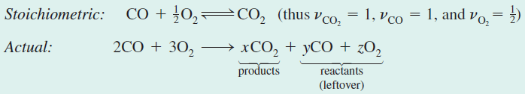
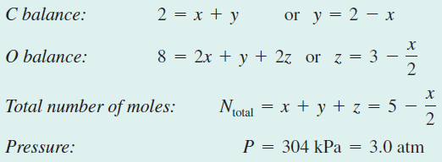
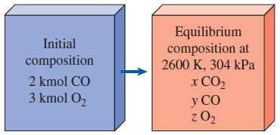

Slide 16



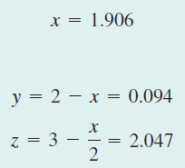


Slide 17
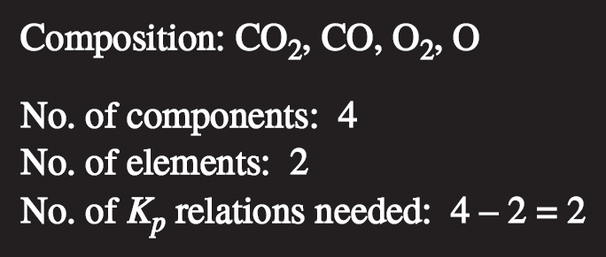
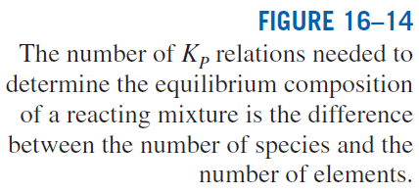
CHEMICAL EQUILIBRIUM FOR SIMULTANEOUS REACTIONS
Most practical chemical reactions involve two or more reactions that occur simultaneously. In such cases, it becomes necessary to apply the equilibrium criterion to all possible reactions that may occur in the reaction chamber.
When a chemical species appears in more than one reaction, the application of the equilibrium criterion, together with the mass balance for each chemical species, results in a system of simultaneous equations from which the equilibrium composition can be determined.
A reacting system at a specified temperature and pressure achieves chemical equilibrium when its Gibbs function reaches a minimum value, that is, (dG)_{T,P} = 0.
When two or more reactions are involved, this condition is satisfied only when (dG)_{T,P} = 0 for each reaction.

Slide 18
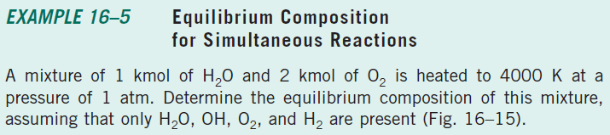
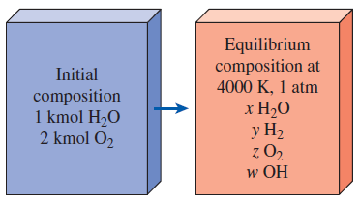



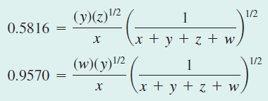
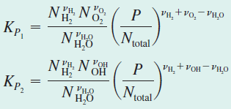



Slide 19
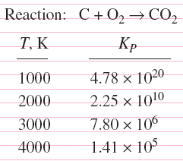
the equilibrium constant K_{P} of an ideal gas
VARIATION OF K_{P} WITH TEMPERATURE
van’t Hoff equation
Taking constant and integrating
This equation provides a means of calculating the of a reaction from a knowledge of K_{P}, which is easier to determine. Also, it shows that exothermic reactions such as combustion processes are less complete at higher temperatures since K_{P} decreases with temperature for such reactions.

Slide 20
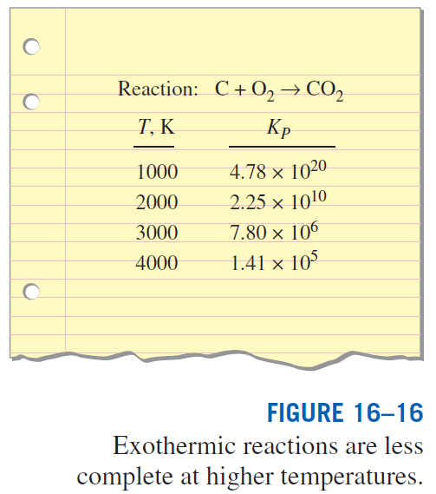
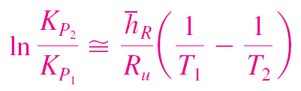
Exothermic reactions such as combustion processes are less complete at higher temperatures since K_{P} decreases with temperature for such reactions.

Slide 21
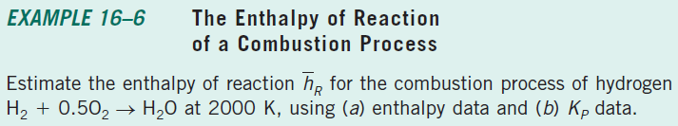
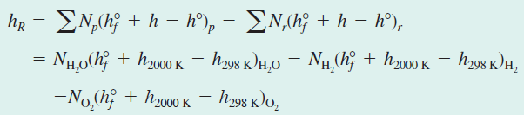
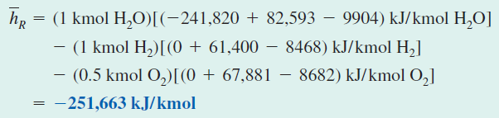
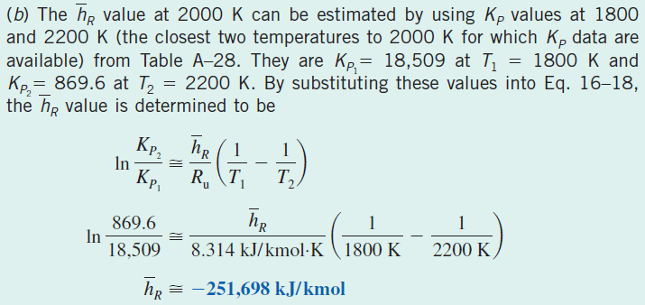

Slide 22
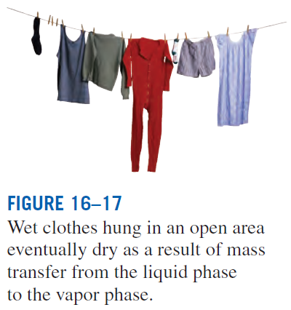
There is a driving force between the two phases of a substance that forces the mass to transform from one phase to another.
The magnitude of this force depends, among other things, on the relative concentrations of the two phases.
A wet T-shirt dries much quicker in dry air than it does in humid air.
In fact, it does not dry at all if the relative humidity of the environment is 100%.
In this case, there is no transformation from the liquid phase to the vapor phase, and the two phases are in phase equilibrium.
The conditions of phase equilibrium change if the temperature or the pressure is changed.
Therefore, we examine phase equilibrium at a specified temperature and pressure.
PHASE EQUILIBRIUM

Slide 23

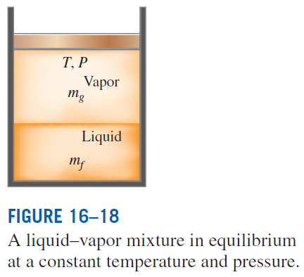

Phase Equilibrium for a Single-Component System
The total Gibbs function of the mixture in the figure is
If during a disturbance a differential amount of liquid dm_{f} evaporates at constant T and P,
At equilibrium, (dG)_{T,P} = 0. Also from the conservation of mass, dm_{g} = − dm_{f}. Substituting,
which must be equal to zero at equilibrium. It yields
The two phases of a pure substance are in equilibrium when each phase has the same value of specific Gibbs function.
At the triple point, the specific Gibbs functions of all three phases are equal to each other. The Gibbs function difference is the driving force for phase change.

Slide 24
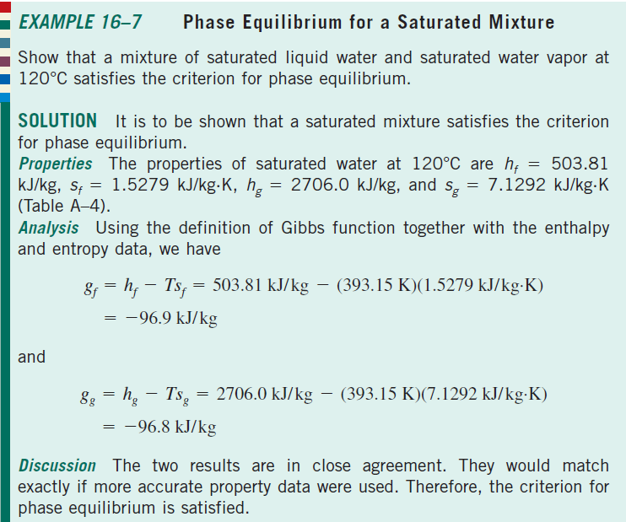

Slide 25
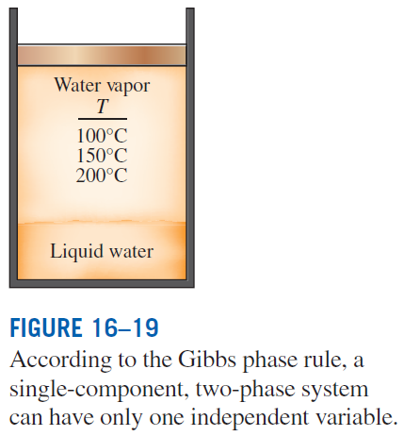
The Phase Rule
A single-component two-phase system has one independent property, which may be taken to be the temperature or the pressure.
In general, the number of independent variables associated with a multicomponent, multiphase system is given by the Gibbs phase rule:
IV = number of independent variables
C = number of components
PH = number of phases present in equilibrium.
Example 1: At the triple point, PH = 3 and thus IV = 0. That is, none of the properties of a pure substance at the triple point can be varied.
Example 2: Based on this rule, two independent intensive properties need to be specified to fix the equilibrium state of a pure substance in a single phase

Slide 26
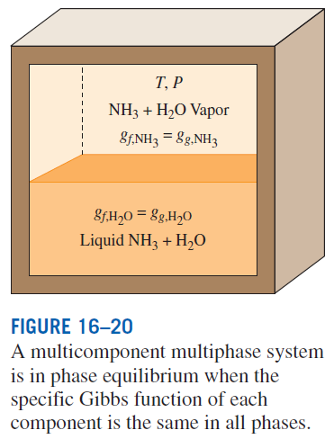
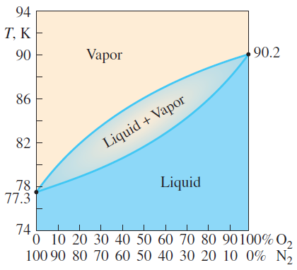
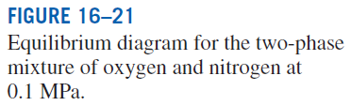
Phase Equilibrium for a Multicomponent System
For the two phases of a two-component system, the mole fraction of a component is different in different phases. On the diagram shown, the vapor line represents the equilibrium composition of the vapor phase at various temperatures, and the liquid line does the same for the liquid phase.

Slide 27
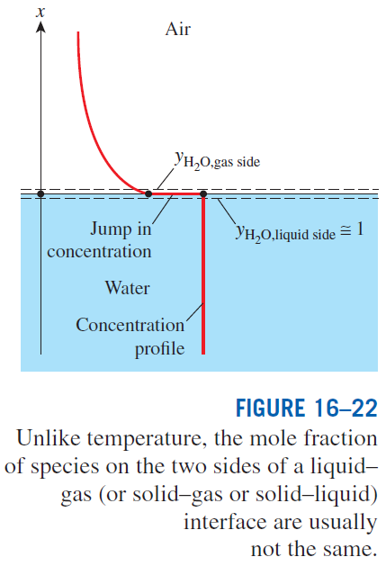
At a given temperature, only a certain amount of solid can be dissolved in a liquid, and the solubility of the solid in the liquid is determined from the requirement that thermodynamic equilibrium exists between the solid and the solution at the interface.
Solubility: The maximum amount of solid that can be dissolved in a liquid at a specified temperature.
Example: The solubility of salt (NaCl) in water at 310 K is 36.5 kg per 100 kg of water (Table 16-1). Therefore, the mass fraction of salt in the saturated brine is simply
whereas the mass fraction of salt in the pure solid salt is mf = 1.0.

Slide 28
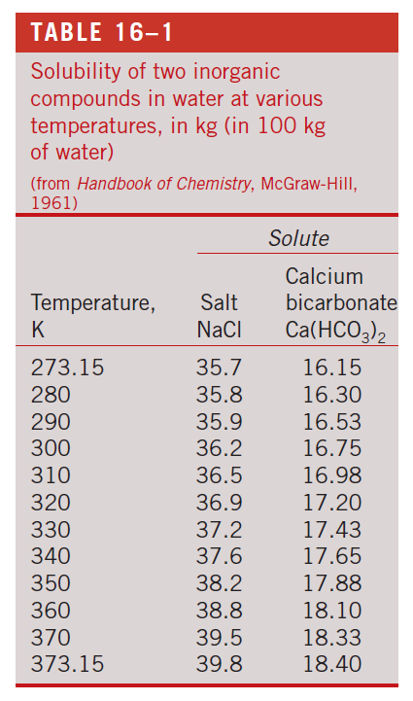

Slide 29
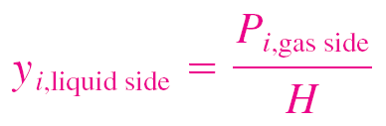
Many processes involve the absorption of a gas into a liquid.
Most gases are weakly soluble in liquids (such as air in water), and for such dilute solutions the mole fractions of a species i in the gas and liquid phases at the interface are observed to be proportional to each other.
That is, y_{i,gas side} ∝ y_{i,liquid side} or P_{i,gas side} ∝ Py_{i,liquid side} since y_{i} = P_{i} /P for ideal-gas mixtures.
This is known as the Henry’s law and is expressed as
where H is the Henry’s constant, which is the product of the total pressure of the gas mixture and the proportionality constant.
For a given species, it is a function of temperature only and is practically independent of pressure for pressures under about 5 atm.

Slide 30
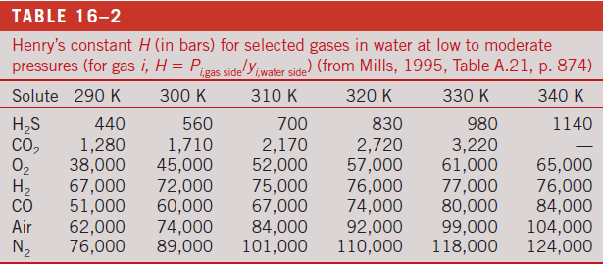

From the table and Henry’s law:
1. The concentration of a gas dissolved in a liquid is inversely proportional to Henry’s constant.
2. The Henry’s constant increases (and thus the fraction of a dissolved gas in the liquid decreases) with increasing temperature.
3. The concentration of a gas dissolved in a liquid is proportional to the partial pressure of the gas. Therefore, the amount of gas dissolved in a liquid can be increased by increasing the pressure of the gas (e.g., the carbonation of soft drinks with CO₂ gas).

Slide 31
When the gas is highly soluble in the liquid (or solid), such as ammonia in water, the linear relationship of Henry’s law does not apply, and the mole
fraction of a gas dissolved in the liquid (or solid) is usually expressed as a
function of the partial pressure of the gas in the gas phase and the temperature.
An approximate relation in this case for the mole fractions of a species
on the liquid and gas sides of the interface is given by Raoult’s law as
P_{i,sat}(T) = the saturation pressure of the species i at the interface temperature
P_{total} = the total pressure on the gas phase side
The molar density of the gas species i in the solid at the interface is proportional to the partial pressure of the species i in the gas on the gas side of the interface and is expressed as
solubility
The product of solubility of a gas and the diffusion coefficient of the gas in a solid is referred to as the permeability, which is a measure of the ability of the gas to penetrate a solid. Permeability is inversely proportional to thickness.

Slide 32


Slide 33






Slide 34





Slide 35





Slide 36
Summary
Criterion for chemical equilibrium
The equilibrium constant for ideal-gas mixtures
Some remarks about the K_{P} of ideal-gas mixtures
Chemical equilibrium for simultaneous reactions
Variation of K_{P} with temperature
Phase equilibrium
  Phase equilibrium for a single-component system
  The phase rule
  Phase equilibrium for a multicomponent system

