Slide 1
CHAPTER 17
COMPRESSIBLE FLOW
Thermodynamics: An Engineering Approach
8th Edition
Yunus A. Çengel, Michael A. Boles
McGraw-Hill, 2015
Lecture slides by
Mehmet Kanoglu
Copyright © The McGraw-Hill Education. Permission required for reproduction or display.

Slide 2
Objectives
Develop the general relations for compressible flows encountered when gases flow at high speeds.
Introduce the concepts of stagnation state, speed of sound, and Mach number for a compressible fluid.
Develop the relationships between the static and stagnation fluid properties for isentropic flows of ideal gases.
Derive the relationships between the static and stagnation fluid properties as functions of specific-heat ratios and Mach number.
Derive the effects of area changes for one-dimensional isentropic subsonic and supersonic flows.
Solve problems of isentropic flow through converging and converging–diverging nozzles.
Discuss the shock wave and the variation of flow properties across the shock wave.
Develop the concept of duct flow with heat transfer and negligible friction known as Rayleigh flow.
Examine the operation of steam nozzles commonly used in steam turbines.

Slide 3
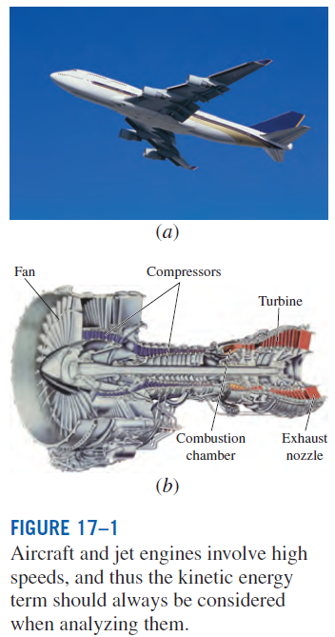
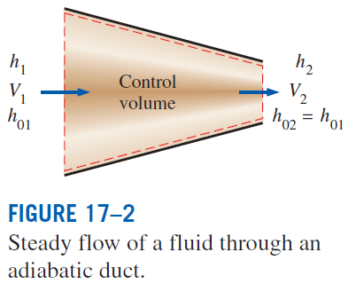
STAGNATION PROPERTIES
Stagnation (or total) enthalpy
Static enthalpy: the ordinary enthalpy h
Energy balance (with no heat or work interaction, no change in potential energy):

Slide 4

If the fluid were brought to a complete stop, the energy balance becomes
Stagnation enthalpy: The enthalpy of a fluid when it is brought to rest adiabatically.
During a stagnation process, the kinetic energy of a fluid is converted to enthalpy, which results in an increase in the fluid temperature and pressure.
The properties of a fluid at the stagnation state are called stagnation properties (stagnation temperature, stagnation pressure, stagnation density, etc.).
The stagnation state is indicated by the subscript 0.

Slide 5
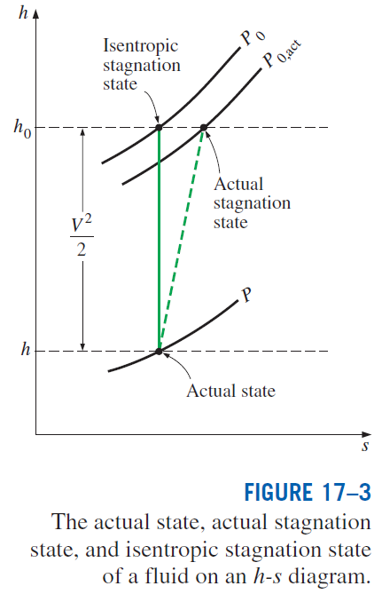
Isentropic stagnation state: When the stagnation process is reversible as well as adiabatic (i.e., isentropic).
The stagnation processes are often approximated to be isentropic, and the isentropic stagnation properties are simply referred to as stagnation properties.
When the fluid is approximated as an ideal gas with constant specific heats
T₀ is called the stagnation (or total) temperature, and it represents the temperature an ideal gas attains when it is brought to rest adiabatically.
The term V²/2c_{p} corresponds to the temperature rise during such a process and is called the dynamic temperature.

Slide 6
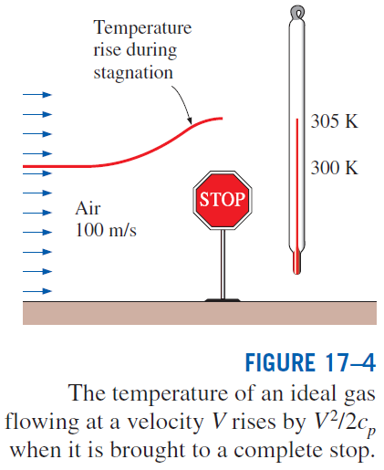
The pressure a fluid attains when brought to rest isentropically is called the stagnation pressure P₀.
Stagnation density ρ₀
When stagnation enthalpies are used, the energy balance for a single-stream, steady-flow device
When the fluid is approximated as an ideal gas with constant specific heats

Slide 7
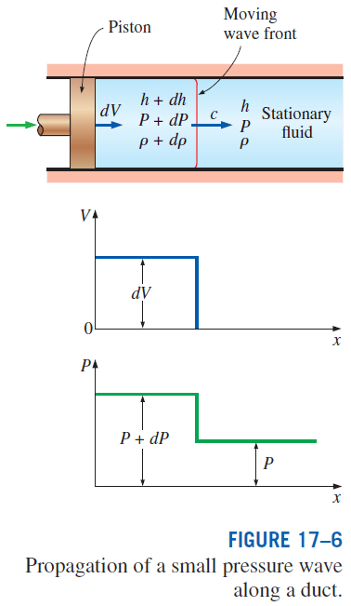
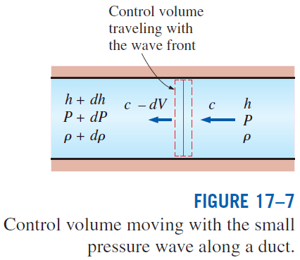
SPEED OF SOUND AND MACH NUMBER
Speed of sound (or the sonic speed): The speed at which an infinitesimally small pressure wave travels through a medium.
To obtain a relation for the speed of sound in a medium, the systems in the figures are considered.

Slide 8
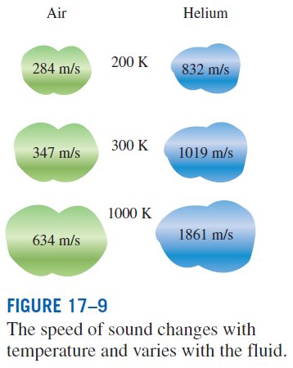

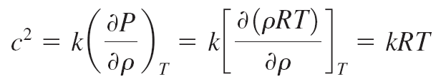
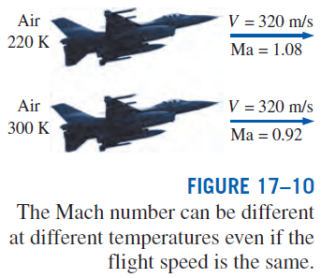
Speed of sound
For an ideal gas
Mach number
Ma = 1 Sonic flow
Ma < 1 Subsonic flow
Ma > 1 Supersonic flow
Ma >> 1 Hypersonic flow
Ma ≅ 1 Transonic flow

Slide 9
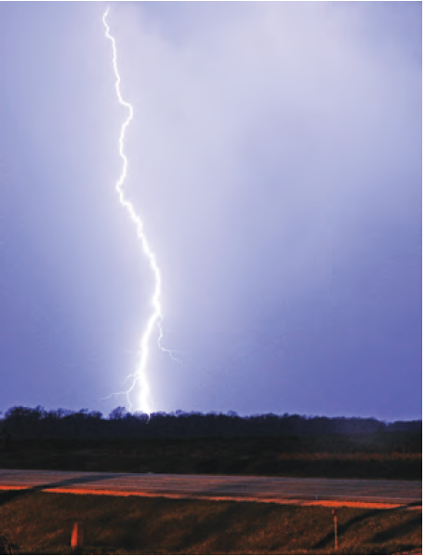
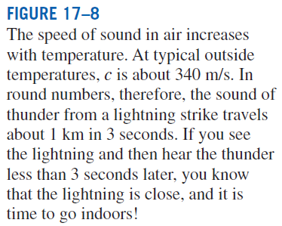

Slide 10
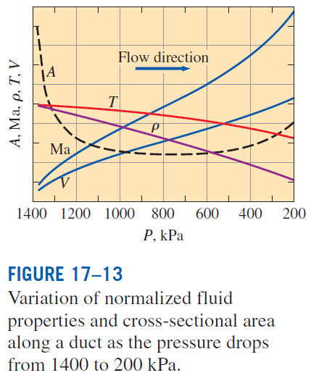
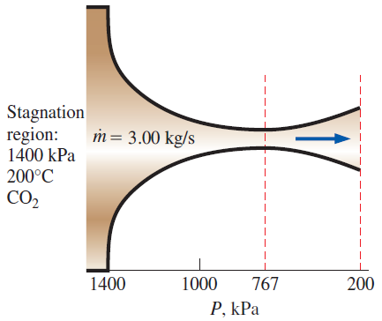
ONE-DIMENSIONAL ISENTROPIC FLOW
During fluid flow through many devices such as nozzles, diffusers, and turbine
blade passages, flow quantities vary primarily in the flow direction only, and the flow can be approximated as one-dimensional isentropic flow with good accuracy.
EXAMPLE
A converging–diverging nozzle.

Slide 11
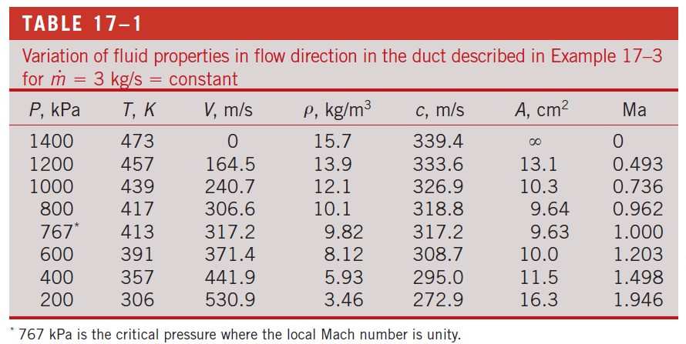

Slide 12
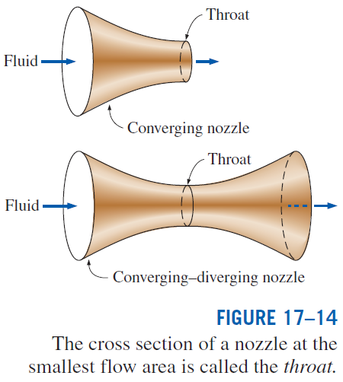
We note from Example that the flow area decreases with decreasing pressure up to a critical-pressure value (Ma = 1), and then it begins to increase with further reductions in pressure.
The Mach number is unity at the location of smallest flow area, called the throat.
The velocity of the fluid keeps increasing after passing the throat although the flow area increases rapidly in that region.
This increase in velocity past the throat is due to the rapid decrease in the fluid density.
The flow area of the duct considered in this example first decreases and then increases. Such ducts are called converging–diverging nozzles.
These nozzles are used to accelerate gases to supersonic speeds and should not be confused with Venturi nozzles, which are used strictly for incompressible flow.

Slide 13
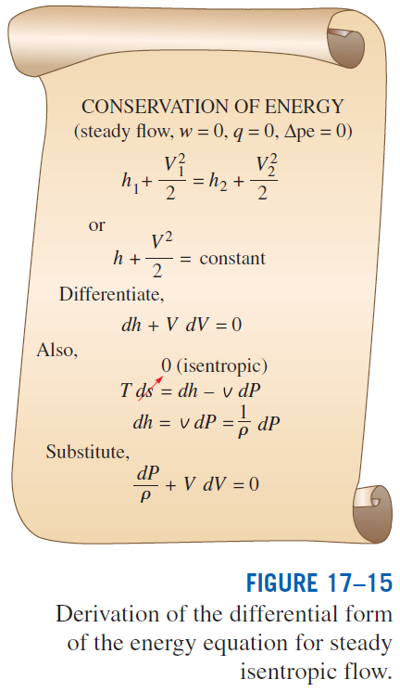
Variation of Fluid Velocity with Flow Area
In this section, the relations for the variation of static-to-stagnation property ratios with the Mach number for pressure, temperature, and density are provided.
This relation describes the variation of pressure with flow area.
At subsonic velocities, the pressure decreases in converging ducts (subsonic nozzles) and increases in diverging ducts (subsonic diffusers).
At supersonic velocities, the pressure decreases in diverging ducts (supersonic nozzles) and increases in converging ducts (supersonic diffusers).

Slide 14
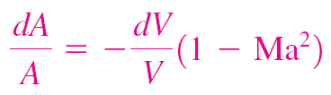
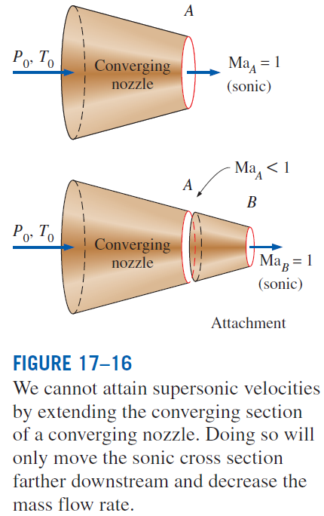
This equation governs the shape of a nozzle or a diffuser in subsonic or supersonic isentropic flow.
The proper shape of a nozzle depends on the highest velocity desired relative to the sonic velocity.
To accelerate a fluid, we must use a converging nozzle at subsonic velocities and a diverging nozzle at supersonic velocities.
To accelerate a fluid to supersonic velocities, we must use a converging–diverging nozzle.

Slide 15
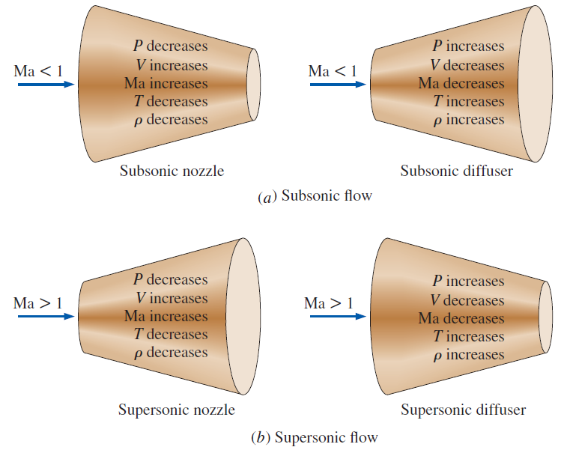
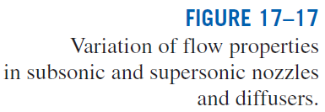

Slide 16
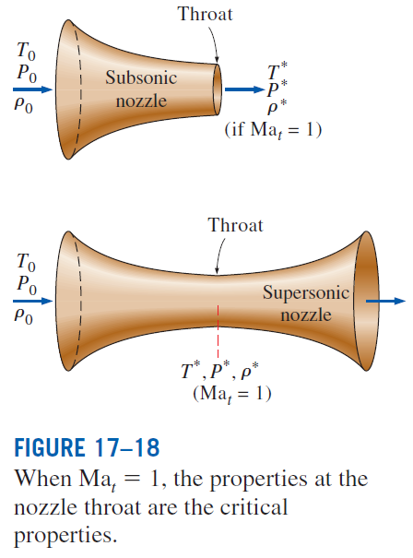
Property Relations for Isentropic Flow of Ideal Gases
The relations between the static properties and stagnation properties of an ideal gas with constant specific heats
Critical ratios (Ma=1)

Slide 17
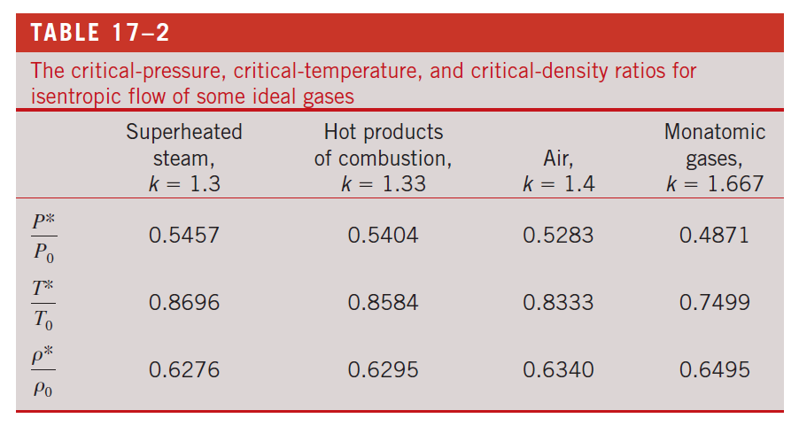

Slide 18
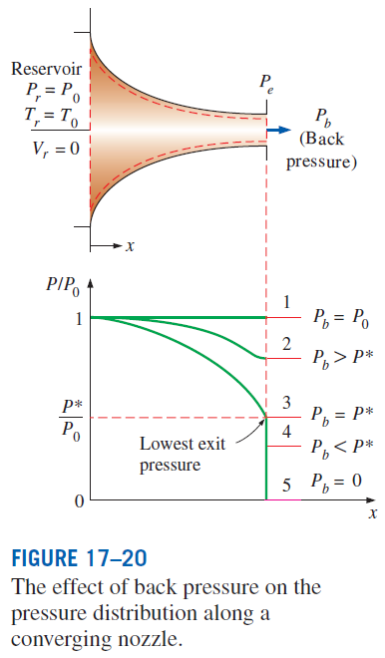
ISENTROPIC FLOW THROUGH NOZZLES
Converging or converging–diverging nozzles are found in steam and gas turbines and aircraft and spacecraft propulsion systems.
In this section we consider the effects of back pressure (i.e., the pressure applied at the nozzle discharge region) on the exit velocity, the mass flow rate, and the pressure distribution along the nozzle.
Converging Nozzles
Mass flow rate through a nozzle
Maximum mass flow rate

Slide 19
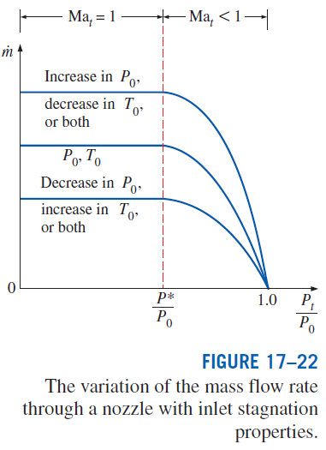
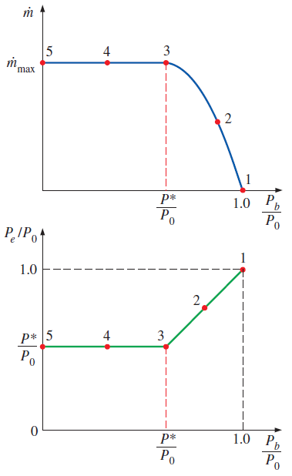
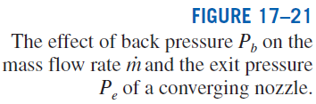

Slide 20
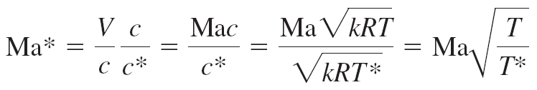
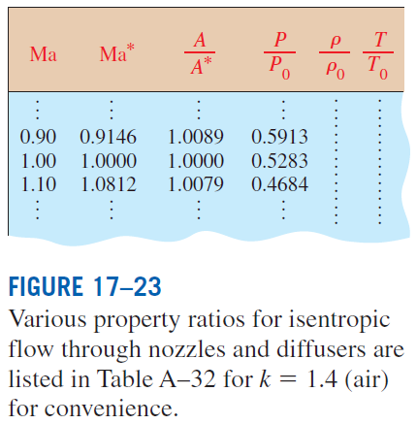
Ma* is the local velocity nondimensionalized with respect to the sonic velocity at the throat.
Ma is the local velocity nondimensionalized with respect to the local sonic velocity.

Slide 21
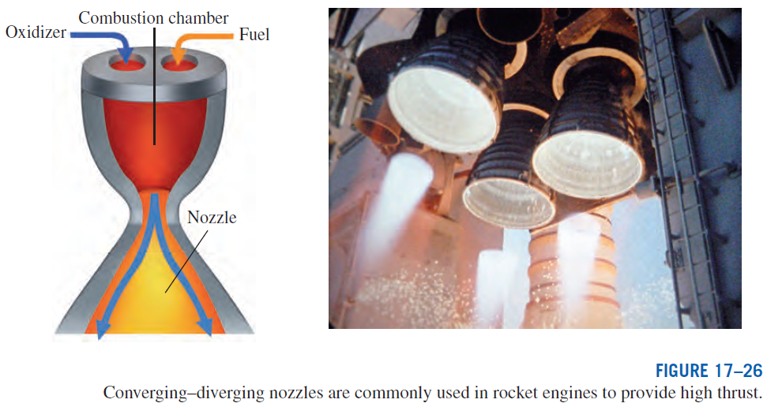
Converging–Diverging Nozzles
The highest velocity in a converging nozzle is limited to the sonic velocity (Ma = 1), which occurs at the exit plane (throat) of the nozzle.
Accelerating a fluid to supersonic velocities (Ma > 1) can be accomplished only by attaching a diverging flow section to the subsonic nozzle at the throat (a converging–diverging nozzle), which is standard equipment in supersonic aircraft and rocket propulsion.

Slide 22
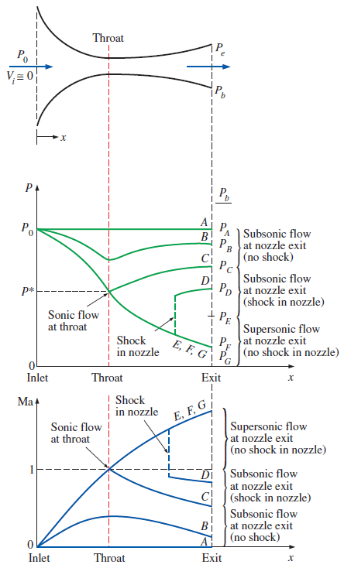
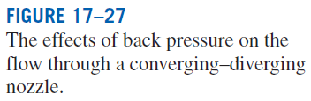
When P_{b} = P₀ (case A), there will be no flow through the nozzle.
1. When P₀ > P_{b} > P_{C}, the flow remains subsonic throughout the nozzle, and the mass flow is less than that for choked flow. The fluid velocity increases in the first (converging) section and reaches a maximum at the throat (but Ma < 1). However, most of the gain in velocity is lost in the second (diverging) section of the nozzle, which acts as a diffuser. The pressure decreases in the converging section, reaches a minimum at the throat, and increases at the expense of velocity in the diverging section.

Slide 23
2. When P_{b} = P_{C}, the throat pressure becomes P* and the fluid achieves sonic velocity at the throat. But the diverging section of the nozzle still acts as a diffuser, slowing the fluid to subsonic velocities. The mass flow rate that was increasing with decreasing P_{b} also reaches its maximum value.
3. When P_{C} > P_{b} > P_{E}, the fluid that achieved a sonic velocity at the throat continues accelerating to supersonic velocities in the diverging section as the pressure decreases. This acceleration comes to a sudden stop, however, as a normal shock develops at a section between the throat and the exit plane, which causes a sudden drop in velocity to subsonic levels and a sudden increase in pressure. The fluid then continues to decelerate further in the remaining part of the converging–diverging nozzle.

Slide 24
4. When P_{E} > Pb > 0, the flow in the diverging section is supersonic, and the fluid expands to P_{F} at the nozzle exit with no normal shock forming within the nozzle. Thus, the flow through the nozzle can be approximated as isentropic.
When P_{b} = P_{F}, no shocks occur within or outside the nozzle.
When P_{b} < P_{F}, irreversible mixing and expansion waves occur downstream of the exit plane of the nozzle.
When P_{b} > P_{F}, however, the pressure of the fluid increases from P_{F} to P_{b} irreversibly in the wake of the nozzle exit, creating what are called oblique shocks.

Slide 25
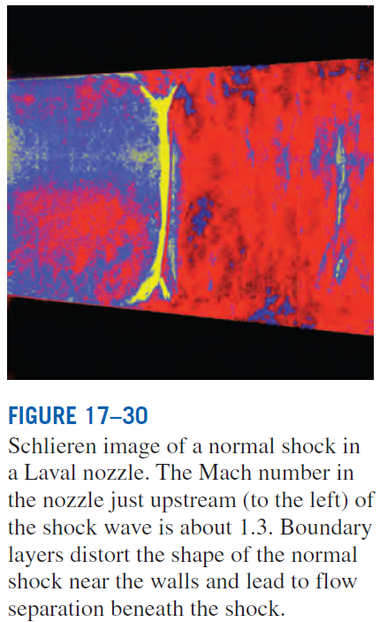
SHOCK WAVES AND EXPANSION WAVES
For some back pressure values, abrupt changes in fluid properties occur in a very thin section of a converging–diverging nozzle under supersonic flow conditions, creating a shock wave.
We study the conditions under which shock waves develop and how they affect the flow.
Normal Shocks
Normal shock waves: The shock waves that occur in a plane normal to the direction of flow. The flow process through the shock wave is highly irreversible.

Slide 26

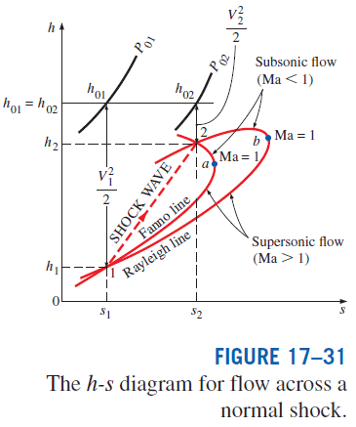
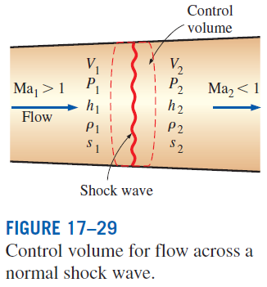
Conservation of mass
Fanno line: Combining the conservation of mass and energy relations into a single equation and plotting it on an h-s diagram yield a curve. It is the locus of states that have the same value of stagnation enthalpy and mass flux.
Rayleigh line: Combining the conservation of mass and momentum equations into a single equation and plotting it on the h-s diagram yield a curve.
Conservation of energy
Conservation of momentum
Increase of entropy

Slide 27
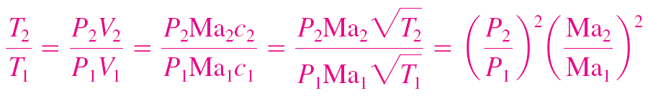
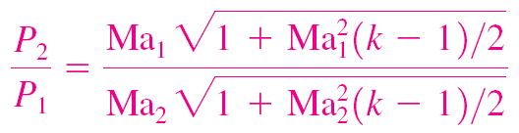
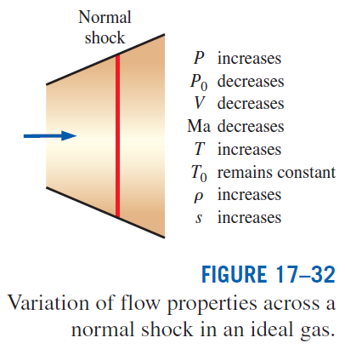
The relations between various properties before and after the shock for an ideal gas with constant specific heats.
Various flow property ratios across the shock are listed in Table A–33.
This represents the intersections of the Fanno and Rayleigh lines.

Slide 28
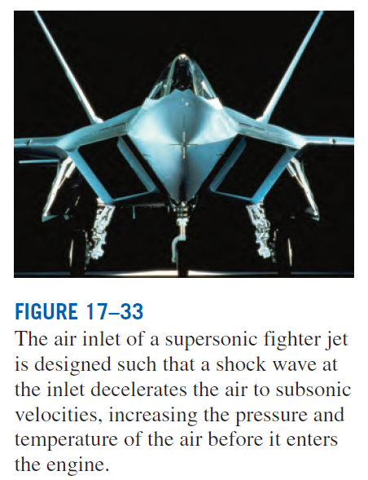

Slide 29
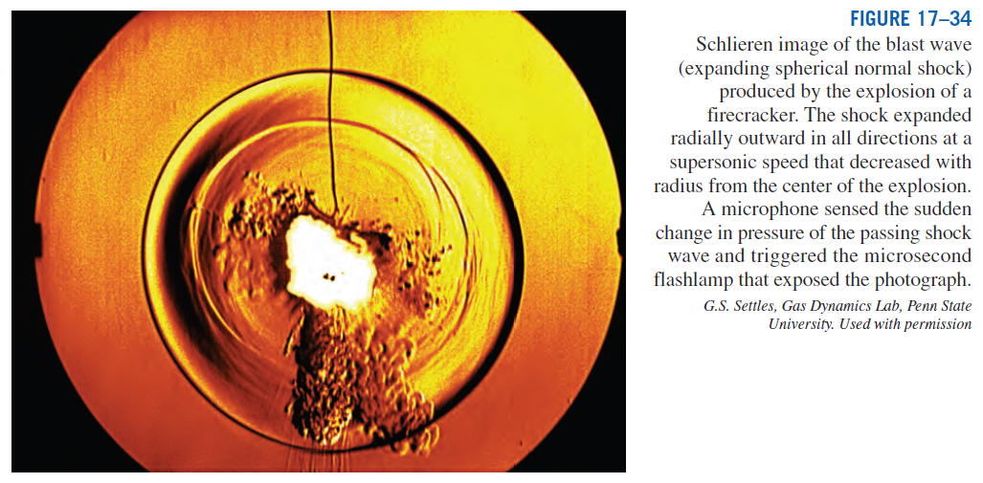

Slide 30
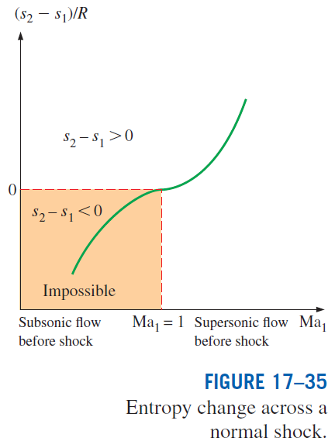
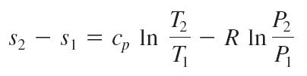
Since the flow across the shock is adiabatic and irreversible, the second law requires that the entropy increase across the shock wave.
Thus, a shock wave cannot exist for values of Ma₁ less than unity where the entropy change would be negative.
For adiabatic flows, shock waves can exist only for supersonic flows, Ma₁ > 1.

Slide 31


Slide 32
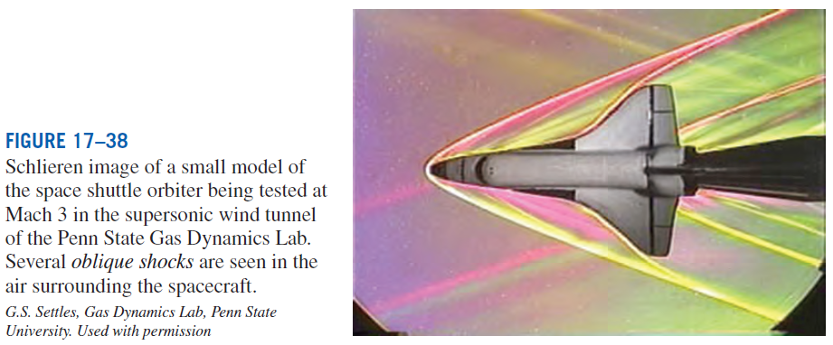
Oblique Shocks
When the space shuttle travels at supersonic speeds through the atmosphere, it produces a complicated shock pattern consisting of inclined shock waves called oblique shocks.
Some portions of an oblique shock are curved, while other portions are straight.

Slide 33
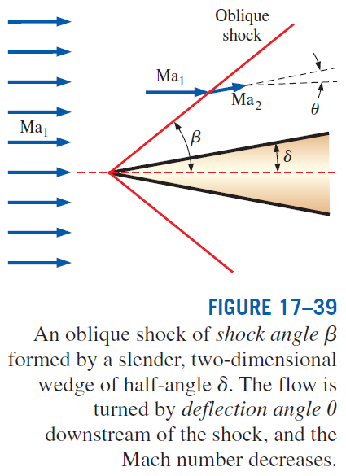
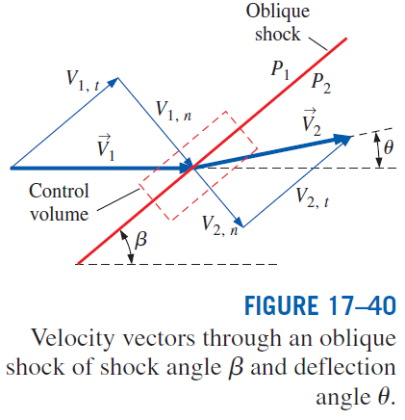
Unlike normal shocks, in which the downstream Mach number is always subsonic, Ma₂ downstream of an oblique shock can be subsonic, sonic, or supersonic, depending on the upstream Mach number Ma₁ and the turning angle.

Slide 34
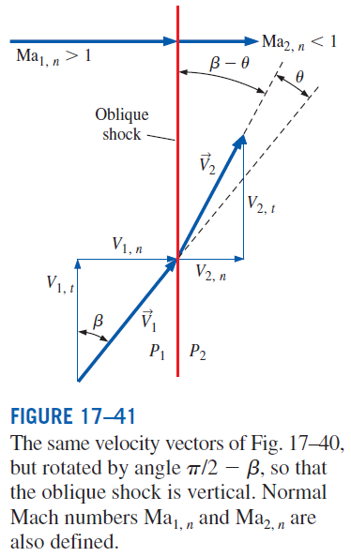
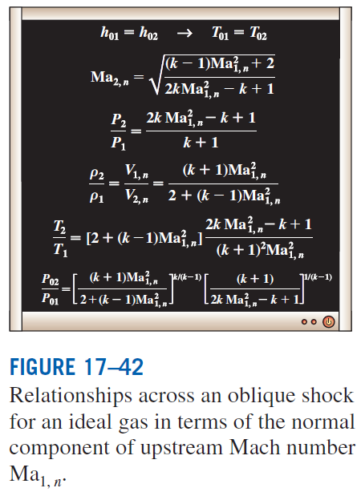
All the equations, shock tables, etc., for normal shocks apply to oblique shocks as well, provided that we use only the normal components of the Mach number.

Slide 35
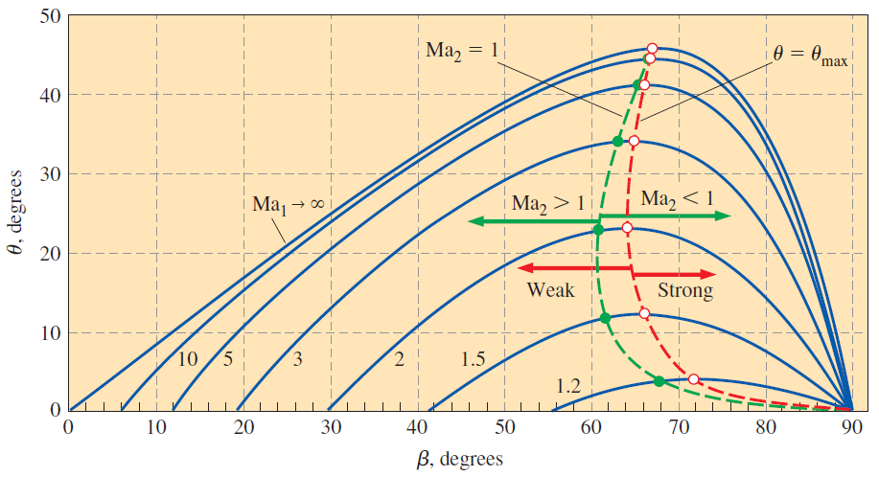
The dependence of straight oblique shock deflection angle θ on shock angle β for several values of upstream Mach number Ma₁. Calculations are for an ideal gas with k = 1.4. The dashed black line connects points of maximum deflection angle (θ = θ _{max}). Weak oblique shocks are to the left of this line, while strong oblique shocks are to the right of this line. The dashed gray line connects points where the downstream Mach number is sonic (Ma₂ = 1). Supersonic downstream flow (Ma₂ > 1) is to the left of this line, while subsonic downstream flow (Ma₂ < 1) is to the right of this line.

Slide 36
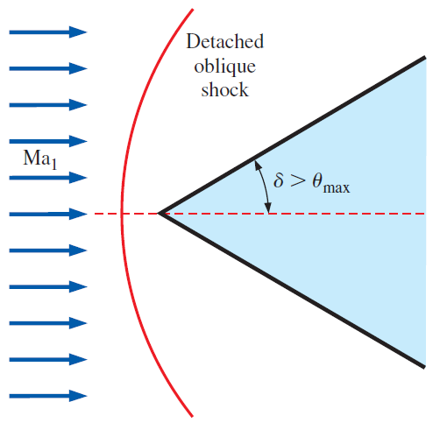
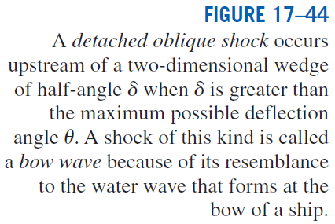

Slide 37
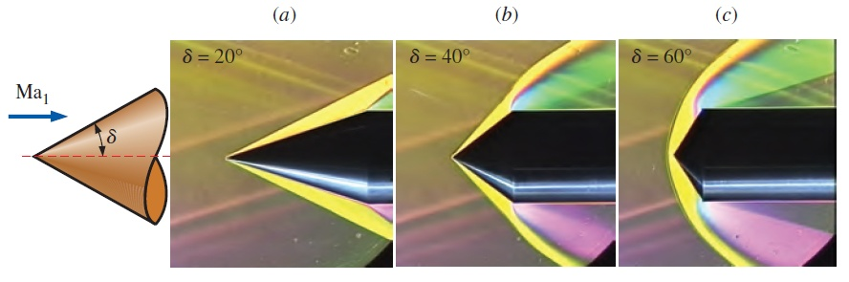


Mach angle

Slide 38



Slide 39

Prandtl–Meyer Expansion Waves
We now address situations where supersonic flow is turned in the opposite direction, such as in the upper portion of a two-dimensional wedge at an angle of attack greater than its half-angle δ.
We refer to this type of flow as an expanding flow, whereas a flow that produces an oblique shock may be called a compressing flow.
As previously, the flow changes direction to conserve mass. However, unlike a compressing flow, an expanding flow does not result in a shock wave.
Rather, a continuous expanding region called an expansion fan appears, composed of an infinite number of Mach waves called Prandtl–Meyer expansion waves.

Slide 40

Prandtl–Meyer function

Slide 41




Slide 42

DUCT FLOW WITH HEAT TRANSFER AND NEGLIGIBLE FRICTION (RAYLEIGH FLOW)
So far we have limited our consideration mostly to isentropic flow (no heat transfer and no irreversibilities such as friction).
Many compressible flow problems encountered in practice involve chemical reactions such as combustion, nuclear reactions, evaporation, and condensation as well as heat gain or heat loss through the duct wall.
Such problems are difficult to analyze exactly since they may involve significant changes in chemical composition during flow, and the conversion of latent, chemical, and nuclear energies to thermal energy.
A simplified model is Rayleigh flow.
Rayleigh flows: Steady one-dimensional flow of an ideal gas with constant specific heats through a constant-area duct with heat transfer, but with negligible friction.

Slide 43


Mass equation
x-Momentum equation
Energy equation
Entropy change
Equation of state
Consider a gas with known properties R, k, and c_{p}. For a specified inlet state 1, the inlet properties P₁, T₁, ρ₁, V₁, and s₁ are known. The five exit properties P₂, T₂, ρ₂, V₂, and s₂ can be determined from the above equations for any specified value of heat transfer q.

Slide 44

From the Rayleigh line and the equations
All the states that satisfy the conservation of mass, momentum, and energy equations as well as the property relations are on the Rayleigh line.
Entropy increases with heat gain, and thus we proceed to the right on the Rayleigh line as heat is transferred to the fluid.
Heating increases the Mach number for subsonic flow, but decreases it for supersonic flow.
Heating increases the stagnation temperature T₀ for both subsonic and supersonic flows, and cooling decreases it.
Velocity and static pressure have opposite trends.
Density and velocity are inversely proportional.
The entropy change corresponding to a specified temperature change (and thus a given amount of heat transfer) is larger in supersonic flow.

Slide 45



Heating or cooling has opposite effects on most properties. Also, the stagnation pressure decreases during heating and increases during cooling regardless of whether the flow is subsonic or supersonic.

Slide 46


Slide 47


Property Relations for Rayleigh Flow
Representative results are given in Table A–34.

Slide 48




Choked Rayleigh Flow
The fluid at the critical state of Ma =1 cannot be accelerated to supersonic velocities by heating. Therefore, the flow is choked.
For a given inlet state, the corresponding critical state fixes the maximum possible heat transfer for steady flow:

Slide 49

STEAM NOZZLES
Water vapor at moderate or high pressures deviates considerably from ideal-gas behavior, and thus most of the relations developed in this chapter are not applicable to the flow of steam through the nozzles or blade passages encountered in steam turbines.
Supersaturated steam: The steam that exists in the wet region without containing any liquid.
Supersaturation states are nonequilibrium (or metastable) states.
Wilson line: The locus of points where condensation takes place regardless of the initial temperatureand pressure at the nozzle entrance.
When steam is assumed ideal gas with k = 1.3

Slide 50
Summary
Stagnation properties
Speed of sound and Mach number
One-dimensional isentropic flow
  Variation of fluid velocity with flow area
  Property relations for isentropic flow of ideal gases
Isentropic flow through nozzles
  Converging nozzles
  Converging–diverging nozzles
Shock waves and expansion waves
  Normal shocks
  Oblique shocks
  Prandtl–Meyer expansion waves
Duct flow with heat transfer and negligible friction (Rayleigh flow)
  Property relations for Rayleigh flow
  Choked Rayleigh flow
Steam nozzles

