Slide 1
CHAPTER 1
INTRODUCTION AND
BASIC CONCEPTS
Thermodynamics: An Engineering Approach
8th Edition
Yunus A. Çengel, Michael A. Boles
McGraw-Hill, 2015
Lecture slides by
Mehmet Kanoglu
Copyright © The McGraw-Hill Education. Permission required for reproduction or display.

Slide 2
Objectives
Identify the unique vocabulary associated with thermodynamics through the precise definition of basic concepts to form a sound foundation for the development of the principles of thermodynamics.
Review the metric SI and the English unit systems.
Explain the basic concepts of thermodynamics such as system, state, state postulate, equilibrium, process, and cycle.
Review concepts of temperature, temperature scales, pressure, and absolute and gage pressure.
Introduce an intuitive systematic problem-solving technique.

Slide 3
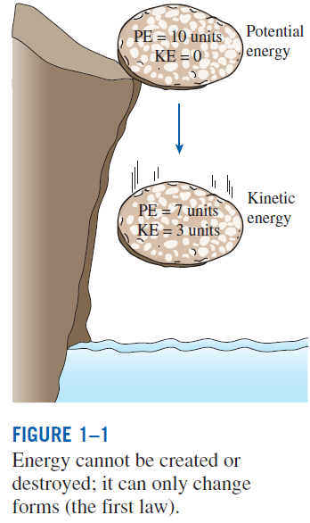
THERMODYNAMICS AND ENERGY
Thermodynamics: The science of energy.
Energy: The ability to cause changes.
The name thermodynamics stems from the Greek words therme (heat) and dynamis (power).
Conservation of energy principle: During an interaction, energy can change from one form to another but the total amount of energy remains constant.
Energy cannot be created or destroyed.
The first law of thermodynamics: An expression of the conservation of energy principle.
The first law asserts that energy is a thermodynamic property.

Slide 4
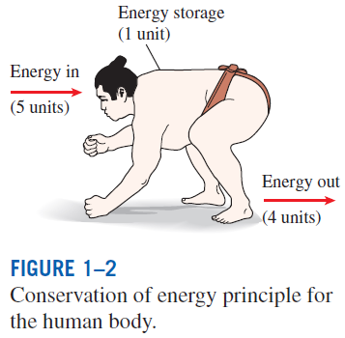
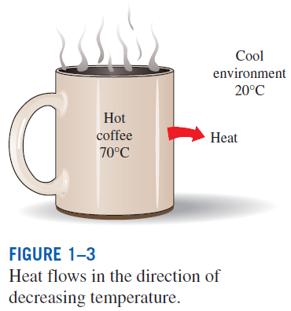
The second law of thermodynamics: It asserts that energy has quality as well as quantity, and actual processes occur in the direction of decreasing quality of energy.
Classical thermodynamics: A macroscopic approach to the study of thermodynamics that does not require a knowledge of the behavior of individual particles.
It provides a direct and easy way to the solution of engineering problems and it is used in this text.
Statistical thermodynamics: A microscopic approach, based on the average behavior of large groups of individual particles.
It is used in this text only in the supporting role.

Slide 5
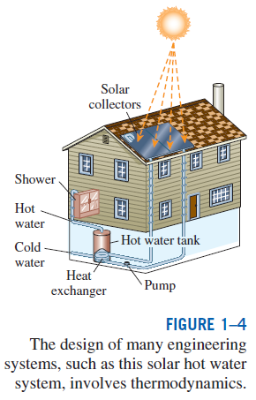
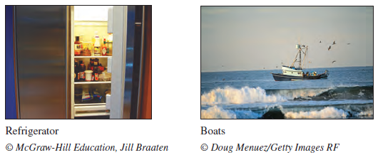
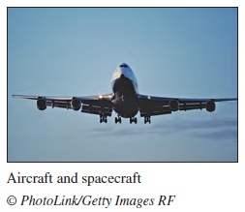
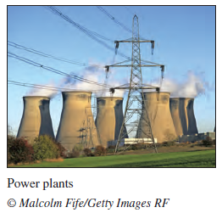
Application Areas of Thermodynamics
All activities in nature involve some interaction between energy and matter; thus, it is hard to imagine an area that does not relate to thermodynamics in some manner.

Slide 6
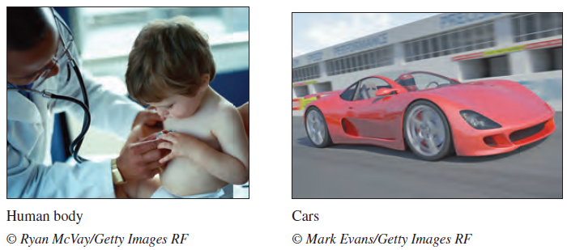
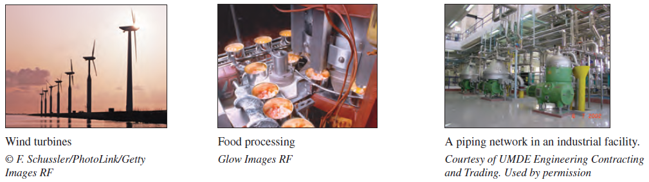

Slide 7
IMPORTANCE OF DIMENSIONS AND UNITS
Any physical quantity can be characterized by dimensions.
The magnitudes assigned to the dimensions are called units.
Some basic dimensions such as mass m, length L, time t, and temperature T are selected as primary or fundamental dimensions, while others such as velocity V, energy E, and volume V are expressed in terms of the primary dimensions and are called secondary dimensions, or derived dimensions.
Metric SI system: A simple and logical system based on a decimal relationship between the various units.
English system: It has no apparent systematic numerical base, and various units in this system are related to each other rather arbitrarily.

Slide 8
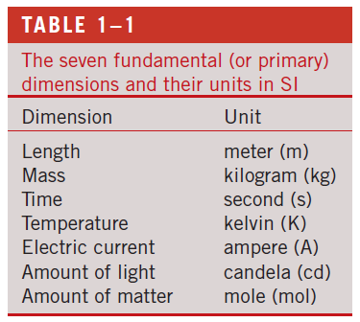
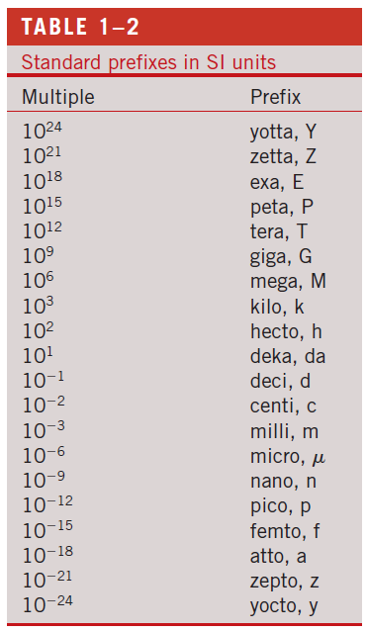

Slide 9
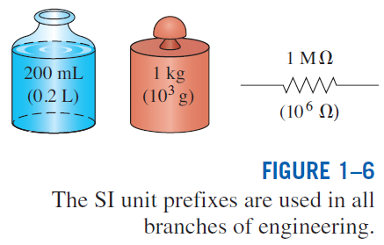

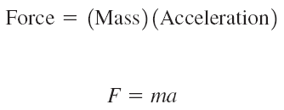
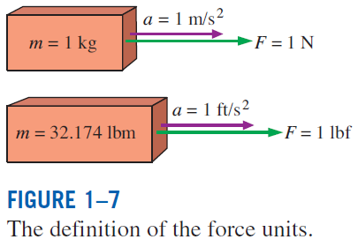

Some SI and English Units
Work = Force × Distance
1 J = 1 N∙m
1 cal = 4.1868 J
1 Btu = 1.0551 kJ

Slide 10
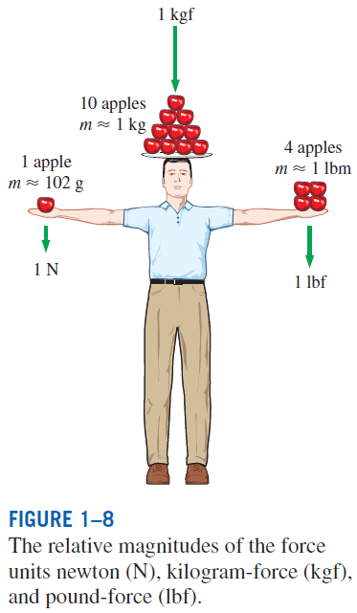
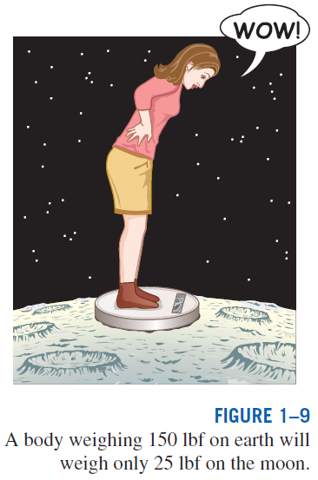

W weight
m mass
g gravitational acceleration

Slide 11
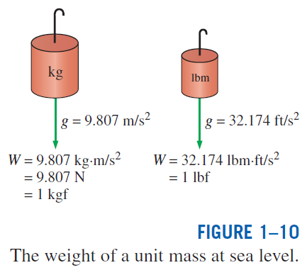
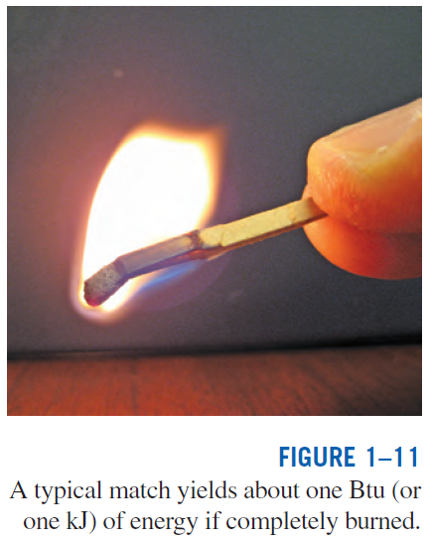

Specific weight γ: The weight of a unit volume of a substance.

Slide 12
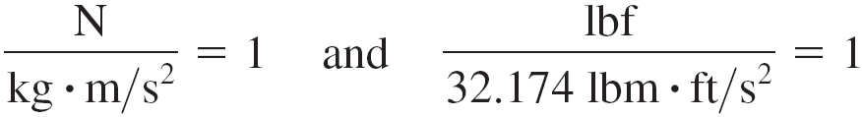
Unity Conversion Ratios
Dimensional homogeneity
All equations must be dimensionally homogeneous.
All nonprimary units (secondary units) can be formed by combinations of primary units.
Force units, for example, can be expressed as
They can also be expressed more conveniently as unity conversion ratios as
Unity conversion ratios are identically equal to 1 and are unitless, and thus such ratios (or their inverses) can be inserted conveniently into any calculation to properly convert units.

Slide 13
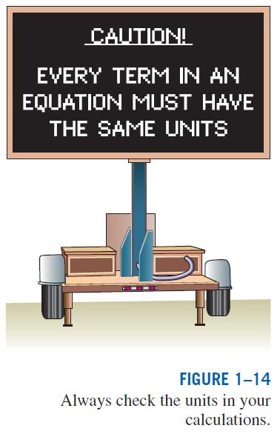
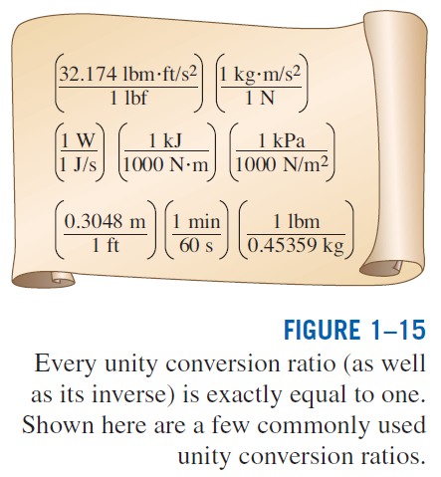

Slide 14
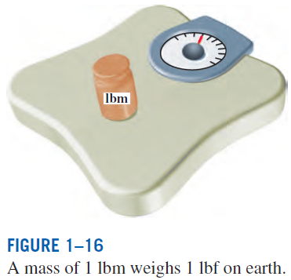
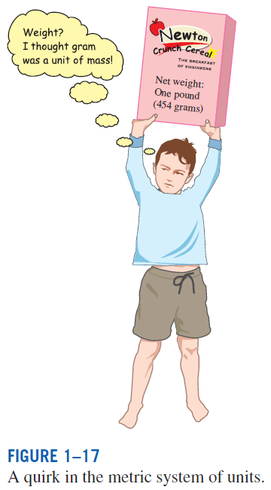


Slide 15
SYSTEMS AND CONTROL VOLUMES
System: A quantity of matter or a region in space chosen for study.
Surroundings: The mass or region outside the system
Boundary: The real or imaginary surface that separates the system from its surroundings.
The boundary of a system can be fixed or movable.
Systems may be considered to be closed or open.
Closed system (Control mass): A fixed amount of mass, and no mass can cross its boundary

Slide 16
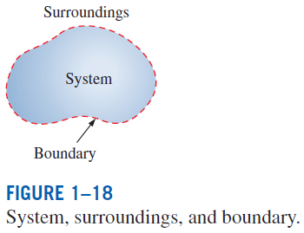
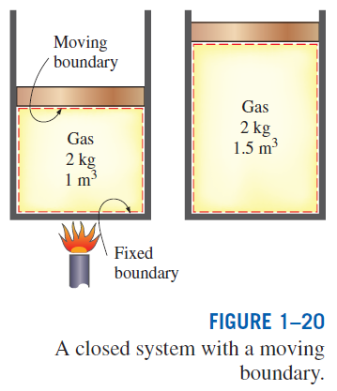
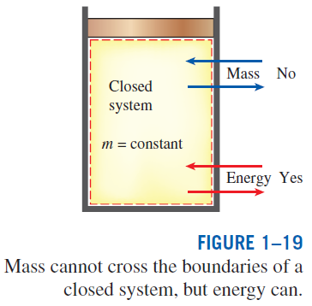

Slide 17
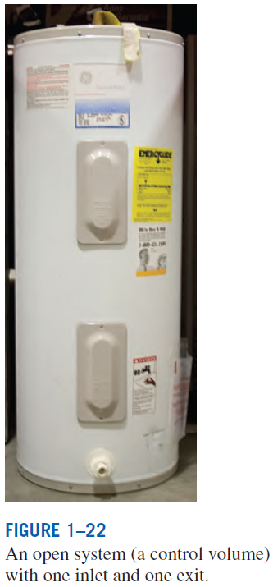
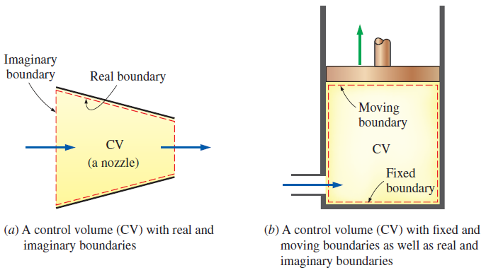
Open system (control volume): A properly selected region in space.
It usually encloses a device that involves mass flow such as a compressor, turbine, or nozzle.
Both mass and energy can cross the boundary of a control volume.
Control surface: The boundaries of a control volume. It can be real or imaginary.
A control volume can involve fixed, moving, real, and imaginary boundaries.

Slide 18
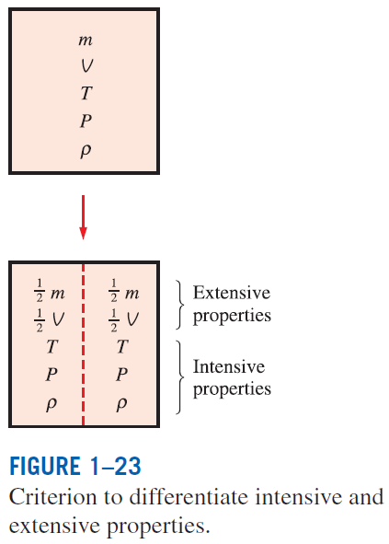


PROPERTIES OF A SYSTEM
Property: Any characteristic of a system.
Some familiar properties are pressure P, temperature T, volume V, and mass m.
Properties are considered to be either intensive or extensive.
Intensive properties: Those that are independent of the mass of a system, such as temperature, pressure, and density.
Extensive properties: Those whose values depend on the size—or extent—of the system.
Specific properties: Extensive properties per unit mass.

Slide 19
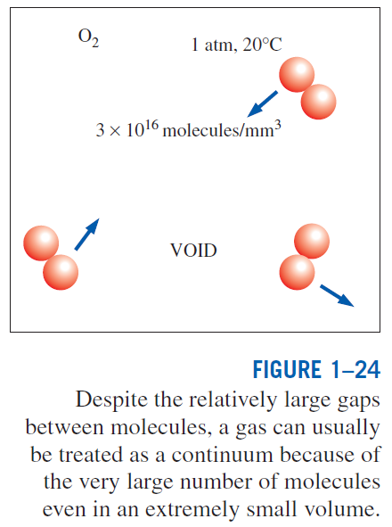
Continuum
Matter is made up of atoms that are widely spaced in the gas phase. Yet it is very convenient to disregard the atomic nature of a substance and view it as a continuous, homogeneous matter with no holes, that is, a continuum.
The continuum idealization allows us to treat properties as point functions and to assume the properties vary continually in space with no jump discontinuities.
This idealization is valid as long as the size of the system we deal with is large relative to the space between the molecules.
This is the case in practically all problems.
In this text we will limit our consideration to substances that can be modeled as a continuum.

Slide 20
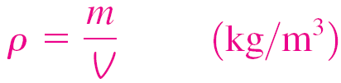
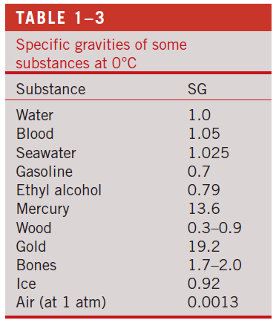
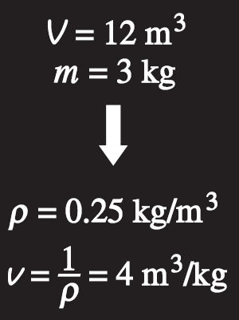

DENSITY AND SPECIFIC GRAVITY
Density
Specific gravity: The ratio of the density of a substance to the density of some standard substance at a specified temperature (usually water at 4°C).
Specific volume
Specific weight: The weight of a unit volume of a substance.
Density is mass per unit volume; specific volume is volume per unit mass.

Slide 21
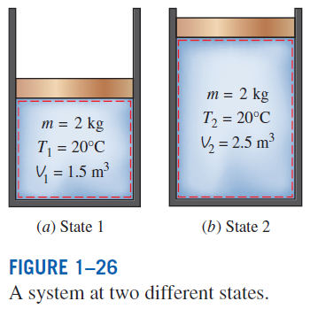
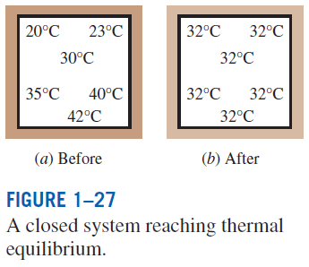
STATE AND EQUILIBRIUM
Thermodynamics deals with equilibrium states.
Equilibrium: A state of balance.
In an equilibrium state there are no unbalanced potentials (or driving forces) within the system.
Thermal equilibrium: If the temperature is the same throughout the entire system.
Mechanical equilibrium: If there is no change in pressure at any point of the system with time.
Phase equilibrium: If a system involves two phases and when the mass of each phase reaches an equilibrium level and stays there.
Chemical equilibrium: If the chemical composition of a system does not change with time, that is, no chemical reactions occur.

Slide 22
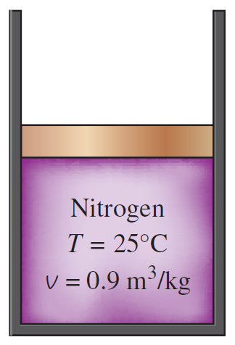
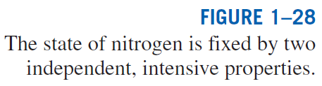
The State Postulate
The number of properties required to fix the state of a system is given by the state postulate:
  The state of a simple compressible system is completely specified by two independent, intensive properties.
Simple compressible system: If a system involves no electrical, magnetic, gravitational, motion, and surface tension effects.

Slide 23
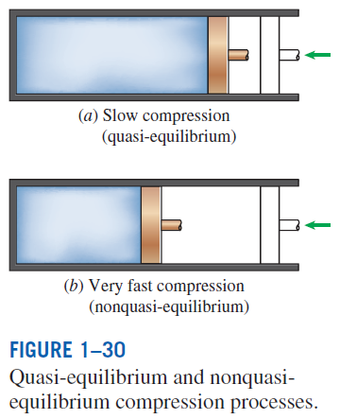
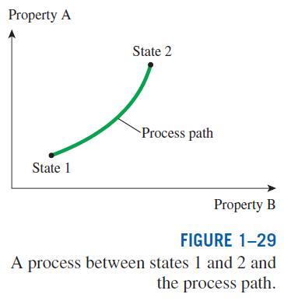
PROCESSES AND CYCLES
Process: Any change that a system undergoes from one equilibrium state to another.
Path: The series of states through which a system passes during a process.
To describe a process completely, one should specify the initial and final states, as well as the path it follows, and the interactions with the surroundings.
Quasistatic or quasi-equilibrium process: When a process proceeds in such a manner that the system remains infinitesimally close to an equilibrium state at all times.

Slide 24
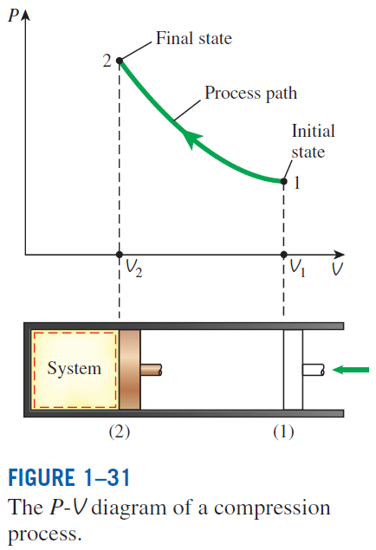
Process diagrams plotted by employing thermodynamic properties as coordinates are very useful in visualizing the processes.
Some common properties that are used as coordinates are temperature T, pressure P, and volume V (or specific volume v).
The prefix iso- is often used to designate a process for which a particularproperty remains constant.
Isothermal process: A process during which the temperature T remains constant.
Isobaric process: A process during which the pressure P remains constant.
Isochoric (or isometric) process: A process during which the specific volume v remains constant.
Cycle: A process during which the initial and final states are identical.

Slide 25
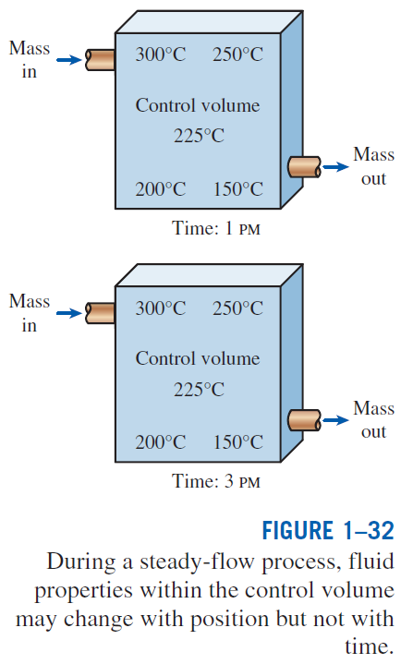
The Steady-Flow Process
The term steady implies no change with time. The opposite of steady is unsteady, or transient.
A large number of engineering devices operate for long periods of time under the same conditions, and they are classified as steady-flow devices.
Steady-flow process: A process during which a fluid flows through a control volume steadily.
Steady-flow conditions can be closely approximated by devices that are intended for continuous operation such as turbines, pumps, boilers, condensers, and heat exchangers or power plants or refrigeration systems.

Slide 26
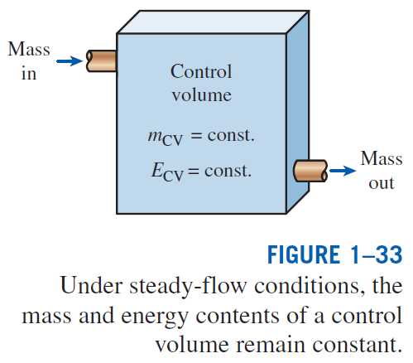

Slide 27
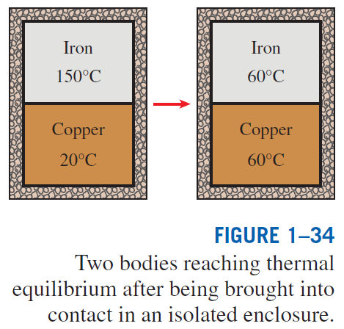
TEMPERATURE AND THE ZEROTH LAW OF THERMODYNAMICS
The zeroth law of thermodynamics: If two bodies are in thermal equilibrium with a third body, they are also in thermal equilibrium with each other.
By replacing the third body with a thermometer, the zeroth law can be restated as two bodies are in thermal equilibrium if both have the same temperature reading even if they are not in contact.

Slide 28
Temperature Scales
All temperature scales are based on some easily reproducible states such as the freezing and boiling points of water: the ice point and the steam point.
Ice point: A mixture of ice and water that is in equilibrium with air saturated with vapor at 1 atm pressure (0°C or 32°F).
Steam point: A mixture of liquid water and water vapor (with no air) in equilibrium at 1 atm pressure (100°C or 212°F).
Celsius scale: in SI unit system
Fahrenheit scale: in English unit system
Thermodynamic temperature scale: A temperature scale that is independent of the properties of any substance.
Kelvin scale (SI) Rankine scale (E)
A temperature scale nearly identical to the Kelvin scale is the ideal-gas temperature scale. The temperatures on this scale are measured using a constant-volume gas thermometer.

Slide 29
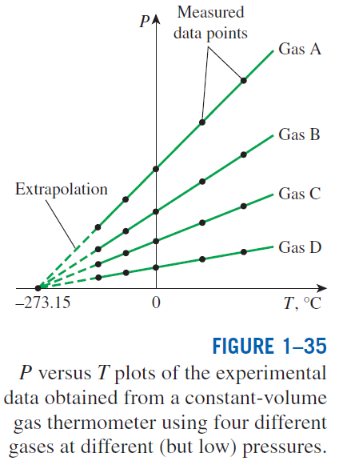
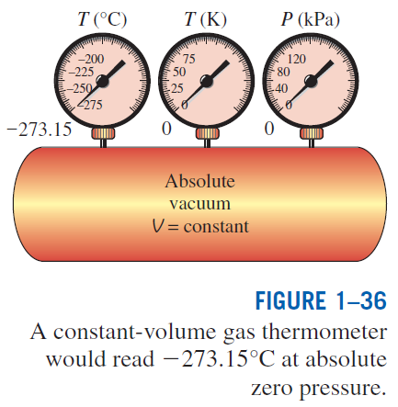

Slide 30
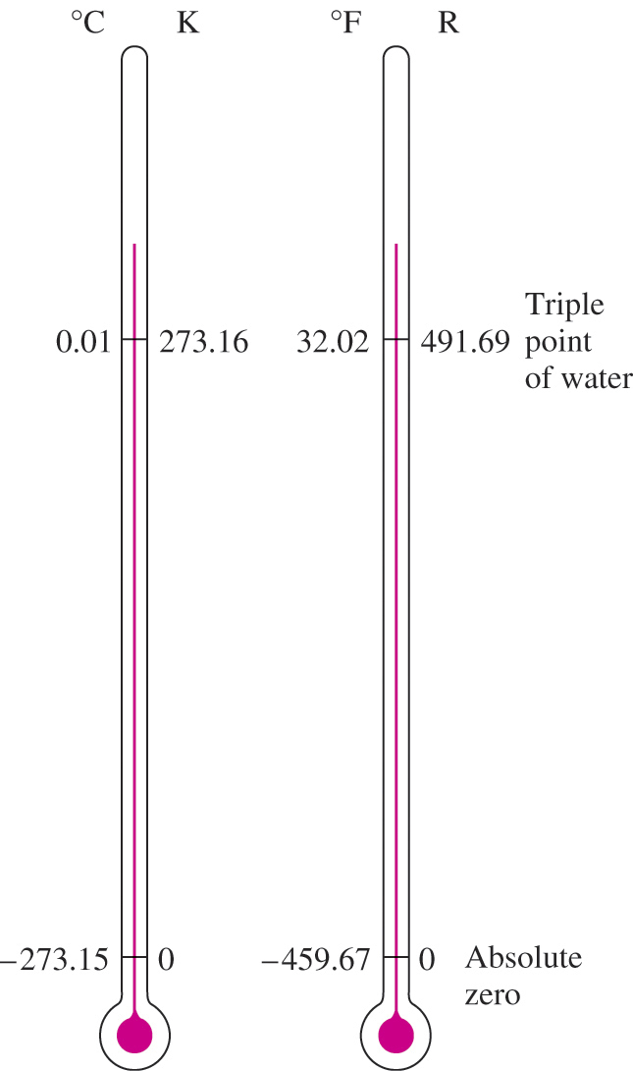
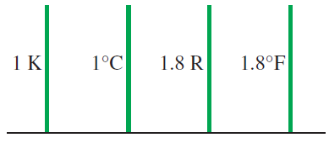
Comparison of temperature scales.
Comparison of magnitudes of various temperature units.
The reference temperature in the original Kelvin scale was the ice point, 273.15 K, which is the temperature at which water freezes (or ice melts).
The reference point was changed to a much more precisely reproducible point, the triple point of water (the state at which all three phases of water coexist in equilibrium), which is assigned the value 273.16 K.

Slide 31
The International Temperature Scale of 1990 (ITS-90)
The International Temperature Scale of 1990 supersedes the International Practical Temperature Scale of 1968 (IPTS-68), 1948 (ITPS-48), and 1927 (ITS-27).
The ITS-90 is similar to its predecessors except that it is more refined with updated values of fixed temperatures, has an extended range, and conforms more closely to the thermodynamic temperature scale.
On this scale, the unit of thermodynamic temperature T is again the kelvin (K), defined as the fraction 1/273.16 of the thermodynamic temperature of the triple point of water, which is sole defining fixed point of both the ITS-90 and the Kelvin scale and is the most important thermometric fixed point used in the calibration of thermometers to ITS-90. The unit of Celsius temperature is the degree Celsius (°C).
The ice point remains the same at 0°C (273.15 K) in both ITS-90 and ITPS-68, but the steam point is 99.975°C in ITS-90 whereas it was 100.000°C in IPTS-68.
The change is due to precise measurements made by gas thermometry by paying particular attention to the effect of sorption (the impurities in a gas absorbed by the walls of the bulb at the reference temperature being desorbed at higher temperatures, causing the measured gas pressure to increase).

Slide 32
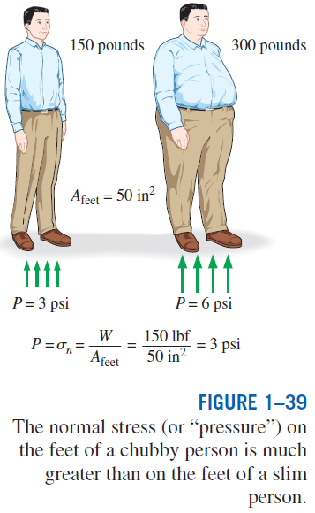

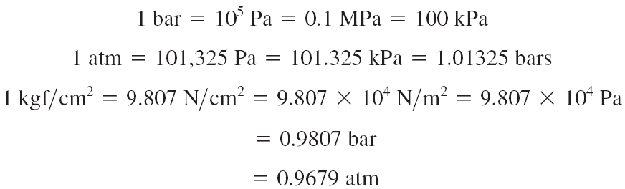
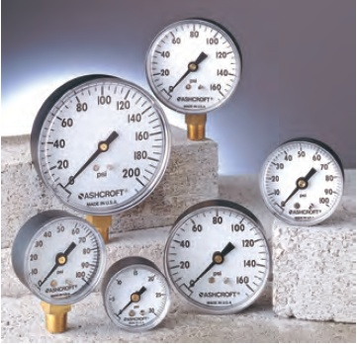
PRESSURE
Pressure: A normal force exerted by a fluid per unit area
Some basic pressure gages.

Slide 33


Absolute pressure: The actual pressure at a given position. It is measured relative to absolute vacuum (i.e., absolute zero pressure).
Gage pressure: The difference between the absolute pressure and the local atmospheric pressure. Most pressure-measuring devices are calibrated to read zero in the atmosphere, and so they indicate gage pressure.
Vacuum pressures: Pressures below atmospheric pressure.
Throughout this text, the pressure P will denote absolute pressure unless specified otherwise.

Slide 34


Variation of Pressure with Depth
When the variation of density with elevation is known

Slide 35



Slide 36


Slide 37

Pascal’s law: The pressure applied to a confined fluid increases the pressure throughout by the same amount.
The area ratio A₂/A₁ is called the ideal mechanical advantage of the hydraulic lift.

Slide 38


PRESSURE MEASUREMENT DEVICES
The Barometer
Atmospheric pressure is measured by a device called a barometer; thus, the atmospheric pressure is often referred to as the barometric pressure.
A frequently used pressure unit is the standard atmosphere, which is defined as the pressure produced by a column of mercury 760 mm in height at 0°C (ρ_{Hg} = 13,595 kg/m³) under standard gravitational acceleration (g = 9.807 m/s²).

Slide 39



Slide 40



The Manometer
It is commonly used to measure small and moderate pressure differences. A manometer contains one or more fluids such as mercury, water, alcohol, or oil.

Slide 41




Slide 42

Other Pressure Measurement Devices
Bourdon tube: Consists of a hollow metal tube bent like a hook whose end is closed and connected to a dial indicator needle.
Pressure transducers: Use various techniques to convert the pressure effect to an electrical effect such as a change in voltage, resistance, or capacitance.
Pressure transducers are smaller and faster, and they can be more sensitive, reliable, and precise than their mechanical counterparts.
Strain-gage pressure transducers: Work by having a diaphragm deflect between two chambers open to the pressure inputs.
Piezoelectric transducers: Also called solid-state pressure transducers, work on the principle that an electric potential is generated in a crystalline substance when it is subjected to mechanical pressure.

Slide 43


Slide 44
PROBLEM-SOLVING TECHNIQUE
Step 1: Problem Statement
Step 2: Schematic
Step 3: Assumptions and Approximations
Step 4: Physical Laws
Step 5: Properties
Step 6: Calculations
Step 7: Reasoning, Verification, and Discussion
EES (Engineering Equation Solver) (Pronounced as ease): EES is a program that solves systems of linear or nonlinear algebraic or differential equations numerically. It has a large library of built-in thermodynamic property functions as well as mathematical functions. Unlike some software packages, EES does not solve engineering problems; it only solves the equations supplied by the user.

Slide 45



Slide 46



Slide 47


Slide 48


A Remark on Significant Digits
In engineering calculations, the information given is not known to more than a certain number of significant digits, usually three digits.
Consequently, the results obtained cannot possibly be accurate to more significant digits.
Reporting results in more significant digits implies greater accuracy than exists, and it should be avoided.

Slide 49
Summary
Thermodynamics and energy
  Application areas of thermodynamics
Importance of dimensions and units
  Some SI and English units, Dimensional homogeneity, Unity conversion ratios
Systems and control volumes
Properties of a system
  Continuum
Density and specific gravity
State and equilibrium
  The state postulate
Processes and cycles
  The steady-flow process
Temperature and the zeroth law of thermodynamics
  Temperature scales
  ITS-90
Pressure
  Variation of pressure with depth
The manometer
  Other pressure measurement devices
The barometer and atmospheric pressure
Problem solving technique

