Slide 1
CHAPTER 5
MASS AND ENERGY ANALYSIS OF CONTROL VOLUMES
Thermodynamics: An Engineering Approach
8th Edition
Yunus A. Çengel, Michael A. Boles
McGraw-Hill, 2015
Lecture slides by
Mehmet Kanoglu
Copyright © The McGraw-Hill Education. Permission required for reproduction or display.

Slide 2
Objectives
Develop the conservation of mass principle.
Apply the conservation of mass principle to various systems including steady- and unsteady-flow control volumes.
Apply the first law of thermodynamics as the statement of the conservation of energy principle to control volumes.
Identify the energy carried by a fluid stream crossing a control surface as the sum of internal energy, flow work, kinetic energy, and potential energy of the fluid and to relate the combination of the internal energy and the flow work to the property enthalpy.
Solve energy balance problems for common steady-flow devices such as nozzles, compressors, turbines, throttling valves, mixers, heaters, and heat exchangers.
Apply the energy balance to general unsteady-flow processes with particular emphasis on the uniform-flow process as the model for commonly encountered charging and discharging processes.

Slide 3
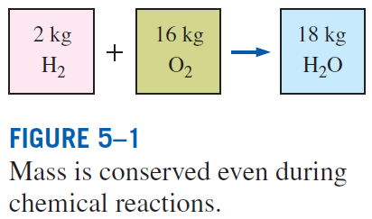
CONSERVATION OF MASS
Conservation of mass: Mass, like energy, is a conserved property, and it cannot be created or destroyed during a process.
Closed systems: The mass of the system remain constant during a process.
Control volumes: Mass can cross the boundaries, and so we must keep track of the amount of mass entering and leaving the control volume.
Mass m and energy E can be converted to each other according to
where c is the speed of light in a vacuum, which is c = 2.9979 × 10⁸ m/s.
The mass change due to energy change is negligible.

Slide 4

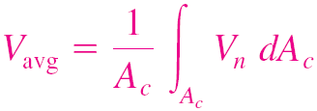
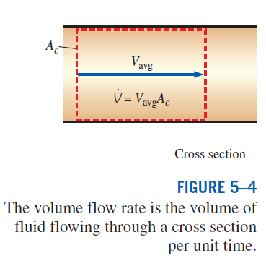
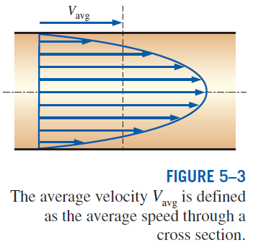
Mass and Volume Flow Rates
Definition of average velocity
Volume flow rate
Mass flow rate

Slide 5
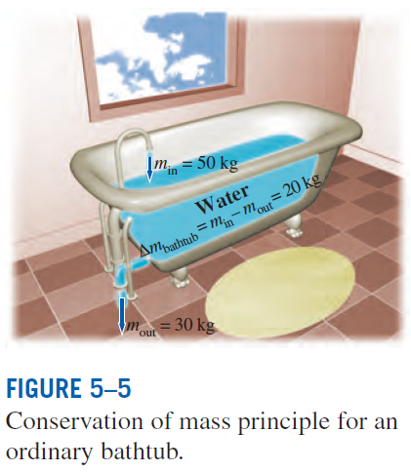

Conservation of Mass Principle
The conservation of mass principle for a control volume: The net mass transfer to or from a control volume during a time interval Δt is equal to the net change (increase or decrease) in the total mass within the control volume during Δt.
These equations are often referred to as the mass balance and are applicable to any control volume undergoing any kind of process.

Slide 6
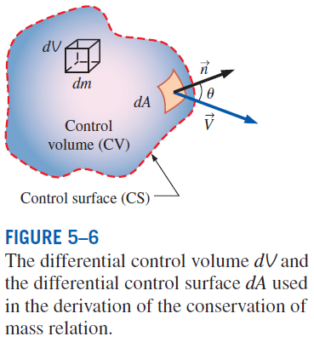






the time rate of change of mass within the control volume plus the net mass flow rate through the control surface is equal to zero.
General conservation of mass in rate form

Slide 7
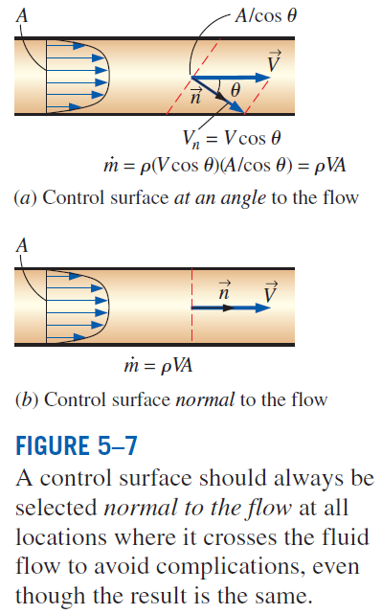

Slide 8
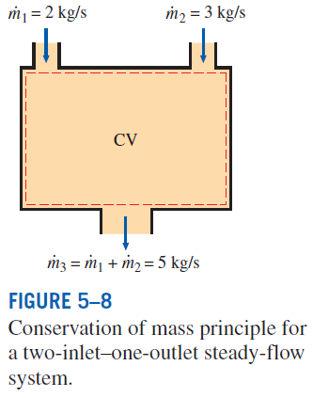
Mass Balance for Steady-Flow Processes
During a steady-flow process, the total amount of mass contained within a control volume does not change with time (m_{CV} = constant).
Then the conservation of mass principle requires that the total amount of mass entering a control volume equal the total amount of mass leaving it.
For steady-flow processes, we are interested in the amount of mass flowing per unit time, that is, the mass flow rate.
Multiple inlets and exits
Single stream
Many engineering devices such as nozzles, diffusers, turbines, compressors, and pumps involve a single stream (only one inlet and one outlet).

Slide 9
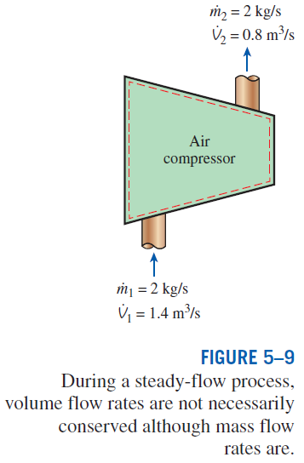
Special Case: Incompressible Flow
The conservation of mass relations can be simplified even further when the fluid is incompressible, which is usually the case for liquids.
Steady, incompressible
Steady, incompressible flow (single stream)
There is no such thing as a “conservation of volume” principle.
For steady flow of liquids, the volume flow rates, as well as the mass flow rates, remain constant since liquids are essentially incompressible substances.

Slide 10
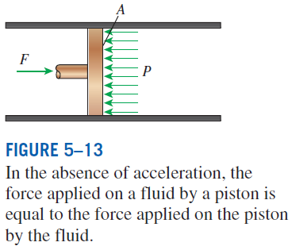
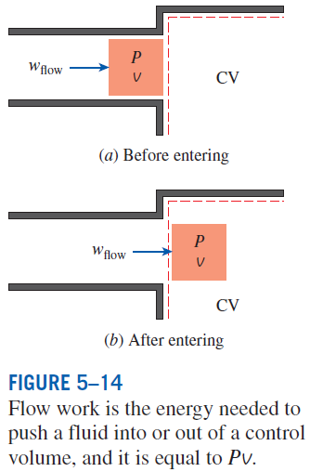
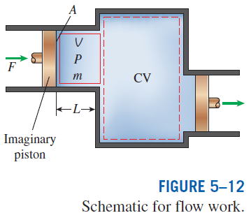
FLOW WORK AND THE ENERGY OF A FLOWING FLUID
Flow work, or flow energy: The work (or energy) required to push the mass into or out of the control volume. This work is necessary for maintaining a continuous flow through a control volume.

Slide 11
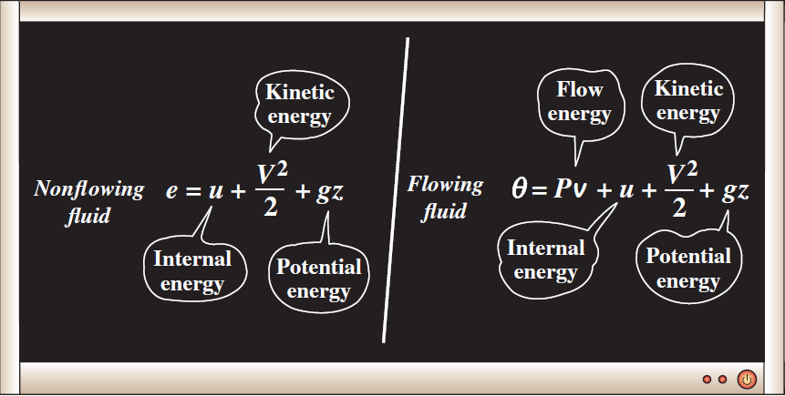
Total Energy of a Flowing Fluid
The flow energy is automatically taken care of by enthalpy. In fact, this is the main reason for defining the property enthalpy.
h = u + Pv
The total energy consists of three parts for a nonflowing fluid and four parts for a flowing fluid.

Slide 12
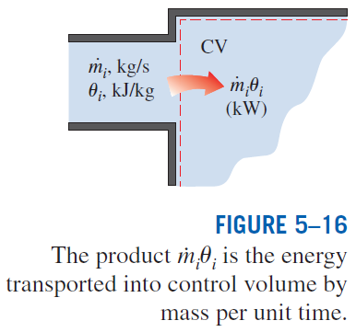

Energy Transport by Mass
When the kinetic and potential energies of a fluid stream are negligible
When the properties of the mass at each inlet or exit change with time as well as over the cross section

Slide 13
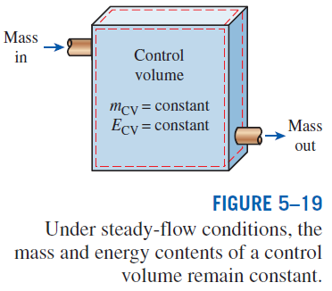
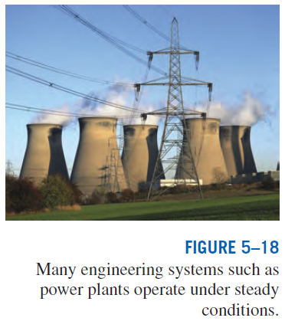
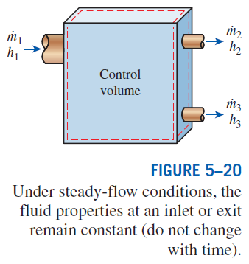
ENERGY ANALYSIS OF STEADY-FLOW SYSTEMS
Steady-flow process: A process during which a fluid flows through a control volume steadily.

Slide 14
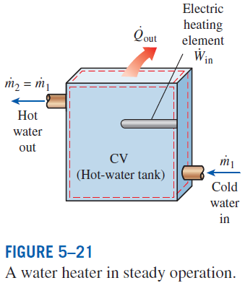


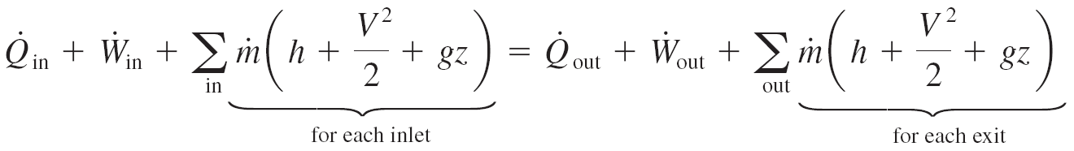
Mass and Energy balances for a steady-flow process
Mass balance
Energy balance

Slide 15
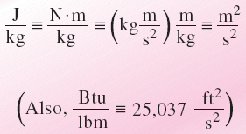
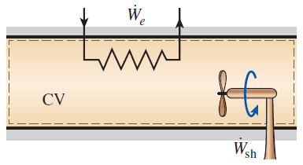
Energy balance relations with sign conventions (i.e., heat input and work output are positive)
The units m²/s² and J/kg
are equivalent.
when kinetic and potential energy changes are negligible
Under steady operation, shaft work and electrical work are the only forms of work a simple compressible system may involve.
At very high velocities, even small changes in velocities can cause significant changes in the kinetic energy of the fluid.

Slide 16
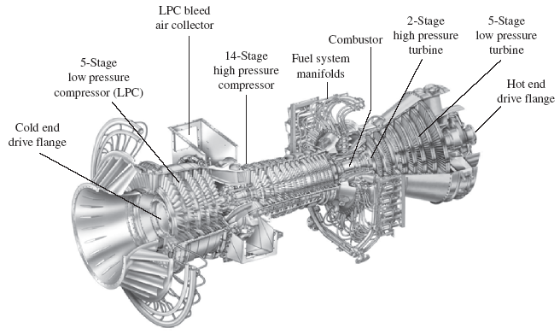
SOME STEADY-FLOW ENGINEERING DEVICES
Many engineering devices operate essentially under the same conditions
for long periods of time. The components of a steam power plant (turbines,
compressors, heat exchangers, and pumps), for example, operate nonstop for
months before the system is shut down for maintenance. Therefore, these devices can be conveniently analyzed as steady-flow devices.
A modern land-based gas turbine used for electric power production. This is a General Electric LM5000 turbine. It has a length of 6.2 m, it weighs 12.5 tons, and produces 55.2 MW at 3600 rpm with steam injection.

Slide 17
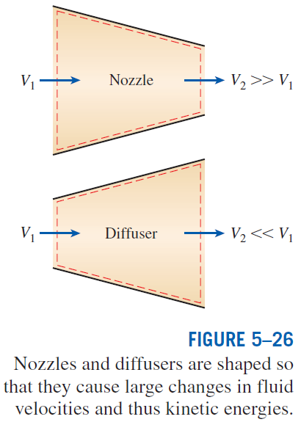
Nozzles and Diffusers
Nozzles and diffusers are commonly utilized in jet engines, rockets, spacecraft, and even garden hoses.
A nozzle is a device that increases the velocity of a fluid at the expense of pressure.
A diffuser is a device that increases the pressure of a fluid by slowing it down.
The cross-sectional area of a nozzle decreases in the flow direction for subsonic flows and increases for supersonic flows. The reverse is true for diffusers.
Energy balance for a nozzle or diffuser:

Slide 18
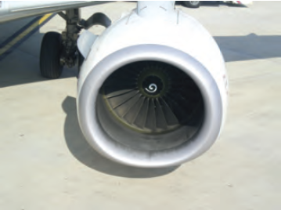
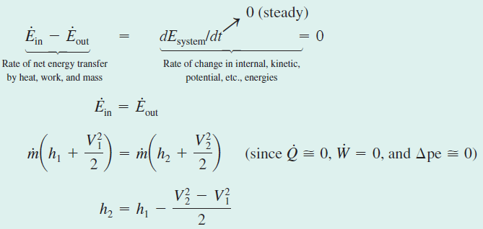
Deceleration of Air in a Diffuser

Slide 19
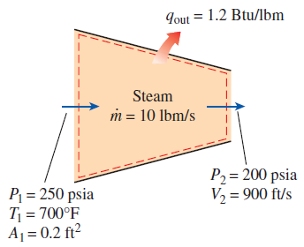
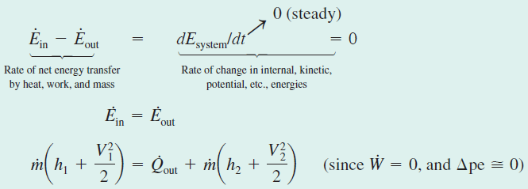

Acceleration of Steam in a Nozzle

Slide 20
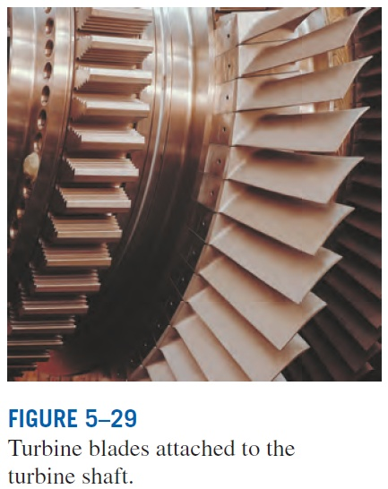
Turbines and Compressors
Turbine drives the electric generator In steam, gas, or hydroelectric power plants.
As the fluid passes through the turbine, work is done against the blades, which are attached to the shaft. As a result, the shaft rotates, and the turbine produces work.
Compressors, as well as pumps and fans, are devices used to increase the pressure of a fluid. Work is supplied to these devices from an external source through a rotating shaft.
A fan increases the pressure of a gas slightly and is mainly used to mobilize a gas.
A compressor is capable of compressing the gas to very high pressures.
Pumps work very much like compressors except that they handle liquids instead of gases.

Slide 21
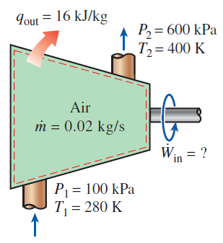
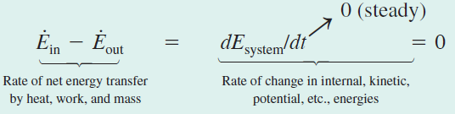
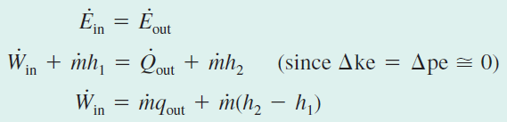
Compressing Air by a Compressor

Slide 22
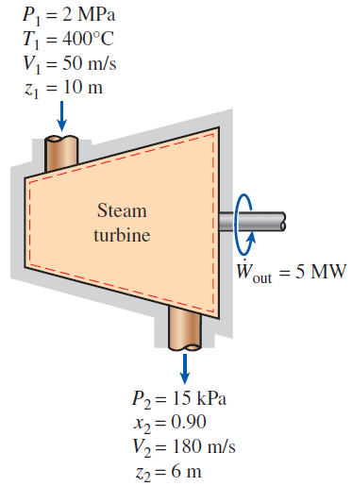
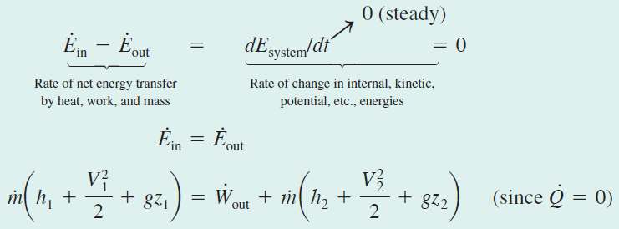
Power Generation by a Steam Turbine

Slide 23

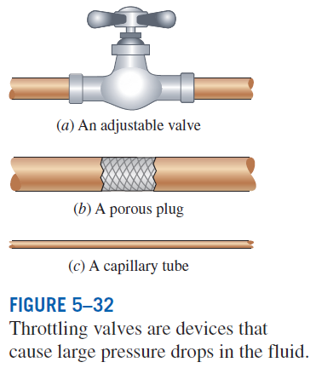

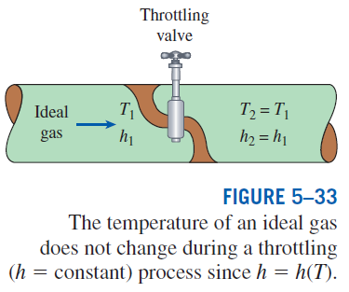
Throttling valves
Throttling valves are any kind of flow-restricting devices that cause a significant pressure drop in the fluid.
What is the difference between a turbine and a throttling valve?
The pressure drop in the fluid is often accompanied by a large drop in temperature, and for that reason throttling devices are commonly used in refrigeration and air-conditioning applications.
Energy balance

Slide 24
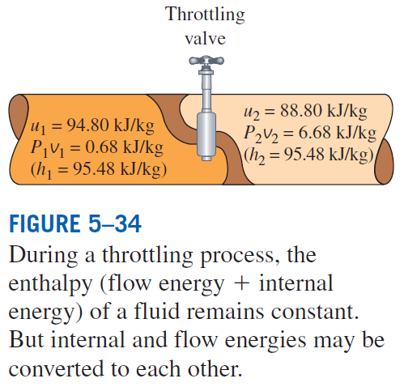


Expansion of Refrigerant-134a in a Refrigerator

Slide 25
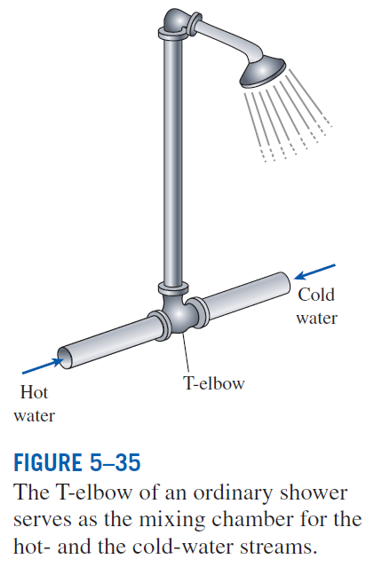
Mixing chambers
In engineering applications, the section where the mixing process takes place is commonly referred to as a mixing chamber.
The mixing chamber does not have to be a distinct “chamber.” An ordinary T-elbow or a Y-elbow in a shower, for example, serves as the mixing chamber for the cold- and hot-water streams.
The conservation of mass principle for a mixing chamber requires that the sum of the incoming mass flow rates equal the mass flow rate of the outgoing mixture.
The conservation of energy equation is analogous to the conservation of mass equation.

Slide 26
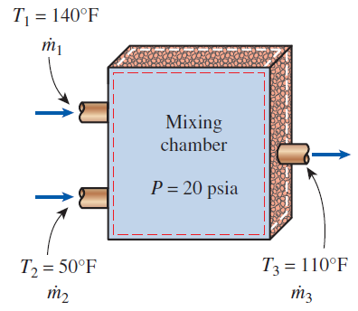

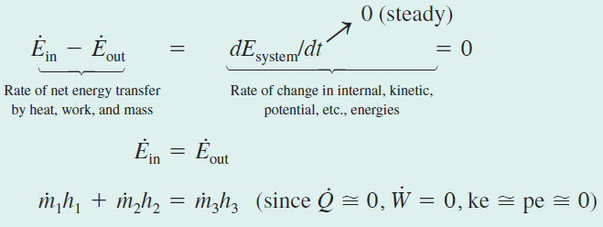

Mixing of Hot and Cold Waters in a Shower

Slide 27
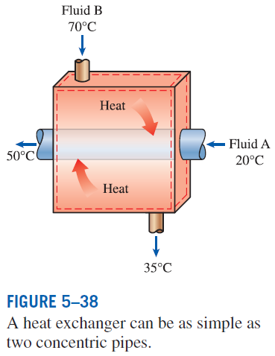
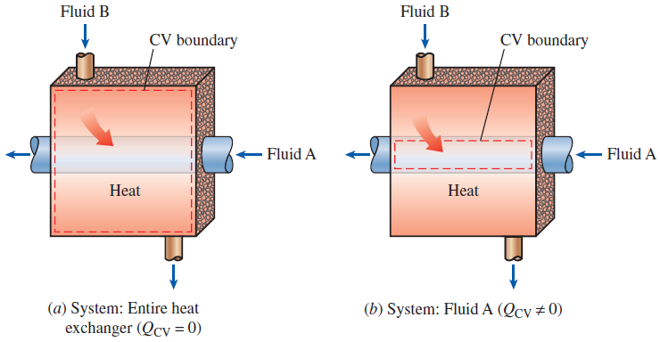
Heat exchangers
Heat exchangers are devices where two moving fluid streams exchange heat without mixing.
Heat exchangers are widely used in various industries, and they come in various designs.
The heat transfer associated with a heat exchanger may be zero or nonzero depending on how the control volume is selected.

Slide 28
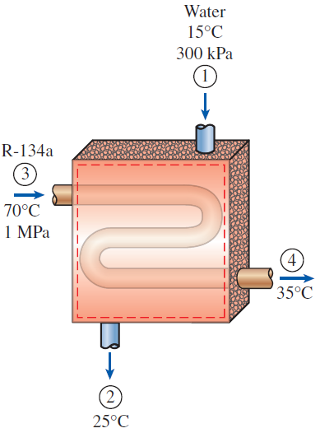

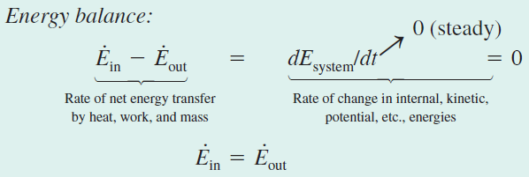

Cooling of Refrigerant-134a by Water

Slide 29
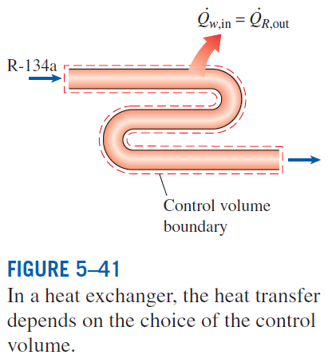
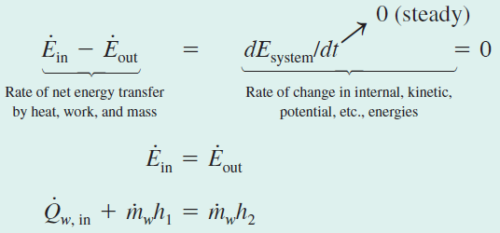


Slide 30
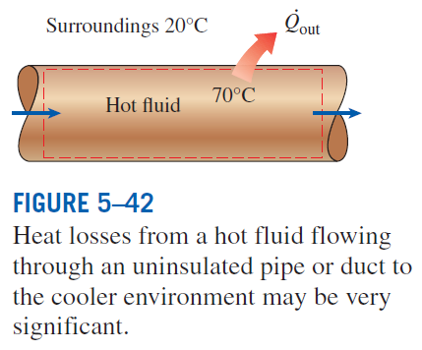
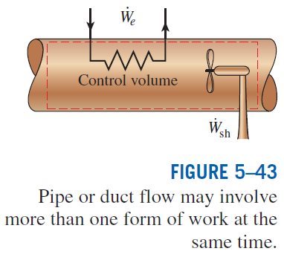
Pipe and duct flow
The transport of liquids or gases in pipes and ducts is of great importance in many engineering applications.
Flow through a pipe or a duct usually satisfies the steady-flow conditions.

Slide 31
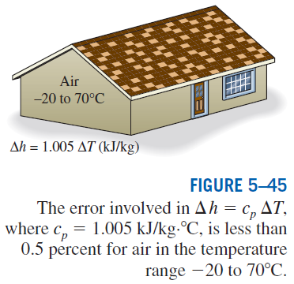
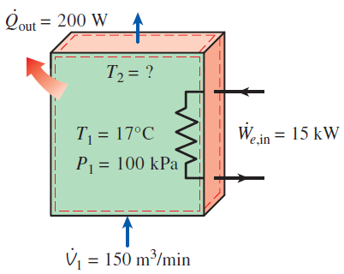
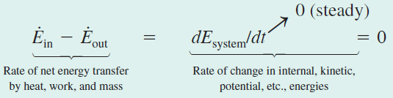

Electric Heating of Air in a House

Slide 32


ENERGY ANALYSIS OF UNSTEADY-FLOW PROCESSES
Many processes of interest, involve changes within the control volume with time. Such processes are called unsteady-flow, or transient-flow, processes.
Most unsteady-flow processes can be represented reasonably well by the uniform-flow process.
Uniform-flow process: The fluid flow at any inlet or exit is uniform and steady, and thus the fluid properties do not change with time or position over the cross section of an inlet or exit. If they do, they are averaged and treated as constants for the entire process.
Charging of a rigid tank from a supply line is an unsteady-flow process since it involves changes within the control volume.
The shape and size of a control volume may change during an unsteady-flow process.

Slide 33






Mass balance
Energy balance
A uniform-flow system may involve electrical, shaft, and boundary work all at once.
The energy equation of a uniform-flow system reduces to that of a closed system when all the inlets and exits are closed.

Slide 34



Charging of a Rigid Tank by Steam

Slide 35


Slide 36


Discharge of Heated Air at Constant Temperature

Slide 37
Summary
Conservation of mass
  Mass and volume flow rates
  Mass balance for a steady-flow process
  Mass balance for incompressible flow
Flow work and the energy of a flowing fluid
  Energy transport by mass
Energy analysis of steady-flow systems
Some steady-flow engineering devices
  Nozzles and Diffusers
  Turbines and Compressors
  Throttling valves
  Mixing chambers and Heat exchangers
  Pipe and Duct flow
Energy analysis of unsteady-flow processes

