Slide 1
CHAPTER 6
THE SECOND LAW OF THERMODYNAMICS
Thermodynamics: An Engineering Approach
8th Edition
Yunus A. Çengel, Michael A. Boles
McGraw-Hill, 2015
Lecture slides by
Mehmet Kanoglu
Copyright © The McGraw-Hill Education. Permission required for reproduction or display.

Slide 2
Objectives
Introduce the second law of thermodynamics.
Identify valid processes as those that satisfy both the first and second laws of thermodynamics.
Discuss thermal energy reservoirs, reversible and irreversible processes, heat engines, refrigerators, and heat pumps.
Describe the Kelvin–Planck and Clausius statements of the second law of thermodynamics.
Discuss the concepts of perpetual-motion machines.
Apply the second law of thermodynamics to cycles and cyclic devices.
Apply the second law to develop the absolute thermodynamic temperature scale.
Describe the Carnot cycle.
Examine the Carnot principles, idealized Carnot heat engines, refrigerators, and heat pumps.
Determine the expressions for the thermal efficiencies and coefficients of performance for reversible heat engines, heat pumps, and refrigerators.

Slide 3
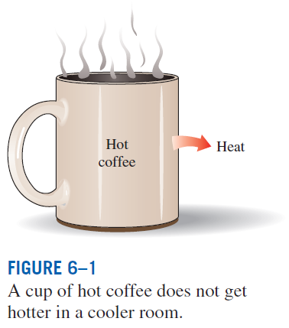
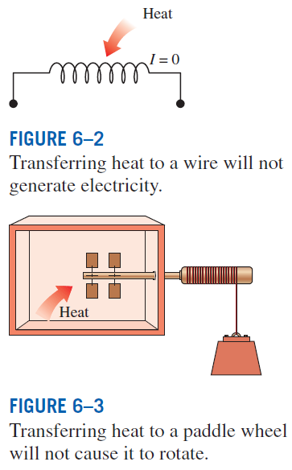
INTRODUCTION TO THE SECOND LAW
These processes cannot occur even though they are not in violation of the first law.

Slide 4
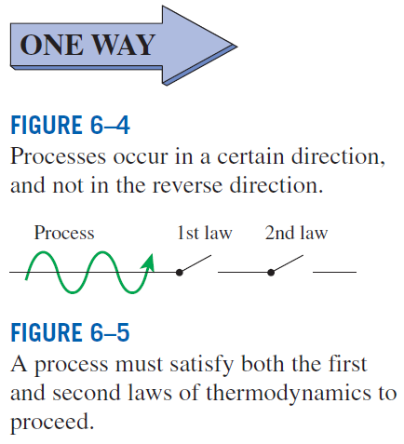
MAJOR USES OF THE SECOND LAW
The second law may be used to identify the direction of processes.
The second law also asserts that energy has quality as well as quantity. The first law is concerned with the quantity of energy and the transformations of energy from one form to another with no regard to its quality. The second law provides the necessary means to determine the quality as well as the degree of degradation of energy during a process.
The second law of thermodynamics is also used in determining the theoretical limits for the performance of commonly used engineering systems, such as heat engines and refrigerators, as well as predicting the degree of completion of chemical reactions.

Slide 5
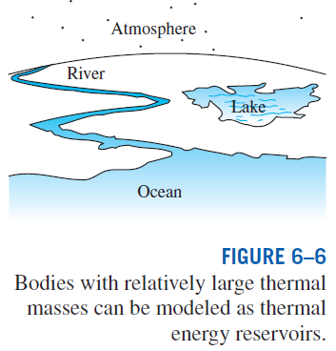
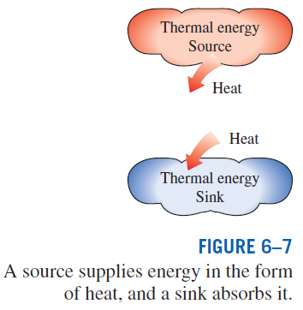
THERMAL ENERGY RESERVOIRS
A hypothetical body with a relatively large thermal energy capacity (mass x specific heat) that can supply or absorb finite amounts of heat without undergoing any change in temperature is called a thermal energy reservoir, or just a reservoir.
In practice, large bodies of water such as oceans, lakes, and rivers as well as the atmospheric air can be modeled accurately as thermal energy reservoirs because of their large thermal energy storage capabilities or thermal masses.

Slide 6
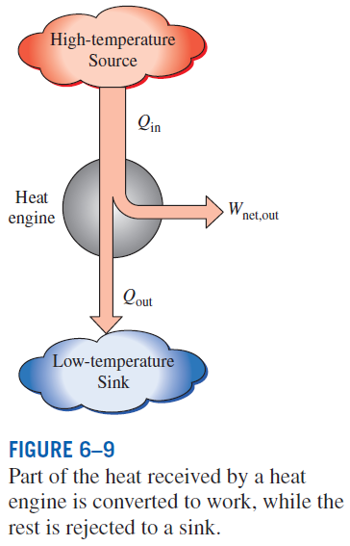
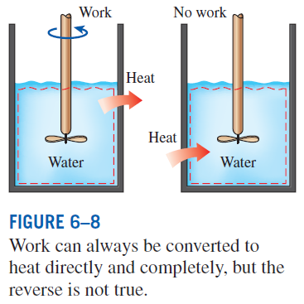
HEAT ENGINES
HEAT ENGINES: The devices that convert heat to work.
They receive heat from a high-temperature source (solar energy, oil furnace, nuclear reactor, etc.).
They convert part of this heat to work (usually in the form of a rotating shaft.)
They reject the remaining waste heat to a low-temperature sink (the atmosphere, rivers, etc.).
They operate on a cycle.
Heat engines and other cyclic devices usually involve a fluid to and from which heat is transferred while undergoing a cycle. This fluid is called the working fluid.

Slide 7
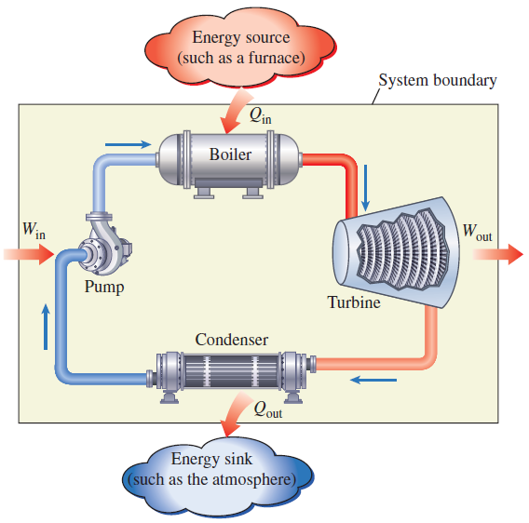
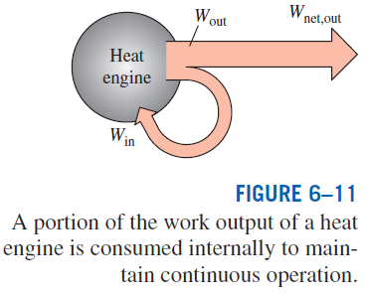
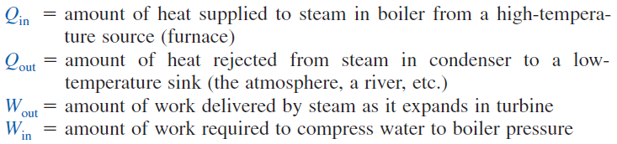
A steam power plant

Slide 8

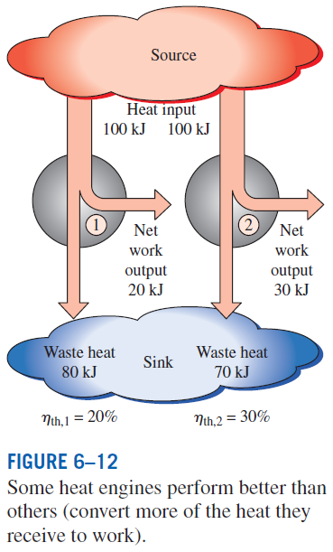
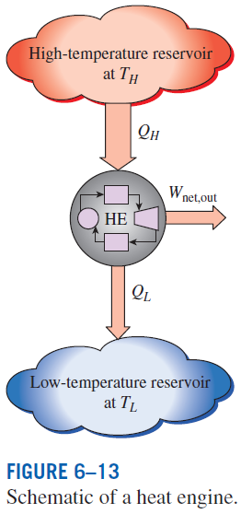



Thermal efficiency

Slide 9
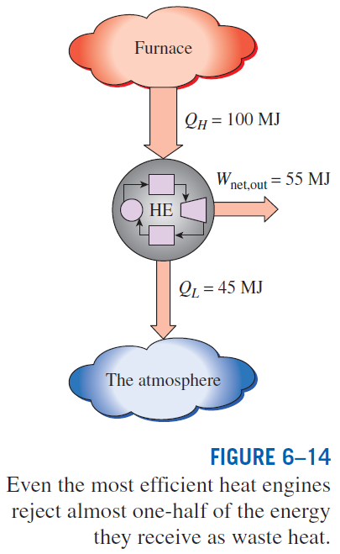
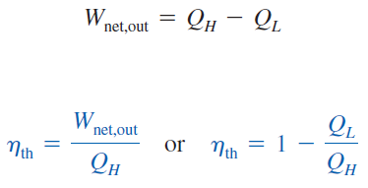

Slide 10
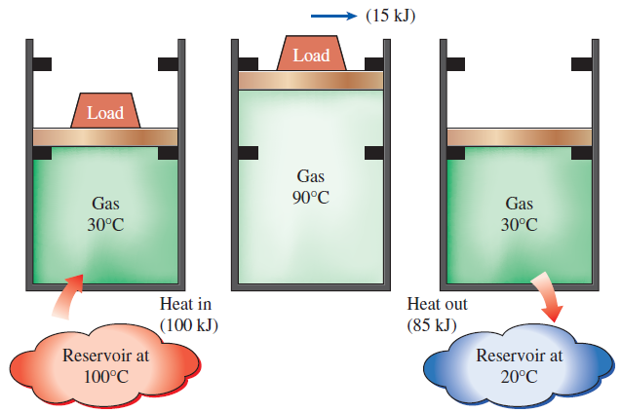
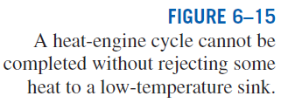
Can we save Q_{out}?
In a steam power plant, the condenser is the device where large quantities of waste heat is rejected to rivers, lakes, or the atmosphere.
Can we not just take the condenser out of the plant and save all that waste energy?
The answer is, unfortunately, a firm no for the simple reason that without a heat rejection process in a condenser, the cycle cannot be completed.
Every heat engine must waste some energy by transferring it to a low-temperature reservoir in order to complete the cycle, even under idealized conditions.

Slide 11
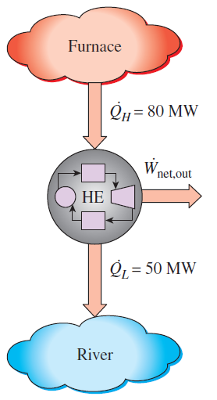

Net Power Production of a Heat Engine

Slide 12
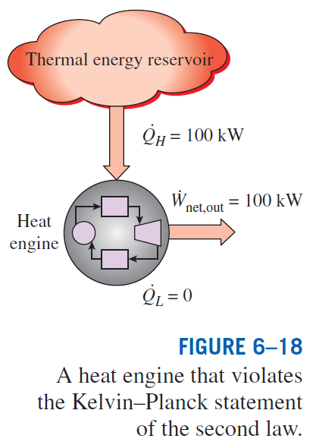
The Second Law of Thermodynamics:
Kelvin–Planck Statement
It is impossible for any device that operates on a cycle to receive heat from a single reservoir and produce a net amount of work.
No heat engine can have a thermal efficiency of 100 percent, or as for a power plant to operate, the working fluid must exchange heat with the environment as well as the furnace.
The impossibility of having a 100% efficient heat engine is not due to friction or other dissipative effects. It is a limitation that applies to both the idealized and the actual heat engines.

Slide 13
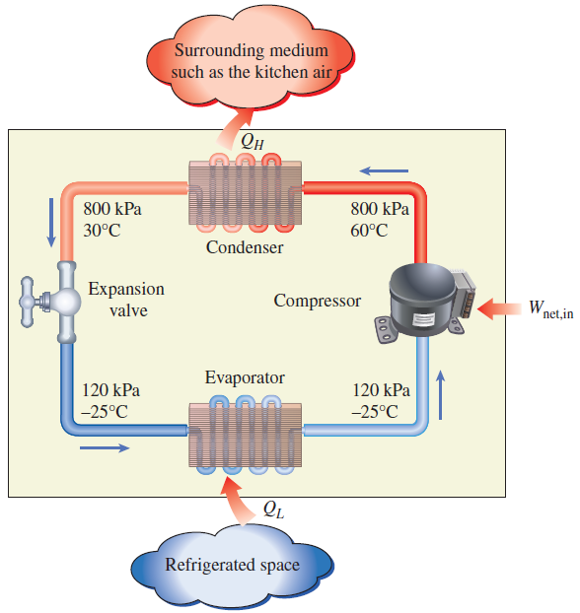
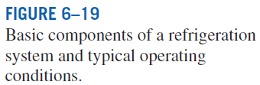
REFRIGERATORS AND HEAT PUMPS
The transfer of heat from a low-temperature medium to a high-temperature one requires special devices called refrigerators.
Refrigerators, like heat engines, are cyclic devices.
The working fluid used in the refrigeration cycle is called a refrigerant.
The most frequently used refrigeration cycle is the vapor-compression refrigeration cycle.
In a household refrigerator, the freezer compartment where heat is absorbed by the refrigerant serves as the evaporator, and the coils usually behind the refrigerator where heat is dissipated to the kitchen air serve as the condenser.

Slide 14
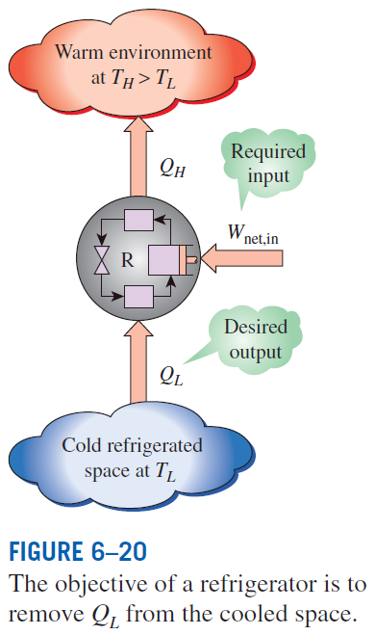
Coefficient of Performance
The efficiency of a refrigerator is expressed in terms of the coefficient of performance (COP).
The objective of a refrigerator is to remove heat (Q_{L}) from the refrigerated space.
Can the value of COP_{R} be greater than unity?

Slide 15
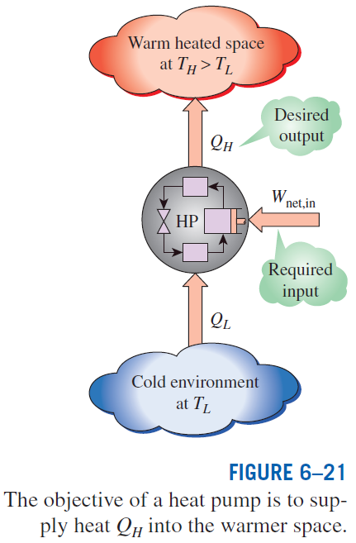



Heat Pumps
for fixed values of Q_{L} and Q_{H}
Can the value of COP_{HP} be lower than unity?
What does COP_{HP}=1 represent?

Slide 16
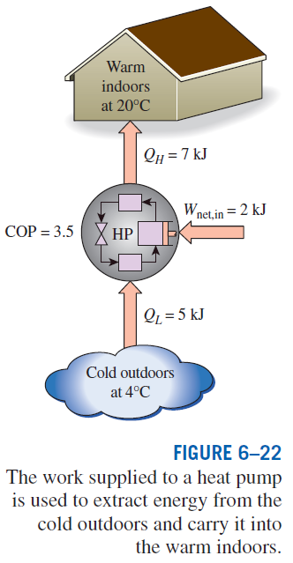

Most heat pumps in operation today have a seasonally averaged COP of 2 to 3.
Most existing heat pumps use the cold outside air as the heat source in winter (air-source HP).
In cold climates their efficiency drops considerably when temperatures are below the freezing point.
In such cases, geothermal (ground-source) HP that use the ground as the heat source can be used.
Such heat pumps are more expensive to install, but they are also more efficient.
Air conditioners are basically refrigerators whose refrigerated space is a room or a building instead of the food compartment.
The COP of a refrigerator decreases with decreasing refrigeration temperature.
Therefore, it is not economical to refrigerate to a lower temperature than needed.
Energy efficiency rating (EER): The amount of heat removed from the cooled space in Btu’s for 1 Wh (watthour) of electricity consumed.

Slide 17
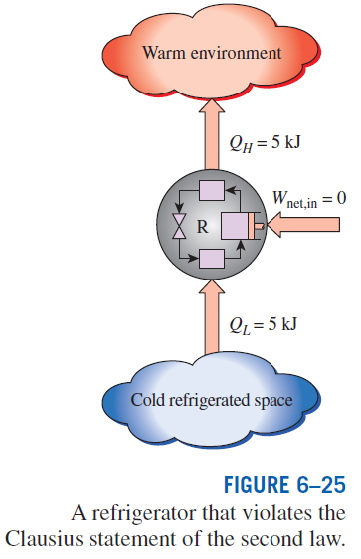
The Second Law of Thermodynamics: Clasius Statement
It is impossible to construct a device that operates in a cycle and produces no effect other than the transfer of heat from a lower-temperature body to a higher-temperature body.
It states that a refrigerator cannot operate unless its compressor is driven by an external power source, such as an electric motor.
This way, the net effect on the surroundings involves the consumption of some energy in the form of work, in addition to the transfer of heat from a colder body to a warmer one.
To date, no experiment has been conducted that contradicts the second law, and this should be taken as sufficient proof of its validity.

Slide 18
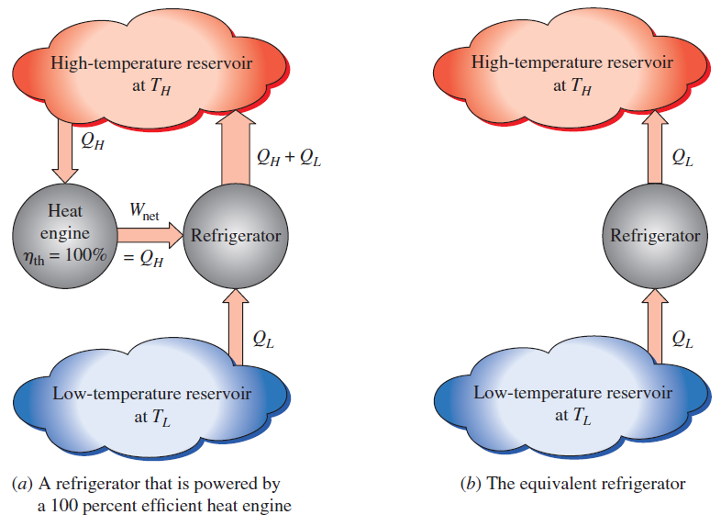
Equivalence of the Two Statements
Proof that the violation of the Kelvin–Planck statement leads to the violation of the Clausius statement.
The Kelvin–Planck and the Clausius statements are equivalent in their consequences, and either statement can be used as the expression of the second law of thermodynamics.
Any device that violates the Kelvin–Planck statement also violates the Clausius statement, and vice versa.

Slide 19
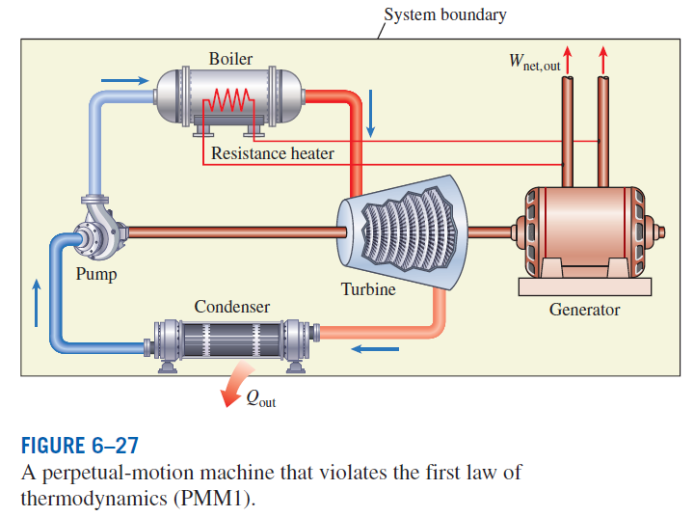
PERPETUAL-MOTION MACHINES
Perpetual-motion machine: Any device that violates the first or the second law.
A device that violates the first law (by creating energy) is called a PMM1.
A device that violates the second law is called a PMM2.

Slide 20
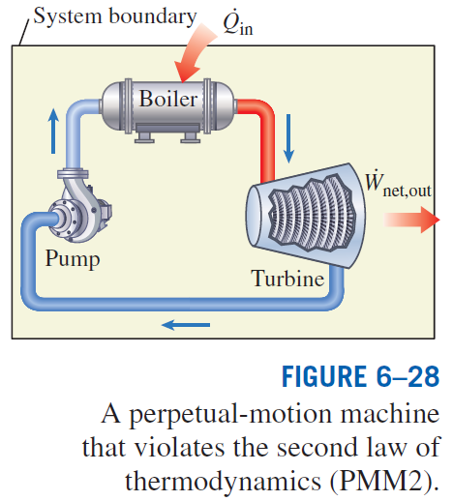
Despite numerous attempts, no perpetual-motion machine is known to have worked.
If something sounds too good to be true, it probably is.

Slide 21
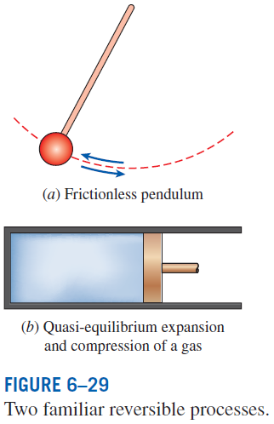
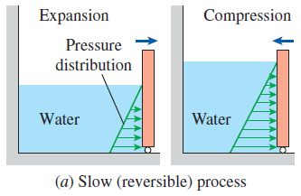
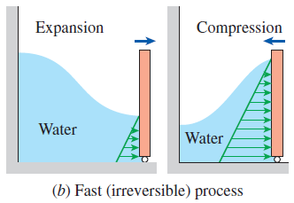
REVERSIBLE AND IRREVERSIBLE PROCESSES
Reversible process: A process that can be reversed without leaving any trace on the surroundings.
Irreversible process: A process that is not reversible.
All the processes occurring in nature are irreversible.
Why are we interested in reversible processes?
(1) they are easy to analyze and (2) they serve as idealized models (theoretical limits) to which actual processes can be compared.
Some processes are more irreversible than others.
We try to approximate reversible processes. Why?
Reversible processes deliver the most and consume the least work.

Slide 22
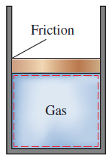
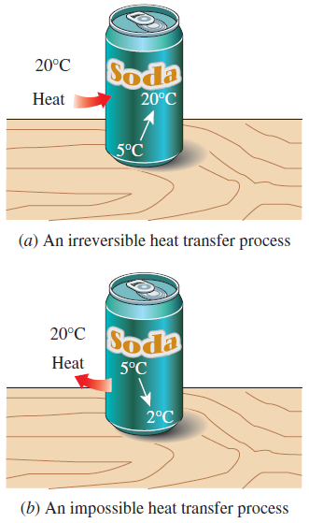
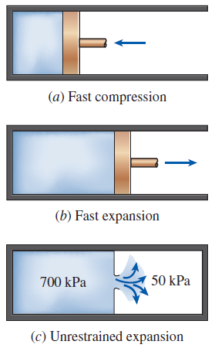
The factors that cause a process to be irreversible are called irreversibilities.
They include friction, unrestrained expansion, mixing of two fluids, heat transfer across a finite temperature difference, electric resistance, inelastic deformation of solids, and chemical reactions.
The presence of any of these effects renders a process irreversible.
Friction renders a process irreversible.
Irreversibilities
(a) Heat transfer through a temperature difference is irreversible, and (b) the reverse process is impossible.
Irreversible compression and expansion processes.

Slide 23
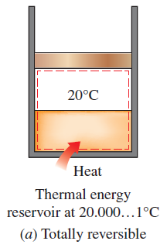
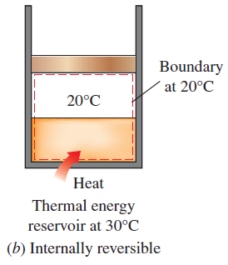
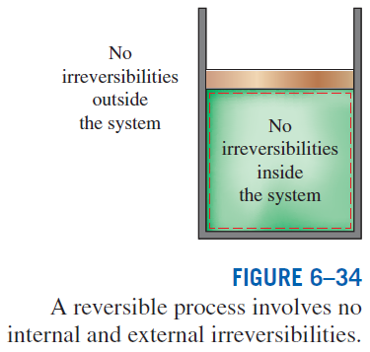

Internally and Externally Reversible Processes
Internally reversible process: If no irreversibilities occur within the boundaries of the system during the process.
Externally reversible: If no irreversibilities occur outside the system boundaries.
Totally reversible process: It involves no irreversibilities within the system or its surroundings.
A totally reversible process involves no heat transfer through a finite temperature difference, no nonquasi-equilibrium changes, and no friction or other dissipative effects.

Slide 24
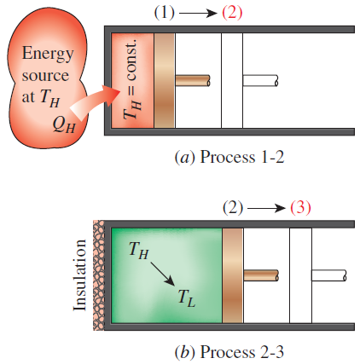
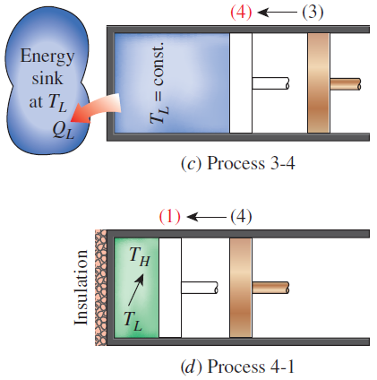
THE CARNOT CYCLE
Execution of the Carnot cycle in a closed system.
Reversible Isothermal Expansion (process 1-2, T_{H} = constant)
Reversible Adiabatic Expansion (process 2-3, temperature drops from T_{H} to T_{L})
Reversible Isothermal Compression (process 3-4, T_{L} = constant)
Reversible Adiabatic Compression (process 4-1, temperature rises from T_{L} to T_{H})

Slide 25
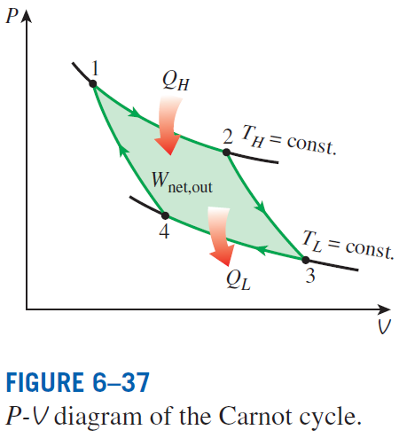
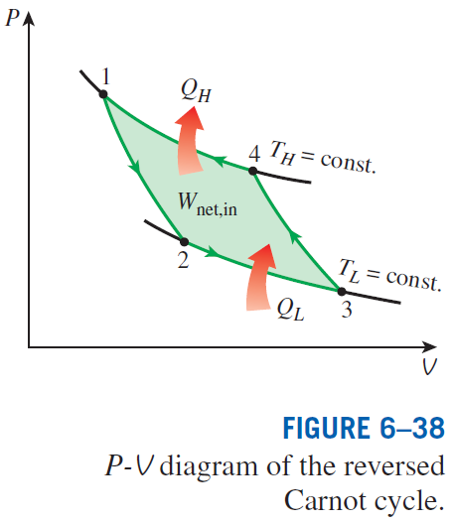
The Reversed Carnot Cycle
The Carnot heat-engine cycle is a totally reversible cycle.
Therefore, all the processes that comprise it can be reversed, in which case it becomes the Carnot refrigeration cycle.

Slide 26
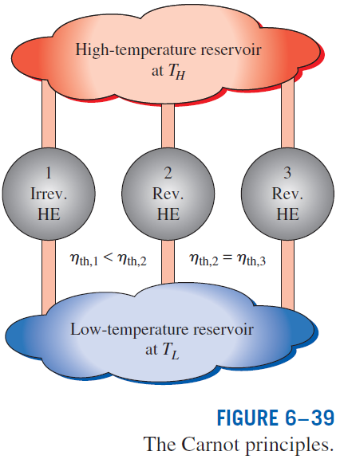
THE CARNOT PRINCIPLES
The efficiency of an irreversible heat engine is always less than the efficiency of a reversible one operating between the same two reservoirs.
The efficiencies of all reversible heat engines operating between the same two reservoirs are the same.

Slide 27
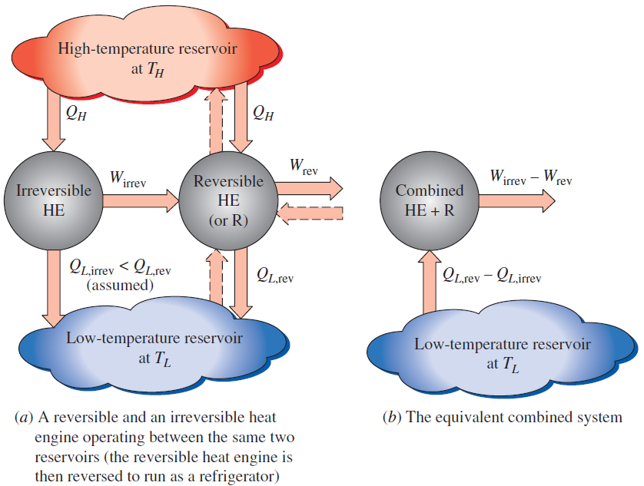


Slide 28
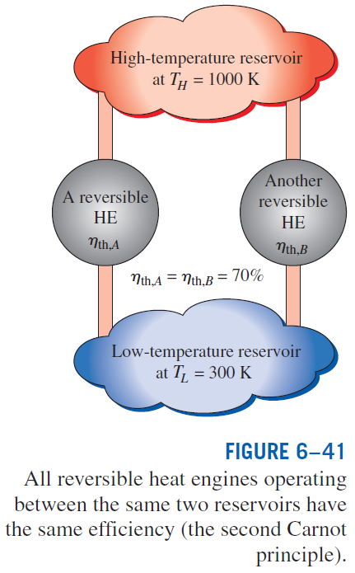

Slide 29
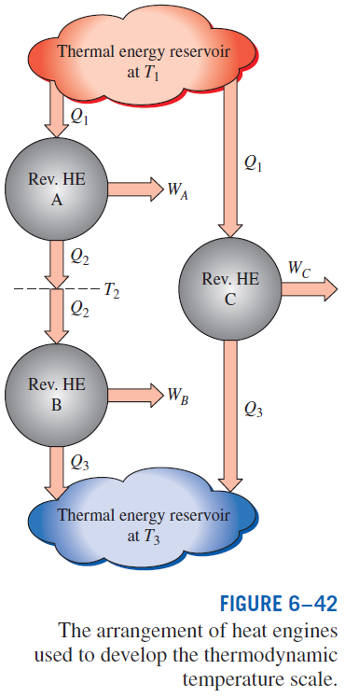
THE THERMODYNAMIC TEMPERATURE SCALE
A temperature scale that is independent of the properties of the substances that are used to measure temperature is called a thermodynamic temperature scale.
Such a temperature scale offers great conveniences in thermodynamic calculations.

Slide 30
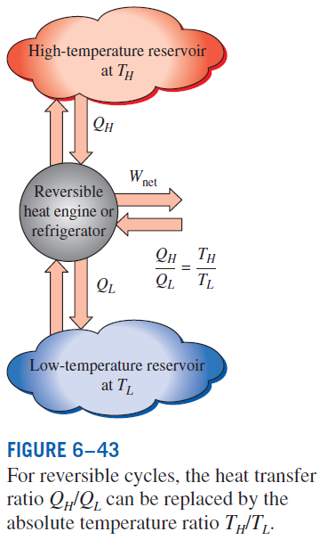
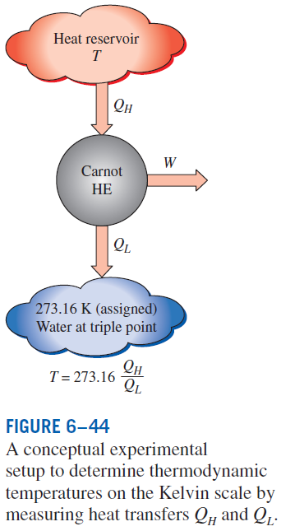


This temperature scale is called the Kelvin scale, and the temperatures on this scale are called absolute temperatures.

Slide 31
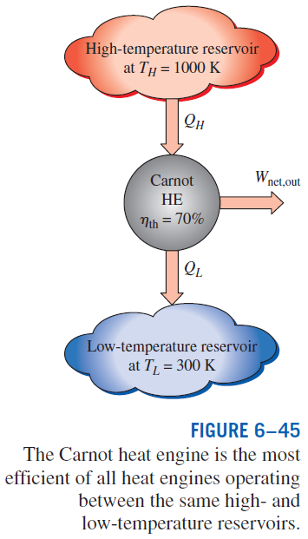


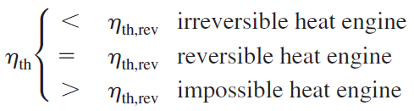
THE CARNOT HEAT ENGINE
Any heat engine
Carnot heat engine

Slide 32
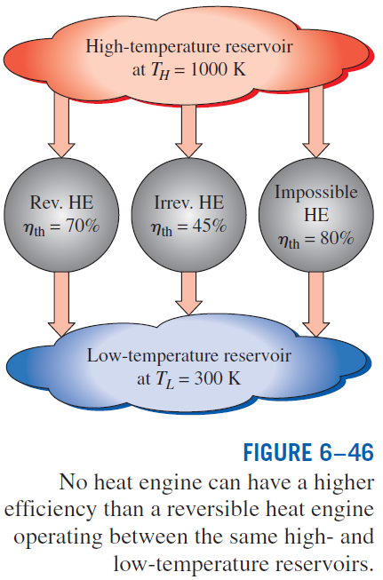

Slide 33
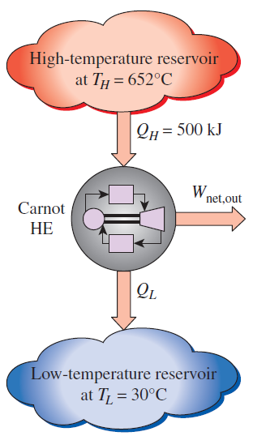


Analysis of a Carnot Heat Engine

Slide 34


The Quality of Energy
Can we use °C unit for temperature here?
How do you increase the thermal efficiency of a Carnot heat engine?
How about for actual heat engines?

Slide 35





THE CARNOT REFRIGERATOR AND HEAT PUMP
Any refrigerator or heat pump
Carnot refrigerator or heat pump
How do you increase the COP of a Carnot refrigerator or heat pump? How about for actual ones?

Slide 36

The COP of a reversible refrigerator or heat pump is the maximum theoretical value for the specified temperature limits.
Actual refrigerators or heat pumps may approach these values as their designs are improved, but they can never reach them.
The COPs of both the refrigerators and the heat pumps decrease as T_{L} decreases.
That is, it requires more work to absorb heat from lower-temperature media.

Slide 37


Heating a House by a Carnot Heat Pump

Slide 38
Summary
Introduction to the second law
Thermal energy reservoirs
Heat engines
  Thermal efficiency
  The 2nd law: Kelvin-Planck statement
Refrigerators and heat pumps
  Coefficient of performance (COP)
  The 2nd law: Clasius statement
Perpetual motion machines
Reversible and irreversible processes
  Irreversibilities, Internally and externally reversible processes
The Carnot cycle
  The reversed Carnot cycle
The Carnot principles
The thermodynamic temperature scale
The Carnot heat engine
  The quality of energy
The Carnot refrigerator and heat pump

