Slide 1
CHAPTER 7
ENTROPY
Thermodynamics: An Engineering Approach
8th Edition
Yunus A. Çengel, Michael A. Boles
McGraw-Hill, 2015
Lecture slides by
Mehmet Kanoglu
Copyright © The McGraw-Hill Education. Permission required for reproduction or display.

Slide 2
Objectives
Apply the second law of thermodynamics to processes.
Define a new property called entropy to quantify the second-law effects.
Establish the increase of entropy principle.
Calculate the entropy changes that take place during processes for pure substances, incompressible substances, and ideal gases.
Examine a special class of idealized processes, called isentropic processes, and develop the property relations for these processes.
Derive the reversible steady-flow work relations.
Develop the isentropic efficiencies for various steady-flow devices.
Introduce and apply the entropy balance to various systems.

Slide 3
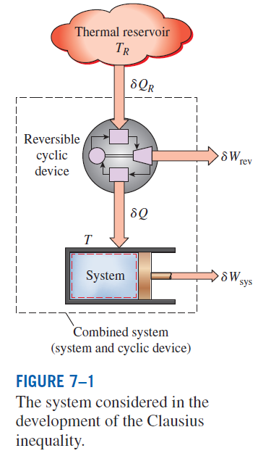



ENTROPY
Clasius inequality
Formal definition of entropy
The equality in the Clausius inequality holds for totally or just internally reversible cycles and the inequality for the irreversible ones.

Slide 4
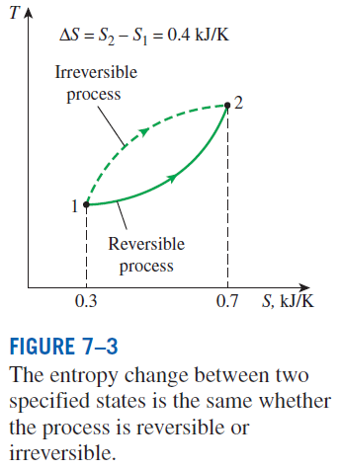
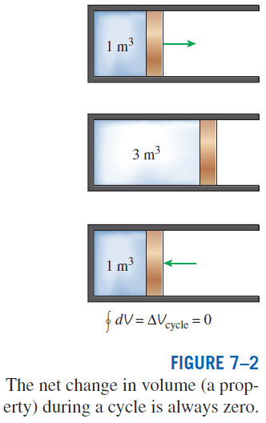
A quantity whose cyclic integral is zero (i.e., a property like volume)
Entropy is an extensive property of a system.
A Special Case: Internally Reversible
Isothermal Heat Transfer Processes
This equation is particularly useful for determining the entropy changes of thermal energy reservoirs.

Slide 5
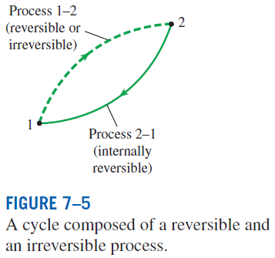



THE INCREASE OF ENTROPY PRINCIPLE
The equality holds for an internally reversible process and the inequality for an irreversible process.
Some entropy is generated or created during an irreversible process, and this generation is due entirely to the presence of irreversibilities.
The entropy generation S_{gen} is always a positive quantity or zero.
Can the entropy of a system during a process decrease?

Slide 6
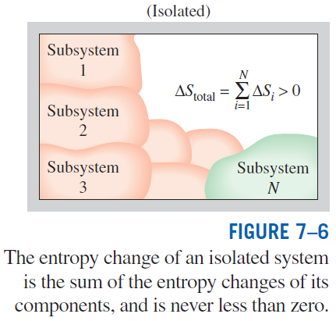
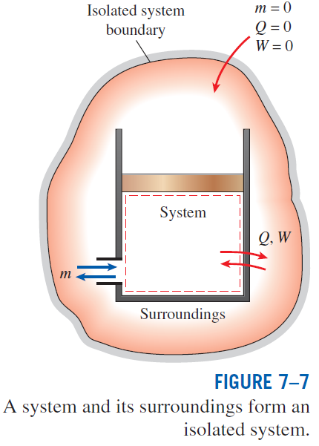
The increase of entropy principle

Slide 7
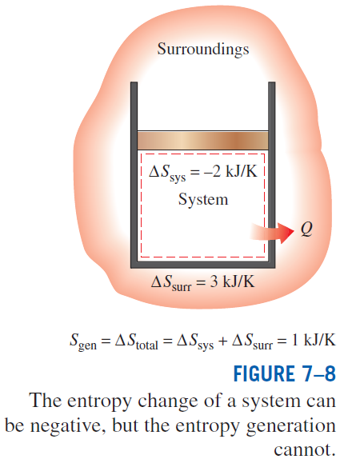
Some Remarks about Entropy
Processes can occur in a certain direction only, not in any direction. A process must proceed in the direction that complies with the increase of entropy principle, that is, S_{gen} ≥ 0. A process that violates this principle is impossible.
Entropy is a nonconserved property, and there is no such thing as the conservation of entropy principle. Entropy is conserved during the idealized reversible processes only and increases during all actual processes.
The performance of engineering systems is degraded by the presence of irreversibilities, and entropy generation is a measure of the magnitudes of the irreversibilities during that process. It is also used to establish criteria for the performance of engineering devices.

Slide 8
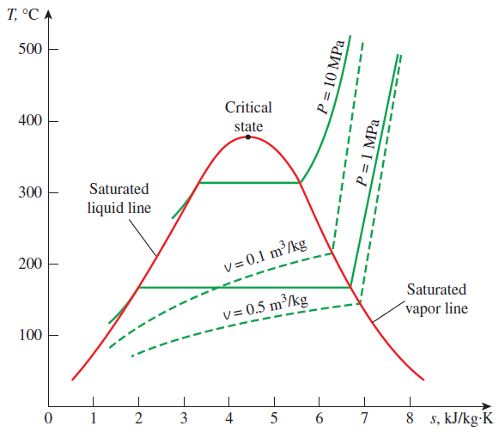
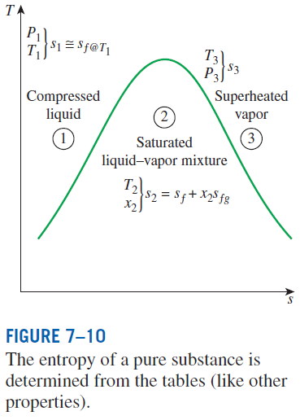

ENTROPY CHANGE OF PURE SUBSTANCES
Entropy is a property, and thus the value of entropy of a system is fixed once the state of the system is fixed.
Entropy change

Slide 9

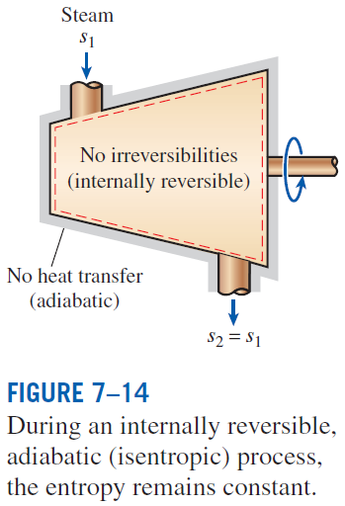
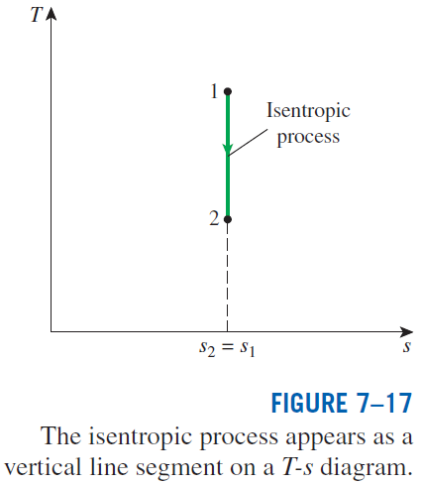
ISENTROPIC PROCESSES
A process during which the entropy remains constant is called an isentropic process.

Slide 10
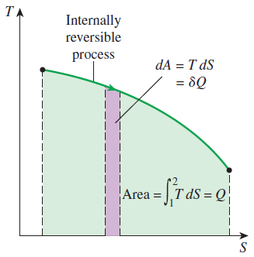
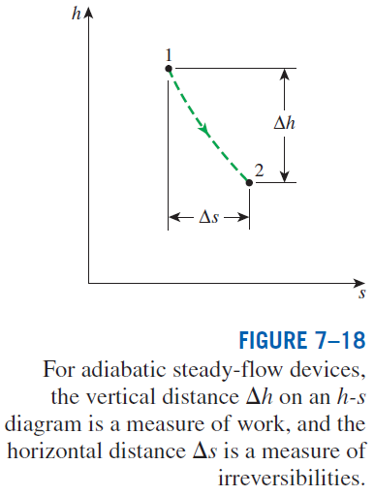

PROPERTY DIAGRAMS INVOLVING ENTROPY
On a T-S diagram, the area under the process curve represents the heat transfer for internally reversible processes.
Mollier diagram: The h-s diagram

Slide 11

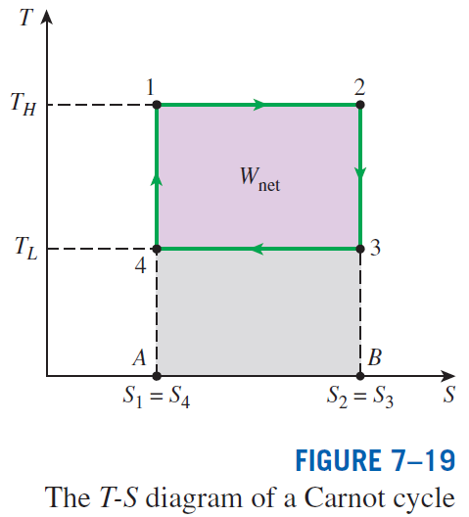

Slide 12
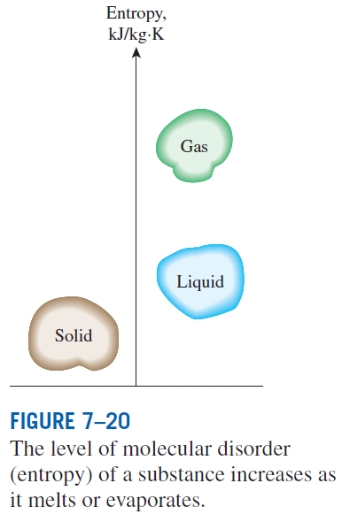


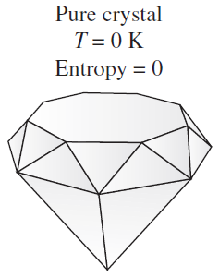
WHAT IS ENTROPY?
Boltzmann relation
W the total number of possible relevant microstates of the system
Gibbs’ formulation
p_{i} sum of all microstates’ uncertainties, i.e., probabilities
Boltzmann constant
A pure crystalline substance at absolute zero temperature is in perfect order, and its entropy is zero (the third law of thermodynamics).

Slide 13
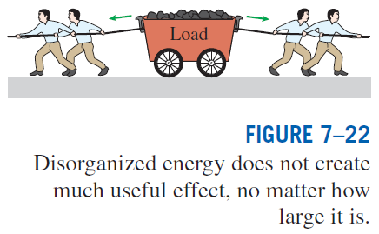
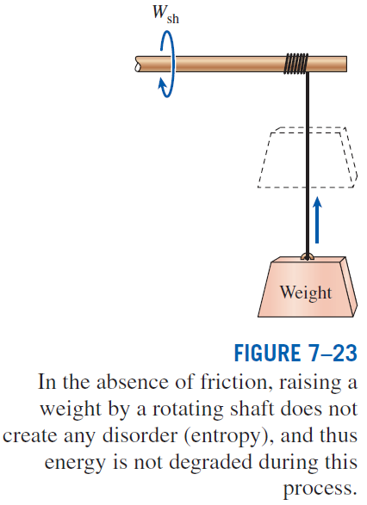

Slide 14
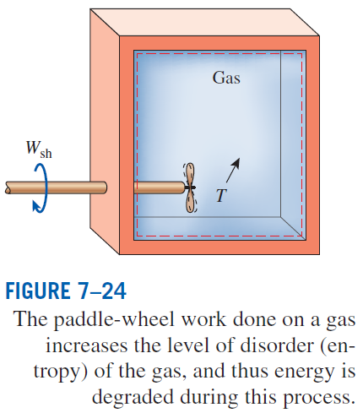
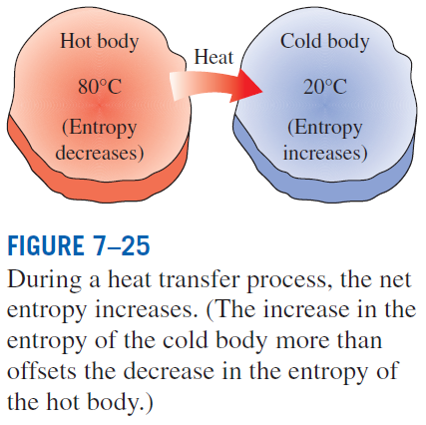

Slide 15
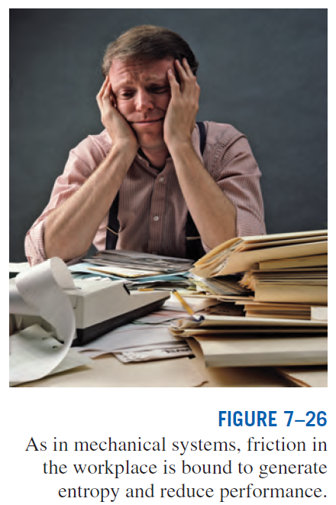

Slide 16
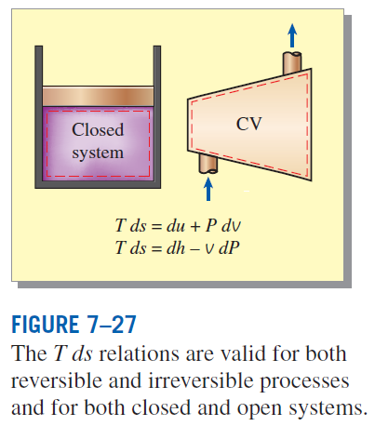



THE T ds RELATIONS
the first T ds, or Gibbs equation
the second T ds equation
Differential changes in entropy in terms of other properties

Slide 17

ENTROPY CHANGE OF LIQUIDS AND SOLIDS
Liquids and solids can be approximated as incompressible substances since their specific volumes remain nearly constant during a process.
Since for liquids and solids
For and isentropic process of an incompressible substance

Slide 18


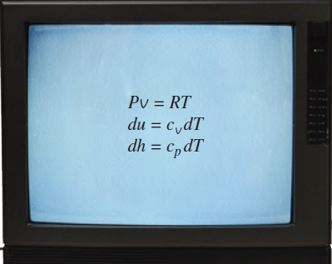

THE ENTROPY CHANGE OF IDEAL GASES
From the first T ds relation
From the second T ds relation

Slide 19
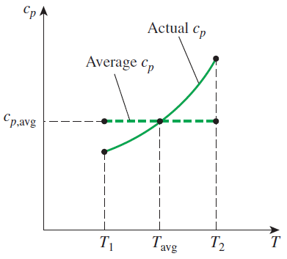
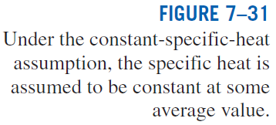
Constant Specific Heats (Approximate Analysis)
Entropy change of an ideal gas on a unit–mole basis

Slide 20
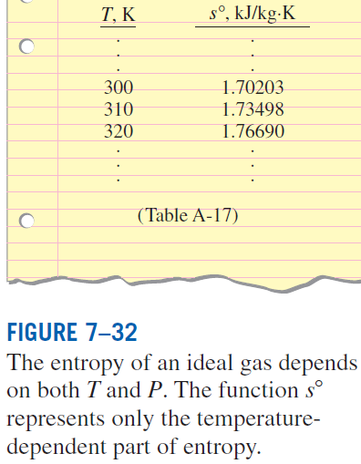

Variable Specific Heats (Exact Analysis)
We choose absolute zero as the reference temperature and define a function s° as
On a unit–mass basis
On a unit–mole basis

Slide 21
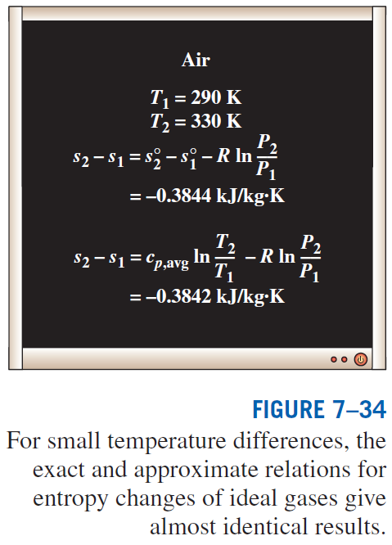

Slide 22
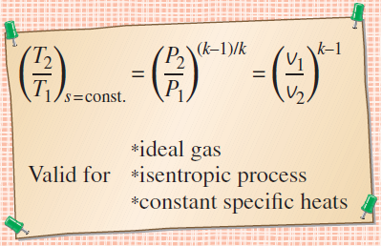
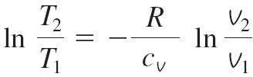
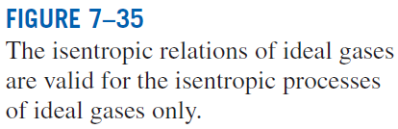
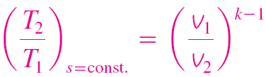
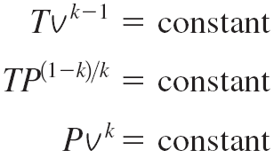
Isentropic Processes of Ideal Gases
Constant Specific Heats (Approximate Analysis)
Setting this eq. equal to zero, we get

Slide 23
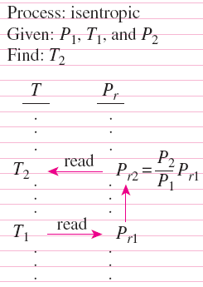


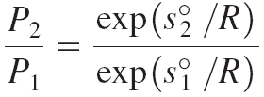
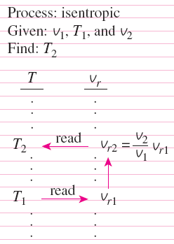
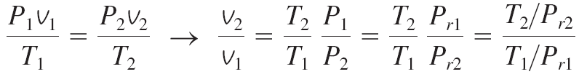
Isentropic Processes of Ideal Gases
Variable Specific Heats (Exact Analysis)
Relative Pressure and Relative Specific Volume
exp(s°/R) is the relative pressure P_{r}.
The use of P_{r} data for calculating the final temperature during an isentropic process.
The use of v_{r} data for calculating the final temperature during an isentropic process
T/P_{r} is the relative
specific volume v_{r}.

Slide 24
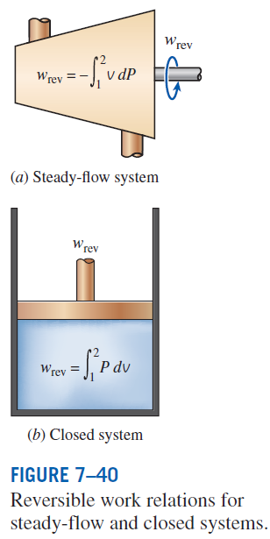
REVERSIBLE STEADY-FLOW WORK
When kinetic and potential energies are negligible
The larger the specific volume, the greater the work produced (or consumed) by a steady-flow device.
For the steady flow of a liquid through a device that involves no work interactions (such as a pipe section), the work term is zero (Bernoulli equation):

Slide 25
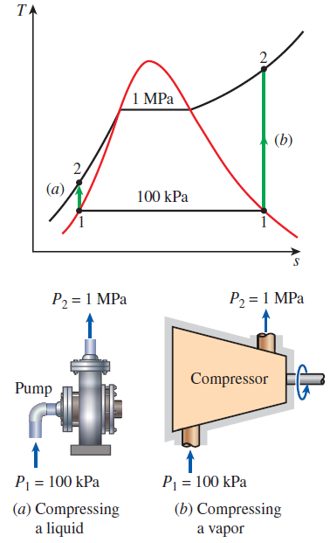
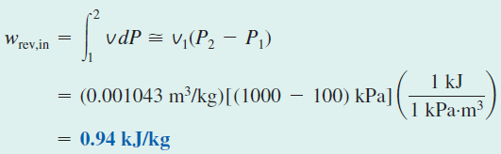


EXAMPLE: Compressing a Substance in the Liquid versus Gas Phases

Slide 26
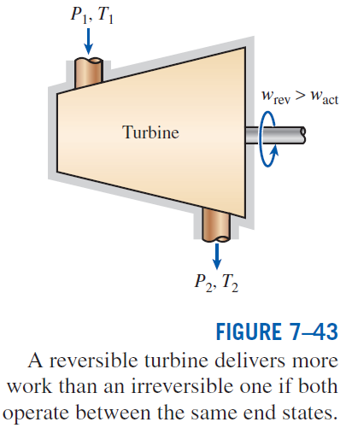


Proof that Steady-Flow Devices Deliver the Most and Consume the Least Work when the Process Is Reversible
Taking heat input and work output positive:
Actual
Reversible
Work-producing devices such as turbines deliver more work, and work-consuming devices such as pumps and compressors require less work when they operate reversibly.

Slide 27
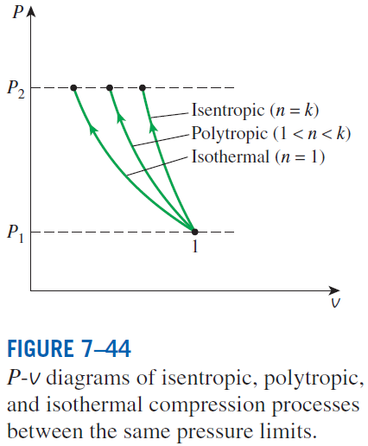
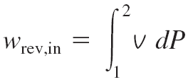
MINIMIZING THE COMPRESSOR WORK
When kinetic and potential energies are negligible
Isentropic (Pv^{k} = constant):
Polytropic (Pv^{n} = constant):
Isothermal (Pv = constant):
The adiabatic compression (Pv^{k} = constant) requires the maximum work and the isothermal compression (T = constant) requires the minimum. Why?

Slide 28
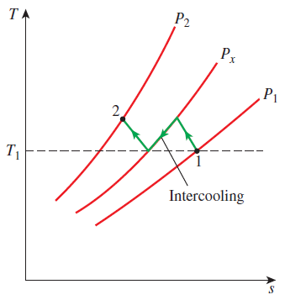
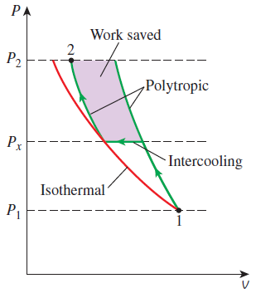

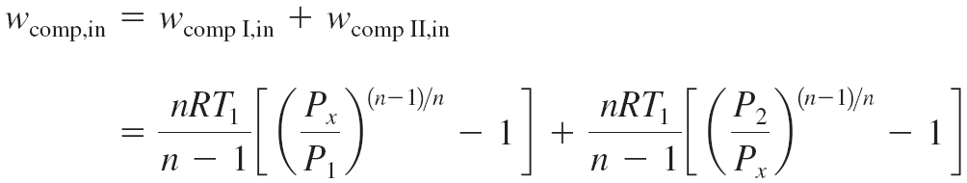
Multistage Compression with Intercooling
The gas is compressed in stages and cooled between each stage by passing it through a heat exchanger called an intercooler.
To minimize compression work during two-stage compression, the pressure ratio across each stage of the compressor must be the same.

Slide 29
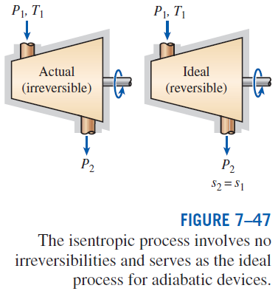
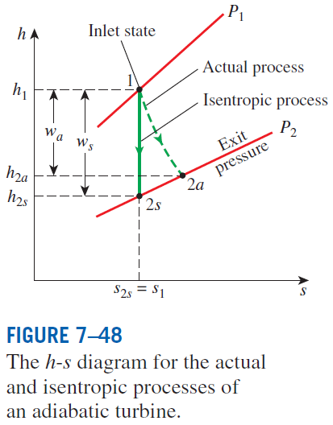

ISENTROPIC EFFICIENCIES OF STEADY-FLOW DEVICES
Isentropic Efficiency
of Turbines

Slide 30
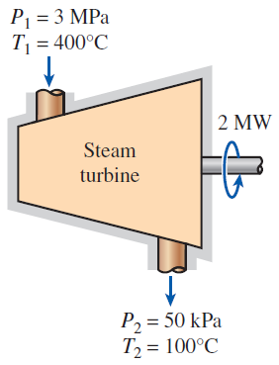
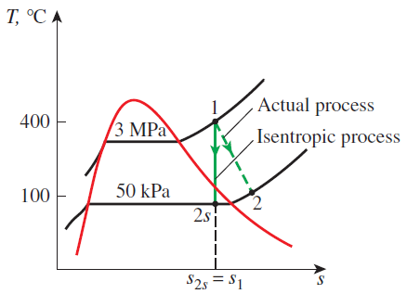

Slide 31
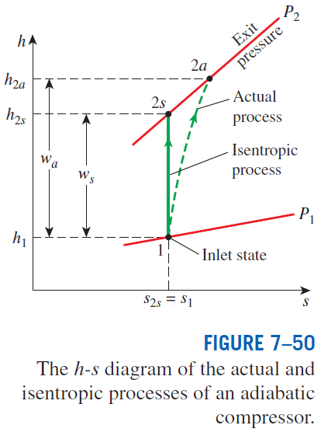


Isentropic Efficiencies of Compressors and Pumps
When kinetic and potential energies are negligible
For a pump
Isothermal efficiency
Compressors are sometimes intentionally cooled to minimize the work input.
Can you use isentropic efficiency for a non-adiabatic compressor?
Can you use isothermal efficiency for an adiabatic compressor?

Slide 32



Slide 33

Isentropic Efficiency of Nozzles
If the inlet velocity of the fluid is small relative to the exit velocity, the energy balance is
Then,

Slide 34



Slide 35
ENTROPY BALANCE
Entropy Change of a System, ∆S_{system}
When the properties of the system are not uniform
Energy and entropy balances for a system.

Slide 36



Mechanisms of Entropy Transfer, S_{in} and S_{out}
1 Heat Transfer
Entropy transfer by heat transfer:
Entropy transfer by work:
No entropy accompanies work as it crosses the system boundary. But entropy may be generated within the system as work is dissipated into a less useful form of energy.

Slide 37

2 Mass Flow
Entropy transfer by mass:
When the properties of the mass change during the process

Slide 38


Entropy Generation, S_{gen}
Entropy generation outside system boundaries can be accounted for by writing an entropy balance on an extended system that includes the system and its immediate
surroundings.
Mechanisms of entropy transfer for a general system.

Slide 39
Closed Systems
The entropy change of a closed system during a process is equal to the sum of the net entropy transferred through the system boundary by heat transfer and the entropy generated within the system boundaries.

Slide 40




Control Volumes
The entropy of a substance always increases (or remains constant in the case of a reversible process) as it flows through a single-stream, adiabatic, steady-flow device.

Slide 41



EXAMPLES
Entropy balance for heat transfer through a wall
Entropy balance for a throttling process

Slide 42





Entropy Generated when a Hot Block Is Dropped in a Lake
or
Entropy Generation in a Heat Exchanger

Slide 43




Entropy Generation Associated with Heat Transfer

Slide 44

Entropy generation associated with a heat transfer process

Slide 45
Summary
Entropy
The Increase of entropy principle
Entropy change of pure substances
Isentropic processes
Property diagrams involving entropy
What is entropy?
The T ds relations
Entropy change of liquids and solids
The entropy change of ideal gases
Reversible steady-flow work
Minimizing the compressor work
Isentropic efficiencies of steady-flow devices
Entropy balance

