Slide 1
CHAPTER 9
GAS POWER CYCLES
Thermodynamics: An Engineering Approach
8th Edition
Yunus A. Çengel, Michael A. Boles
McGraw-Hill, 2015
Lecture slides by
Mehmet Kanoglu
Copyright © The McGraw-Hill Education. Permission required for reproduction or display.

Slide 2
Objectives
Evaluate the performance of gas power cycles for which the working fluid remains a gas throughout the entire cycle.
Develop simplifying assumptions applicable to gas power cycles.
Review the operation of reciprocating engines.
Analyze both closed and open gas power cycles.
Solve problems based on the Otto, Diesel, Stirling, and Ericsson cycles.
Solve problems based on the Brayton cycle; the Brayton cycle with regeneration; and the Brayton cycle with intercooling, reheating, and regeneration.
Analyze jet-propulsion cycles.
Identify simplifying assumptions for second-law analysis of gas power cycles.
Perform second-law analysis of gas power cycles.

Slide 3
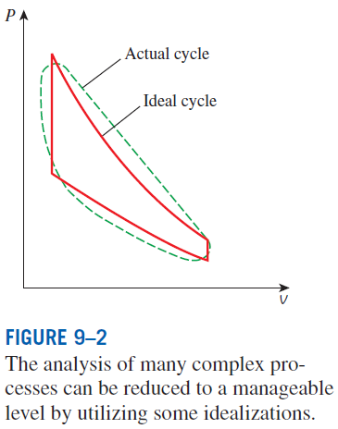
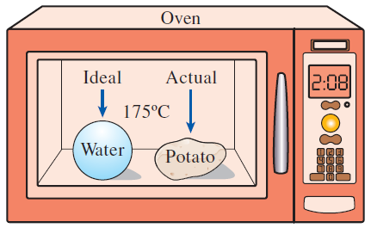
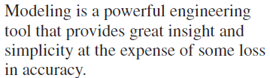
BASIC CONSIDERATIONS IN THE ANALYSIS OF POWER CYCLES
Thermal efficiency of heat engines:
Most power-producing devices operate on cycles.
Ideal cycle: A cycle that resembles the actual cycle closely but is made up totally of internally reversible processes is called an.
Reversible cycles such as Carnot cycle have the highest thermal efficiency of all heat engines operating between the same temperature levels. Unlike ideal cycles, they are totally reversible, and unsuitable as a realistic model.

Slide 4
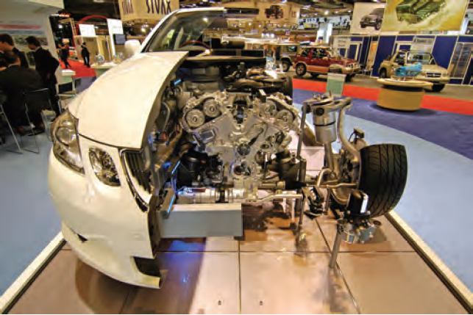
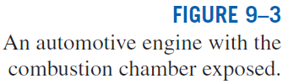
The ideal cycles are internally reversible, but, unlike the Carnot cycle, they are not necessarily externally reversible.
Therefore, the thermal efficiency of an ideal cycle, in general, is less than that of a totally reversible cycle operating between the same temperature limits.
However, it is still considerably higher than the thermal efficiency of an actual cycle because of the idealizations utilized.

Slide 5
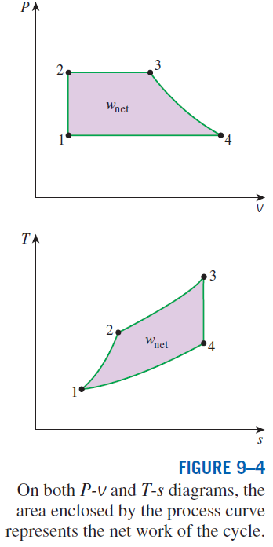
The idealizations and simplifications in the analysis of power cycles:
The cycle does not involve any friction. Therefore, the working fluid does not experience any pressure drop as it flows in pipes or devices such as heat exchangers.
All expansion and compression processes take place in a quasi-equilibrium manner.
The pipes connecting the various components of a system are well insulated, and heat transfer through them is negligible.
On a T-s diagram, the ratio of the area enclosed by the cyclic curve to the area under the heat-addition process curve represents the thermal efficiency of the cycle.
Any modification that increases the ratio of these two areas will also increase the thermal efficiency of the cycle.

Slide 6
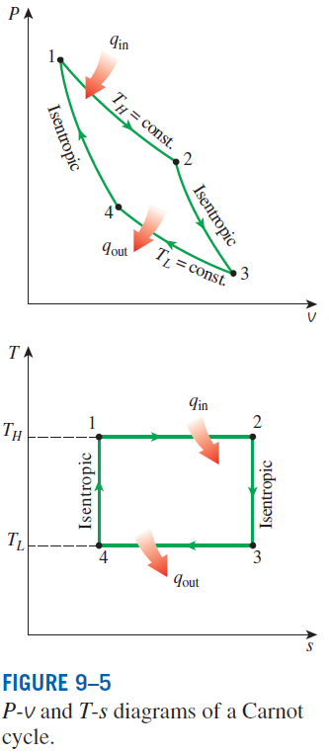

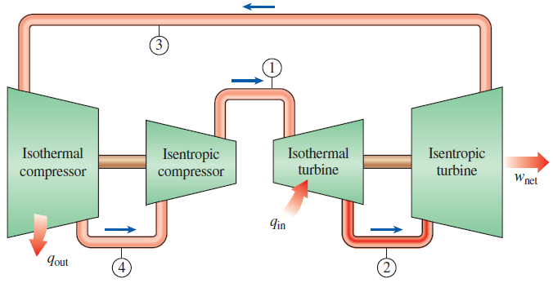
THE CARNOT CYCLE AND ITS VALUE IN ENGINEERING
The Carnot cycle is composed of four totally reversible processes: isothermal heat addition, isentropic expansion, isothermal heat rejection, and isentropic compression.
For both ideal and actual cycles: Thermal efficiency increases with an increase in the average temperature at which heat is supplied to the system or with a decrease in the average temperature at which heat is rejected from the system.
A steady-flow Carnot engine.

Slide 7
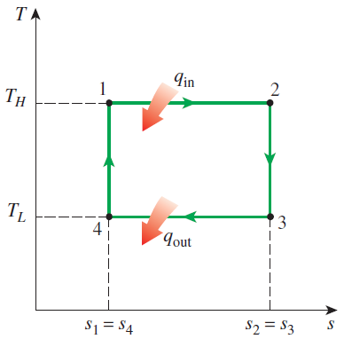



Derivation of the Efficiency of the Carnot Cycle

Slide 8
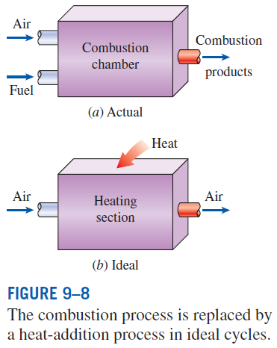
AIR-STANDARD ASSUMPTIONS
Air-standard assumptions:
The working fluid is air, which continuously circulates in a closed loop and always behaves as an ideal gas.
All the processes that make up the cycle are internally reversible.
The combustion process is replaced by a heat-addition process from an external source.
The exhaust process is replaced by a heat-rejection process that restores the working fluid to its initial state.
Cold-air-standard assumptions: When the working fluid is considered to be air with constant specific heats at room temperature (25°C).
Air-standard cycle: A cycle for which the air-standard assumptions are applicable.

Slide 9
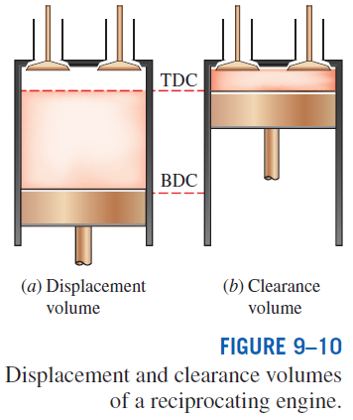
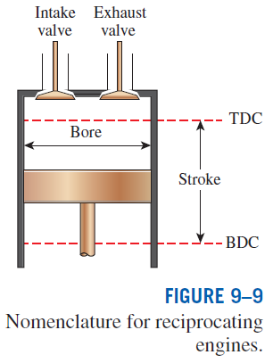
AN OVERVIEW OF RECIPROCATING ENGINES
Compression ratio
Spark-ignition (SI) engines
Compression-ignition (CI) engines

Slide 10
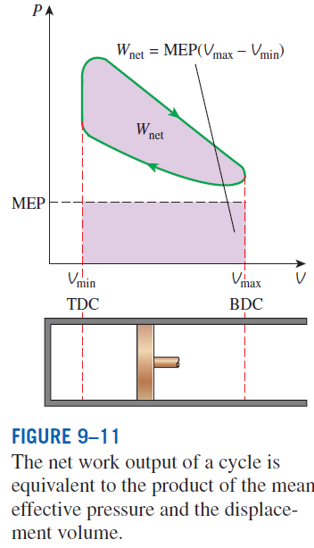

Mean effective pressure
The mean effective pressure can be used as a parameter to compare the performances of reciprocating engines of equal size.
The engine with a larger value of MEP delivers more net work per cycle and thus performs better.

Slide 11
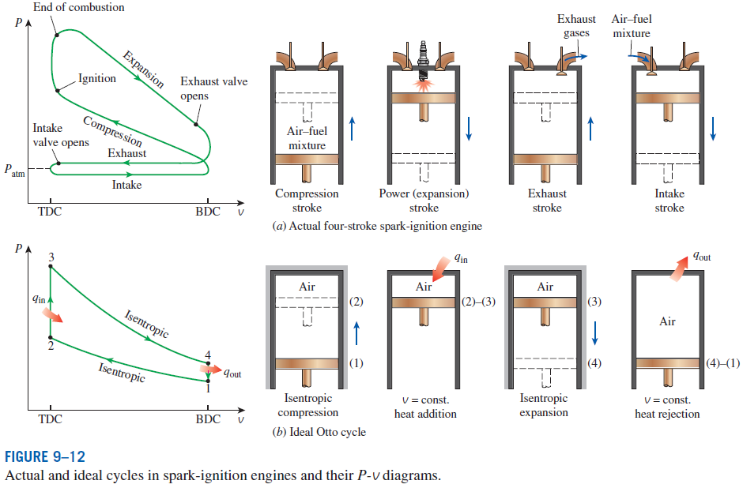
OTTO CYCLE: THE IDEAL CYCLE FOR SPARK-IGNITION ENGINES

Slide 12
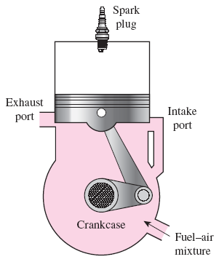
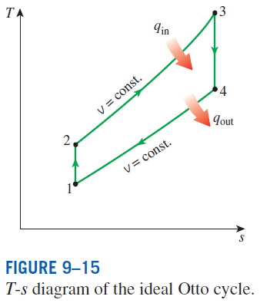
Four-stroke cycle
1 cycle = 4 stroke = 2 revolution
Two-stroke cycle
1 cycle = 2 stroke = 1 revolution
The two-stroke engines are generally less efficient than their four-stroke counterparts but they are relatively simple and inexpensive, and they have high power-to-weight and power-to-volume ratios.
Schematic of a two-stroke reciprocating engine.

Slide 13
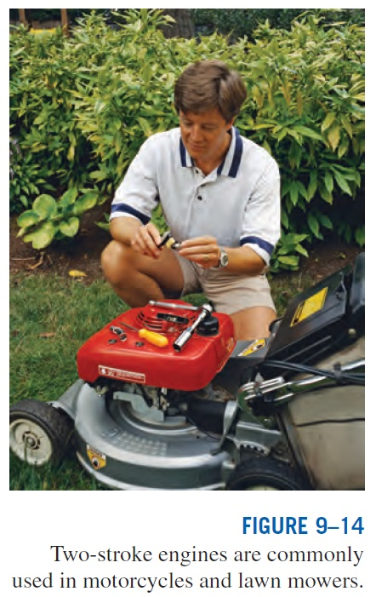

Slide 14
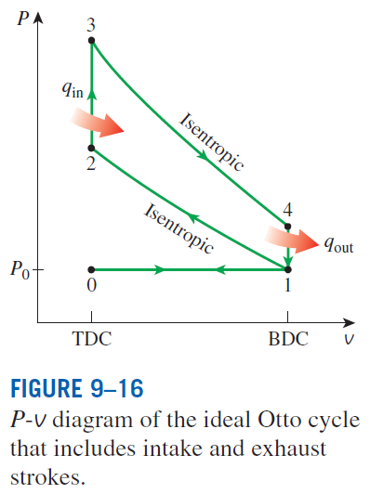
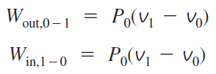
Air enters the cylinder through the open intake valve at atmospheric pressure P₀ during process 0-1 as the piston moves from TDC to BDC.
The intake valve is closed at state 1 and air is compressed isentropically to state 2. Heat is transferred at constant volume (process 2-3); it is expanded isentropically to state 4; and heat is rejected at constant volume (process 4-1).
Air is expelled through the open exhaust valve (process 1-0).
Work interactions during intake and exhaust cancel each other, and thus inclusion of the intake and exhaust processes has no effect on the net work output from the cycle.
However, when calculating power output from the cycle during an ideal Otto cycle analysis, we must consider the fact that the ideal Otto cycle has four strokes just like actual four-stroke spark-ignition engine.

Slide 15
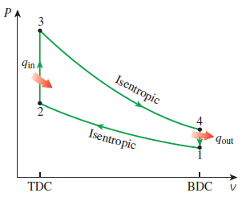


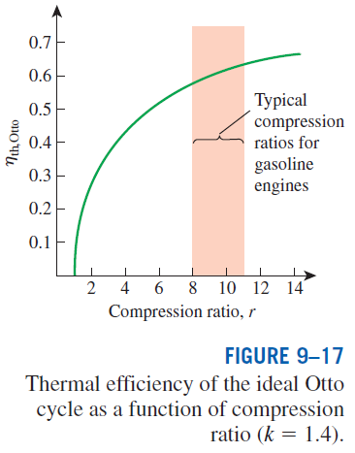

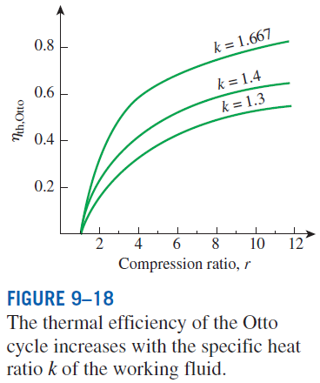
In SI engines, the compression ratio is limited by autoignition or engine knock.

Slide 16
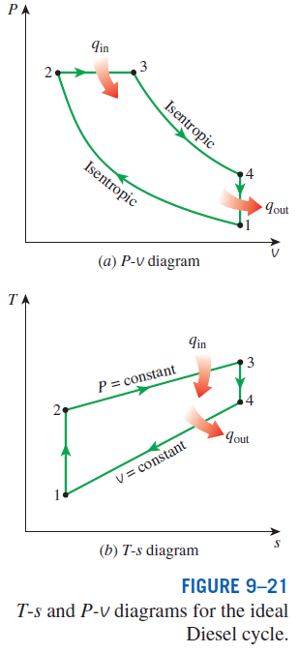
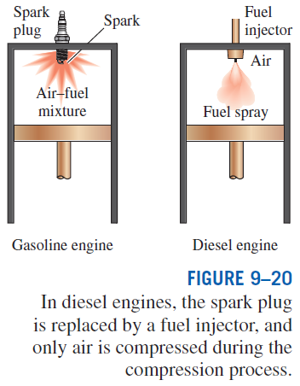
DIESEL CYCLE: THE IDEAL CYCLE
FOR COMPRESSION-IGNITION ENGINES
In diesel engines, only air is compressed during the compression stroke, eliminating the possibility of autoignition (engine knock). Therefore, diesel engines can be designed to operate at much higher compression ratios than SI engines, typically between 12 and 24.
1-2 isentropic compression
2-3 constant-volume heat addition
3-4 isentropic expansion
4-1 constant-volume heat rejection.

Slide 17


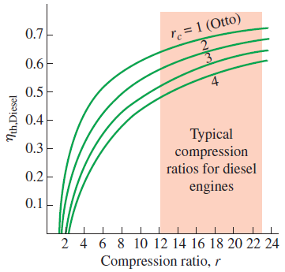
Cutoff ratio
for the same compression ratio
Thermal efficiency of the ideal Diesel cycle as a function of compression and cutoff ratios (k=1.4).

Slide 18
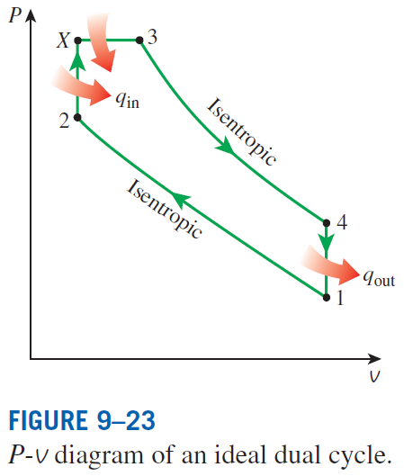
Dual cycle: A more realistic ideal cycle model for modern, high-speed compression ignition engine.
In modern high-speed compression ignition engines, fuel is injected into the combustion chamber much sooner compared to the early diesel engines.
Fuel starts to ignite late in the compression stroke, and consequently part of the combustion occurs almost at constant volume.
Fuel injection continues until the piston reaches the top dead center, and combustion of the fuel keeps the pressure high well into the expansion stroke.
Thus, the entire combustion process can better be modeled as the combination of constant-volume and constant-pressure processes.

Slide 19
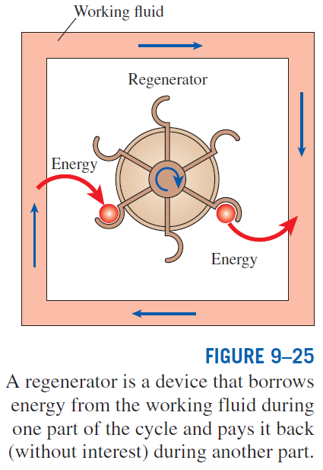
STIRLING AND ERICSSON CYCLES
Stirling cycle
1-2 T = constant expansion (heat addition from the external source)
2-3 v = constant regeneration (internal heat transfer from the working fluid to the regenerator)
3-4 T = constant compression (heat rejection to the external sink)
4-1 v = constant regeneration (internal heat transfer from the regenerator back to the working fluid)

Slide 20
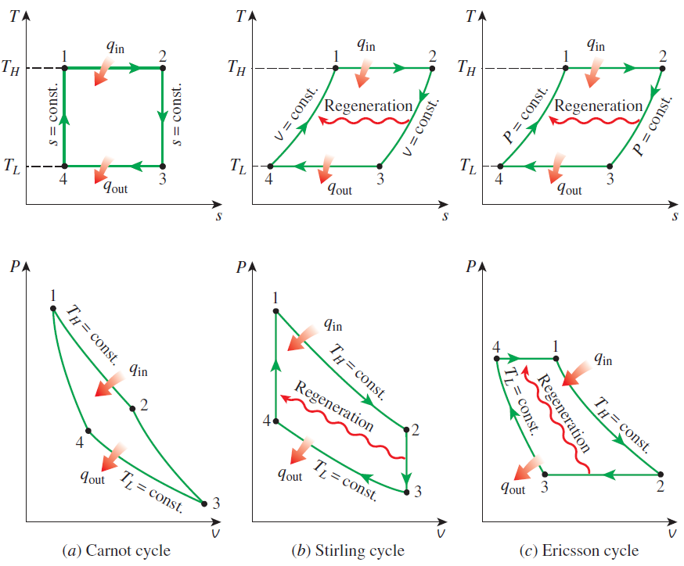
T-s and P-v diagrams of Carnot, Stirling, and Ericsson cycles.

Slide 21
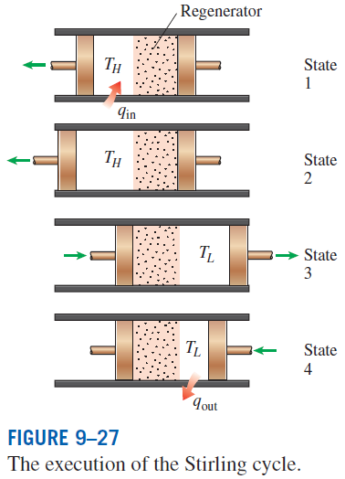
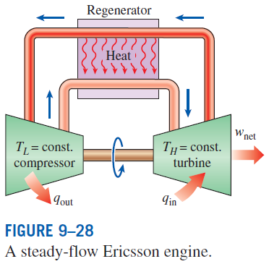
The Stirling and Ericsson cycles give a message: Regeneration can increase efficiency.
Both the Stirling and Ericsson cycles are totally reversible, as is the Carnot cycle, and thus:
The Ericsson cycle is very much like the Stirling cycle, except that the two constant-volume processes are replaced by two constant-pressure processes.

Slide 22
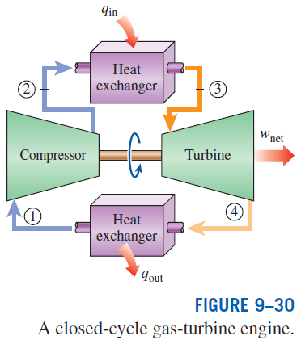
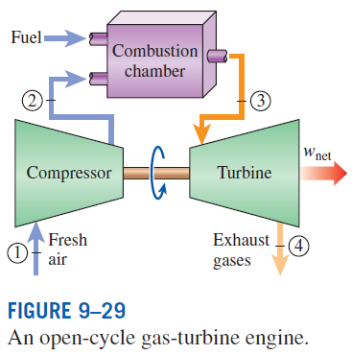
BRAYTON CYCLE: THE IDEAL CYCLE FOR GAS-TURBINE ENGINES
The combustion process is replaced by a constant-pressure heat-addition process from an external source, and the exhaust process is replaced by a constant-pressure heat-rejection process to the ambient air.
1-2 Isentropic compression (in a compressor)
2-3 Constant-pressure heat addition
3-4 Isentropic expansion (in a turbine)
4-1 Constant-pressure heat rejection

Slide 23
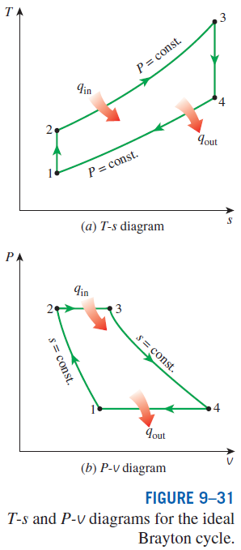

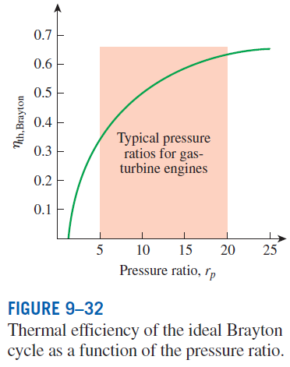

Pressure ratio

Slide 24
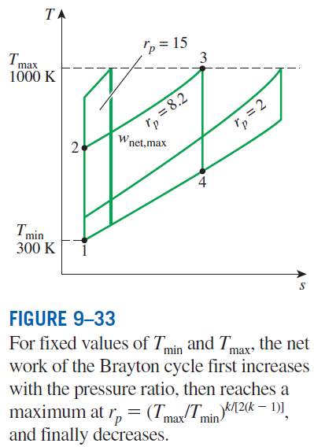
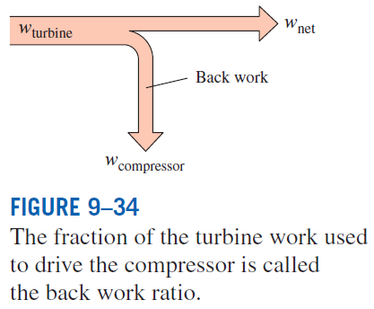
The two major application areas of gas-turbine engines are aircraft propulsion and electric power generation.
The highest temperature in the cycle is limited by the maximum temperature that the turbine blades can withstand. This also limits the pressure ratios that can be used in the cycle.
The air in gas turbines supplies the necessary oxidant for the combustion of the fuel, and it serves as a coolant to keep the temperature of various components within safe limits. An air–fuel ratio of 50 or above is not uncommon.

Slide 25
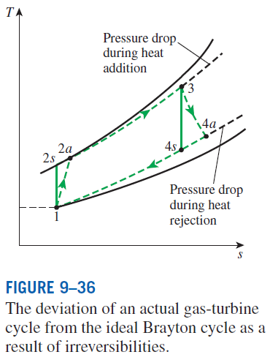
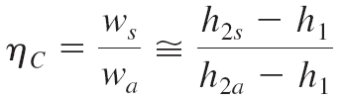
Development of Gas Turbines
Increasing the turbine inlet (or firing) temperatures
Increasing the efficiencies of turbomachinery components (turbines, compressors):
Adding modifications to the basic cycle (intercooling, regeneration or recuperation, and reheating).
Deviation of Actual Gas-Turbine Cycles from Idealized Ones
Reasons: Irreversibilities in turbine and compressors, pressure drops, heat losses
Isentropic efficiencies of the compressor and turbine

Slide 26
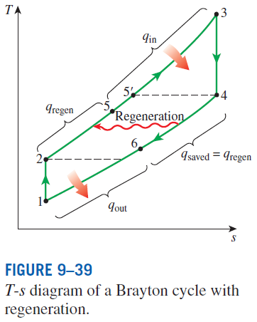
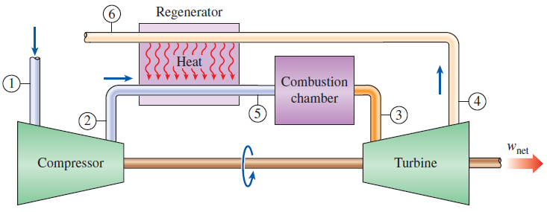
THE BRAYTON CYCLE WITH REGENERATION
In gas-turbine engines, the temperature of the exhaust gas leaving the turbine is often considerably higher than the temperature of the air leaving the compressor.
Therefore, the high-pressure air leaving the compressor can be heated by the hot exhaust gases in a counter-flow heat exchanger (a regenerator or a recuperator).
The thermal efficiency of the Brayton cycle increases as a result of regeneration since less fuel is used for the same work output.
A gas-turbine engine with regenerator.

Slide 27
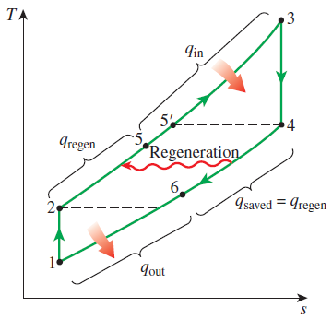
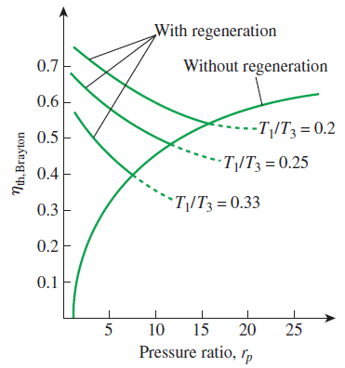
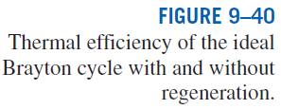
Effectiveness of regenerator
Effectiveness under cold-air standard assumptions
Under cold-air standard assumptions
The thermal efficiency depends on the ratio of the minimum to maximum temperatures as well as the pressure ratio.
Regeneration is most effective at lower pressure ratios and low minimum-to-maximum temperature ratios.
Can regeneration be used at high pressure ratios?

Slide 28
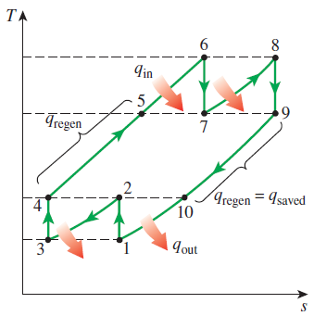
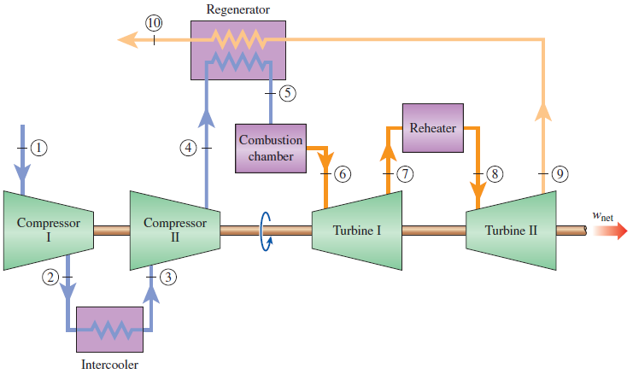

THE BRAYTON CYCLE WITH INTERCOOLING, REHEATING, AND REGENERATION
For minimizing work input to compressor and maximizing work output from turbine:
T-s diagram of an ideal gas-turbine cycle with intercooling, reheating, and regeneration.

Slide 29
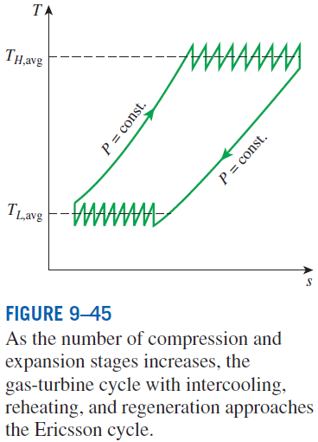
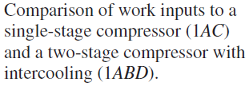
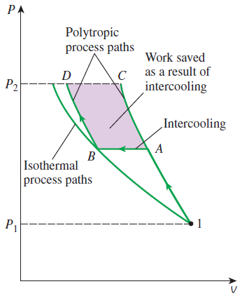
Multistage compression with intercooling: The work required to compress a gas between two specified pressures can be decreased by carrying out the compression process in stages and cooling the gas in between. This keeps the specific volume as low as possible.
Multistage expansion with reheating keeps the specific volume of the working fluid as high as possible during an expansion process, thus maximizing work output.
Intercooling and reheating always decreases the thermal efficiency unless they are accompanied by regeneration. Why?

Slide 30
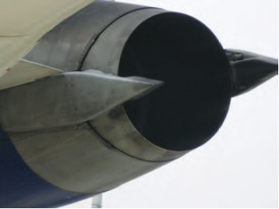
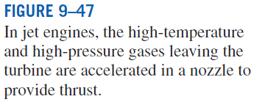
IDEAL JET-PROPULSION CYCLES
Gas-turbine engines are widely used to power aircraft because they are light and compact and have a high power-to-weight ratio.
Aircraft gas turbines operate on an open cycle called a jet-propulsion cycle.
The ideal jet-propulsion cycle differs from the simple ideal Brayton cycle in that the gases are not expanded to the ambient pressure in the turbine. Instead, they are expanded to a pressure such that the power produced by the turbine is just sufficient to drive the compressor and the auxiliary equipment.
The net work output of a jet-propulsion cycle is zero. The gases that exit the turbine at a relatively high pressure are subsequently accelerated in a nozzle to provide the thrust to propel the aircraft.
Aircraft are propelled by accelerating a fluid in the opposite direction to motion. This is accomplished by either slightly accelerating a large mass of fluid (propeller-driven engine) or greatly accelerating a small mass of fluid (jet or turbojet engine) or both (turboprop engine).

Slide 31




Thrust (propulsive force)
Propulsive efficiency
Propulsive power

Slide 32


Slide 33


Modifications to Turbojet Engines
The first airplanes built were all propeller-driven, with propellers powered by engines essentially identical to automobile engines.
Both propeller-driven engines and jet-propulsion-driven engines have their own strengths and limitations, and several attempts have been made to combine the desirable characteristics of both in one engine.
Two such modifications are the propjet engine and the turbofan engine.
The most widely used engine in aircraft propulsion is the turbofan (or fanjet) engine wherein a large fan driven by the turbine forces a considerable amount of air through a duct (cowl) surrounding the engine.

Slide 34



Slide 35




Various engine types:
Turbofan, Propjet, Ramjet, Sacramjet, Rocket

Slide 36
SECOND-LAW ANALYSIS OF GAS POWER CYCLES
Exergy destruction for a closed system
For a steady-flow system
Steady-flow, one-inlet, one-exit
Exergy destruction of a cycle
For a cycle with heat transfer only with a source and a sink
Closed system exergy
Stream exergy
A second-law analysis of these cycles reveals where the largest irreversibilities occur and where to start improvements.

Slide 37
Summary
Basic considerations in the analysis of power cycles
The Carnot cycle and its value in engineering
Air-standard sssumptions
An overview of reciprocating engines
Otto cycle: The ideal cycle for spark-ignition engines
Diesel cycle: The ideal cycle for compression-ignition engines
Stirling and Ericsson cycles
Brayton cycle: The ideal cycle for gas-turbine engines
The Brayton cycle with regeneration
The Brayton cycle with intercooling, reheating, and regeneration
Ideal jet-propulsion cycles
Second-law analysis of gas power cycles

